Slide 1
Women in Politics OVERVIEW
Gender, Women and Democracy
National Democratic Institute
2016

Slide 2
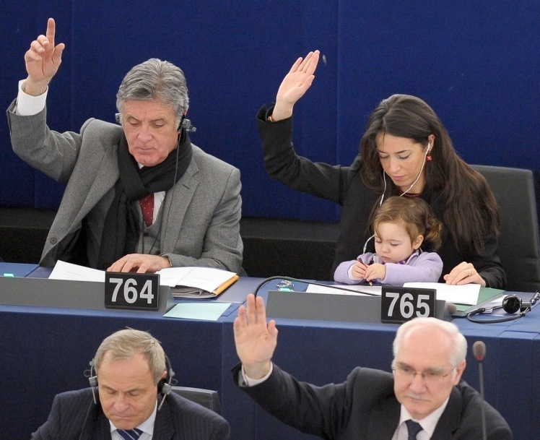
Women in Politics Overview:
Objectives
Understand the need for women’s political participation and the related legal framework within global, regional and country-specific contexts

Slide 3
Women in Politics: Overview
Women are a key part of democracies, not just as individuals, but through their collective influence.
It is critical that women can participate in all areas of public life: civil society, political parties, electoral processes and governing bodies

Slide 4
Women in Politics: Overview
Women are a key part of democracies, not just as individuals, but through their collective influence. It is important for women to work in networks in order to advocate for change, types may include:
  Women’s Wings
  Women’s Parliamentary Caucuses
  Women’s Coalitions/Cross-Sector
  Women’s Networks

Slide 5
Women in Politics: Overview
Although there has been advancement in broader participation and many successful activities have been implemented, larger, sustainable shifts in attitudes, policy and institutions have not taken place within the political sphere.

Slide 6
Global Trends for Women
Reaching parity in primary education but…
2/3 of illiterate adults are women
Women’s wages are 70-90 percent those of men
Women spend at least twice as much time as men on domestic work
  Source: UN “The World’s Women 2010: Trends and Statistics”

Slide 7
Global Trends for Women
1 in 3 women globally have experienced violence.
  Source: UN Women
Gender digital divide: women are less likely to have access to, or the education to use, technology
  Source: World Bank: “Bridging the Gender Digital Divide”
Women are more likely than men to live in poverty

Slide 8
Global Trends for Women
As of January 2014, women occupied 22.2% of seats in national legislatures
  Rwanda has the highest percentage of women in parliament, at 64%
The UN estimates that globally women are about 27 percent of judges worldwide
43 countries (23%) have reached or surpassed a threshold of 30% women in the single or lower houses of their national parliaments

Slide 9
Global Trends for Women
Globally, there are 37 countries in which women account for less than 10% of parliamentarians in single or lower houses, as of August 2015, including 6 chambers with no women at all
Globally, women hold16.7% of ministerial posts
11 heads of state are women
13 heads of government are women

Slide 10
EXERCISE: Brainstorm
WHY WOMEN?
Benefits
Barriers
Results
Notes:
TRAINER NOTES:
So women still have a long way to go in terms of being well represented in elected bodies. But why do we even care? Why is women’s political participation so important? What are the benefits that accrue to a country when women are adequately represented?
EXERCISE: Brainstorm: Why Women?
Brainstorming exercise on the topic of the benefits of women’s political participation.
What are the benefits of improving women’s representation in politics?
When there are more women involved meaningfully in politics, what are the results for a government? A country? Its citizens?
What are the barriers and challenges that prevent women from achieving full and equal participation?

Slide 11
The Benefits of Women in Politics
There is strong evidence that shows that more women in elected office leads to:
  Higher standards of living
  The concerns of marginalized voters being represented
  More collaborative leadership styles
  Working across party lines
  Stronger peace-building efforts

Slide 12
Benefits: Higher Standards & Concerns of Women and Other Marginalized Groups
In a survey of 187 women who hold public office in 65 countries, researchers found that 90% of women believe they have a responsibility to represent women’s interests and advocate for other members of society
  Source: UNICEF (2006)
In Argentina, despite only representing 14% of deputies, women parliamentarians introduced no fewer than 78% of the bills related to women’s rights

Slide 13
Benefits: Higher Standards & Concerns of Women and Other Marginalized Groups
Another study found that in 31 democratic countries, the presence of more women in legislatures is positively correlated with enhanced perceptions of government legitimacy among both men and women
  Source: Schwindt-Baryer, L.A. & W. Mishler (2005)
Data from 19 OECD countries found that having more women legislators resulted in an increase in total education spending
Growing evidence from India shows that women’s participation in local government has positively changed parents’ aspirations for their daughters and led to better availability of public services
Notes:
Organisation for Economic Co-operation and Development

Slide 14
Benefits: Collaborative Leadership & Across Party Lines
Research shows that women's leadership and conflict resolution styles embody democratic ideals.
Moreover, women tend to work in a less hierarchical fashion, instead working in a more participatory and collaborative way than their male colleagues.
Women are also more likely to work across parties and party lines, even in highly partisan environments.

Slide 15
Benefits: Peace Process
Women have a profound effect on peace building and post-conflict reconstruction
Research and case studies suggest that peace agreements, post-conflict reconstruction and governance have a better chance of long term success when women are involved Increased
Data shows that there is a 24% probability of ending violence within a year when local women are included in a peace process

Slide 16
Pathways for Women’s Political Participation
Women should be able to participate in all areas of politics:
As VOTERS
As MEMBERS, LEADERS AND ELECTED REPRESENTATIVES OF POLITICAL PARTIES
As CIVIL LEADERS and ACTIVISTS
As ELECTED OFFICIALS IN GOVERNING BODIES

Slide 17
Women as Voters
Voting is a fundamental right of citizens in a democracy. Though women have been granted suffrage in almost every country in the world, there are significant barriers to women’s participation.
Women may face physical, logistical, social and cultural challenges to participation as voters.

Slide 18
Women in Political Parties
Parties offer citizens meaningful choices in governance, avenues for political participation, and opportunities to shape their country’s future. To be truly representative, parties must reflect the diversity of the population including women.
Parties are often the gateway to elected office and so are a critical entry point for women into public life.

Slide 19
Women in Civil Society
When women have a vocal role as activists and issue advocates, their inclusion guarantees that a wide spectrum of voices will more accurately represent a broader range of citizens’ concerns.
Civic groups often provide a more welcoming environment for women, and this is where women have more frequently demonstrated their leadership.

Slide 20
Women in Civil Society
Once women are elected, they should be able to effectively govern and represent their constituents
It is not enough to be present. Women should have an influence and the ability to include their priorities on the agenda

Slide 21
What are the obstacles to women’s political participation?
Socio-Cultural Norms
Structural barriers
  Legal
  Economic
  Institutional
Individual confidence, capacity and connections to succeed

Slide 22
Barriers: Socio-Cultural Norms
In many societies, politics are often perceived as corrupt and dirty by women, and not relevant to the daily lives and needs of women
Women are often perceived as not being political, their role being that of the homemaker as opposed to men who are identified as leaders and public figures
Social norms impact the time and resources women have to devote to political participation as well, as they are often burdened with house and child work

Slide 23
Barriers: Individual Skills and Confidence
Women often lack the individual confidence, capacity and connections to equip them to participate effectively in politics.
  Women often lack equal access to education and opportunities to gain political experience
  They also lack access to power networks where money and decision-making are rooted
  There is a historical lack of access for women to training and education
  Prevalent social norms lead to women’s reduced confidence in their political abilities

Slide 24
Barriers: Financial, Institutional, Legal
Women face economic barriers to their engagement in politics, as it requires funding, particularly when running for office
Political institutions, such as parties and parliaments, have rules and processes that inhibit women’s ability to fully participate
Laws that govern political participation, such as political party laws or electoral laws, can inhibit women’s participation if not drafted with a gender lens
Notes:
Institutional and structural environments – legal, financial, and political systems and practices exist that support gender equality.
This includes the laws and institutions that are linked to political processes and women’s ability to participate.
Strategies: Gender sensitize institutions and support legal changes.

Slide 25
Barrier: Physical Security
Women may have concerns about their safety as they may be threatened for their political beliefs or simply put themselves at greater risk for attempting to participate in public life.
In Bolivia, for example, 48% of the women leaving office in 2010 reported being victims political violence

Slide 26
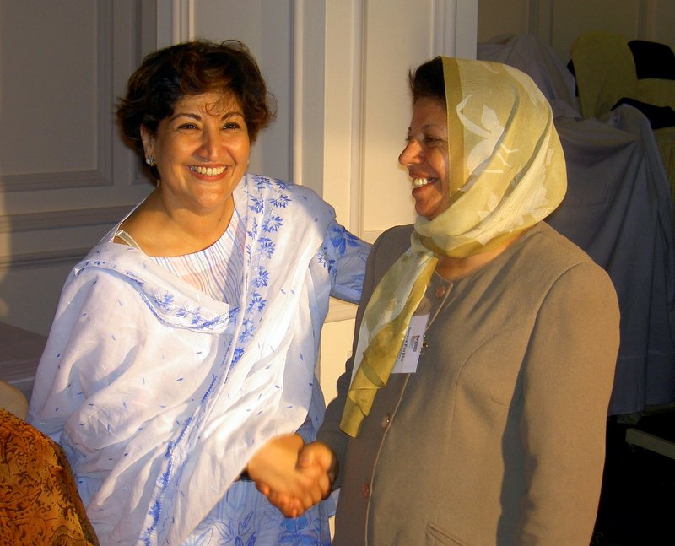
So what is needed for women to participate in politics?
Access to positions of power
Changing cultural norms
Women’s economic empowerment
Political will
Critical Mass

Slide 27
Access to Positions of Power
Political leadership is often centralized among a small, elite group and based on personal relationships and networks.
Women’s historical absence from the political system can present significant barriers, thus support to creating opportunities for advancement, networks, and ensuring women’s legal rights helps to develop a pathway to political power.

Slide 28
Changing Cultural Norms
Citizens, families and communities must be willing to accept new ideas about gender roles in society
Awareness needs to be raised about gender inequality and the ways in which stereotypical gender roles create formal and informal barriers for women
Having male allies inside and outside of politics is also a key ingredient to a climate that supports women’s participation

Slide 29
Women’s Economic Empowerment
The ability of women to attain financial autonomy or access to economic resources is also necessary for their greater participation in political life.
Women’s lower economic status and relative poverty are substantial hurdles to overcome.
Formal and informal costs of standing for election often hinder women’s participation.

Slide 30
Political Will
Support from existing leadership is key to achieving change
Outreach and buy-in from male party leaders, parliamentarians, and other decision makers is essential
Political will helps to facilitate the implementation and enforcement of new policies for political institutions and legal reforms governing political processes

Slide 31
Voice & Numbers
Individual women need to develop the confidence and capacity for effective participation but there is also a need for a critical mass of women, or a collective voice in order to drive a common agenda
Even if there is not a large percentage, finding ways to join forces can be impactful

Slide 32
Mobilizing Women for Change: Mechanisms
Women’s Political Participation
Women’s Parliamentary Caucuses
Single-sector Coalitions
Women’s Wings within Political Parties
Cross-Sector Groups
Notes:
Women’s active participation in public life has a positive impact on communities, legislatures, political parties and citizen’s daily lives. When they work together, women can have a profound and positive impact on their communities. There are a number of mechanisms that can be used to mobilize women for change.
Women’s parliamentary caucuses: Women can form a parliamentary caucus to introduce legislation that addresses priority issues for the achievement of gender equality.
Women’s wings within political parties: Women’s wings within political parties can be another mechanism for promoting reform.
Civil society organizations: Women’s organizations around the world have been at the forefront of change in their communities.
Cross-sector groups: Groups that include representatives from civil society organizations and women activists from different political parties can work together to address women’s concerns at the local or national levels.

