Slide 1
Gender and Election Observation: Election Day Observation and
Parallel Vote Tabulations
Gender, Women and Democracy
NDI, 2016
Notes:
This tool was developed by Caroline Hubbard and Claire DeSoi for NDI's Votes Without Violence program and toolkit.

Slide 2
GENDER AND ELECTION OBSERVATION: OBJECTIVES
Understand why gender is important for a democratic election
Identify potential barriers to women’s participation in the electoral process
Understand specific ways to incorporate gender into a Parallel Vote Tabulation (PVT), including training, checklists and reporting
Notes:
TRAINER NOTE: You may also wish to ask participants what expectations they have for the session. What do they hope to learn or gain from it? You can then relate their expectations to the objectives and suggest how unrelated expectations might be met in other ways.

Slide 3
KEY TERMS
Gender
Sex
Gender equality
Gender equity
Notes:
TRAINER NOTE: See if people want to define these terms, or go around the room and ask participants to define them as a participatory activity.
Gender: Refers to the socially determined differences between women and men that are learned, changeable over time and have wide variations both within and between cultures.
Sex: Refers to the biological characteristic that categorize someone as either male or female. These characteristics are generally universal and determined at birth.
Gender Equality: Equality means that women’s and men’s rights, responsibilities and opportunities will not depend on whether they are born male or female.
Gender Equity: Provisions should be made to redress inequality before women can take advantage of the opportunities provided, creating equality of process and outcome.

Slide 4
WHY INCLUDE GENDER IN
ELECTION OBSERVATION
Democratic elections should be inclusive, transparent and accountable.
Inclusive elections are ones that enable both men and women to participate (50/50).
The principle of inclusion is not only about enabling but also about taking positive action to address particular barriers women might face.

Slide 5
WHY INCLUDE GENDER IN
ELECTION OBSERVATION
Domestic observers should assess the quality of women’s participation in each stage of the electoral process - including on election day - as part of their assessment of the quality of the election.
As a tool to systematically collect data on election day, PVTs present a key method for evaluating equal and genuine opportunity for women to participate as voters and election workers.
Notes:
ADDITIONAL NOTES: To link arguments to fraud and identity problems directly:
PVTs are used as a chance to measure fraud, but this has to be viewed through a gender lens. Does electoral fraud affect one gender disproportionately? Are women more at risk for being victims of fraud? Are they more likely to be pressured or intimidated into committing fraud? The same kinds of questions can be asked about identity problems. Are women more at risk? Are they, for example, more likely to be challenged during voter accreditation?
How are they differently affected by these processes? Example: in Afghanistan, women did not vote because there were not enough women poll worker and security officials to answer the demand.

Slide 6
WHY INCLUDE GENDER IN
ELECTION OBSERVATION
Democratic elections must include equal participation by women in every phase of the process, including as:
Voters
Candidates
Election administrators
Observers
Women’s participation can be measured through a combination of long-term observation and PVT.
Notes:
ADDITIONAL NOTES: As this is a PVT training, it is focused on women who are voting and women who are working in the polls. That is what a PVT measures, and thus what can be measured in terms of gender as well.
This is a transition slide: it introduces the outline of the next section of the presentation, which gives the broader context in which to locate the PVT. As a PVT training, it is focused on voters and poll workers, but the PVT process is not isolated from the wider context.

Slide 7
ELECTION OBSERVATION:
WOMEN AS CANDIDATES
Observing inclusiveness in elections involves paying attention to norms and practices that affect equity in men’s and women’s ability to run for public office and can include:
Electoral systems
Political party practices
Political-electoral financing systems
Traditional and social media coverage
Notes:
ADDITIONAL NOTES: This information is not directly relevant to PVT, but is helpful in building an understanding of the way gender impacts women. It is not something that can be observed as part of a PVT on election day, because observers are stationed inside or outside polling stations, and PVTs are about the voter process.

Slide 8
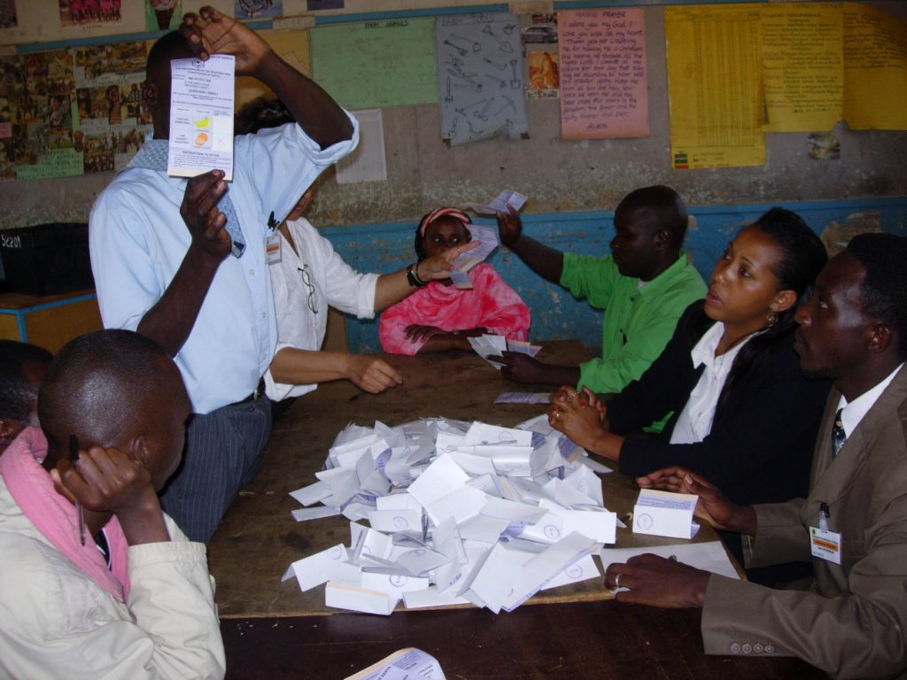
ELECTION OBSERVATION:
ELECTION ADMINISTRATION
Assess the number of women in election administration:
How many women are in leadership and decision-making roles at polling stations?
Women should have the ability to participate as election observers, commission members, poll workers, etc.
Assess the election administration’s awareness of barriers for women.
Gauge the responsiveness of administrators to any related issues that may arise on election day.
Picture Source: ACE Project
Notes:
Election observers should take note of the number of women represented in the election administration at the central, regional and polling station levels, as well as the number who are in leadership and decision-making roles.
TRAINER NOTE: Discuss the composition of the election administration (from the commission itself to regional offices and poll workers) and whether the structure/leadership have an individual focused on gender.

Slide 9
ELECTION OBSERVATION:
WOMEN AS VOTERS
Observing the inclusiveness of voting requires assessing whether men and women have equal access to:
Voting locations
Voting and verification processes
Complaint processes
This includes recording and analyzing incidents of threats, intimidation or actual violence against women voters at polling stations.

Slide 10
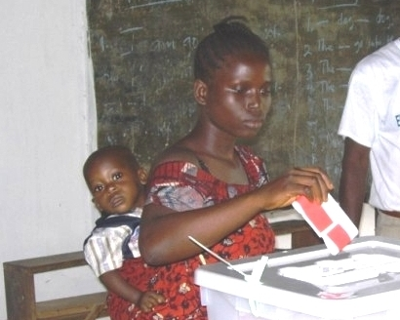
ELECTION OBSERVATION:
WOMEN AS VOTERS
Women can face significant barriers to participation as voters.
These barriers can be:
Physical
Legal
Logistical
Historical or traditional
Social or cultural
Picture Source: NDI
Notes:
A PVT can be used to measure threats/intimidation/violence against women voters. It is important to detail that women face significant barriers as opposed to men, and the following slides detail what barriers may be observed.

Slide 11
ELECTION DAY: WHAT TO OBSERVE OR ASSESS
Is the polling station safe? Secure? Accessible?
How many women are on the polling station committee?
What sex is the chairperson of the committee?
Do women voters understand procedures?
Is sex disaggregated voter data available?
Are women disproportionately affected by problems with the voting process?

Slide 12
ELECTION DAY: WHAT TO OBSERVE OR ASSESS
Are there instances of violence against voters or workers? If yes, what kinds?
Of the voters turned away, how many are women?
Is the secrecy of the vote protected?
Are there instances of family or proxy voting?
What are the voter rates, both at central and regional levels?
Notes:
TRAINER NOTE: These are questions that are able to be asked in a PVT.
Ask participants what other factors or issues they think should be considered when observing election day. It may also be useful to talk about how to observe instances of family or proxy voting, and if there are any particular issues in that country. (Refer back to definitions given earlier if necessary.)

Slide 13
PARALLEL VOTE TABULATION (PVT)

Slide 14
PVT: WHAT ARE WE MEASURING?
What are the important criteria for election day?
Participatory: All eligible voters have a genuine opportunity to freely work or observe an election and cast their vote.
Accountable: Procedures are followed to ensure the secrecy of the ballot, prevent illegal voting and reflect the will of the voters individually - not their parties or families.
Transparent: Citizens (women and men) have the right to be present (for example, as observers or party poll watchers) from the time the polling station is preparing to open until it closes.
Notes:
A PVT is a specific and important tool that can complement the wider electoral observation. It can be used to verify or challenge official results, but importantly, it is used to measure whether the voting process - and election itself - was participatory, transparent, and accountable. In other words, if the election was democratic.

Slide 15
PVT: METHODOLOGY
PVTs require a different approach from long term observation and therefore include different types of questions.
PVTs provide a unique way to observe the integrity of the electoral process, and a way to cross-check data using a long-term observation which allows for more systematic data collection

Slide 16
PVT: WHAT CAN IT MEASURE?
Percentage of election officials who are women
The gender of the polling station president or supervisor
Percentage of women representing parties or candidates as poll watchers
The percentage of women observers
The atmosphere around the polling stations and general security environment
Incidents of threats and intimidation to influence or stop women from voting

Slide 17
PVT: WHAT CAN IT MEASURE?
Percentage of women among voters who were refused or turned away from the polling station
The secrecy of the ballot and any cases of assisted voting, proxy voting or family voting
Cases of sexual violence against voters, observers or party poll watchers
Cases of physical violence against women

Slide 18
PVT: WHAT CAN IT MEASURE?
A PVT can provide important information about an incident, especially through the use of a critical incident form:
Date and time
Type of violence
Harassment, intimidation, physical violence, sexual violence, etc.
Perpetrator(s) of violence, including gender and affiliation
Victim(s) of violence, including gender and affiliation
Motivation for the violence
Impact of the violence

Slide 19
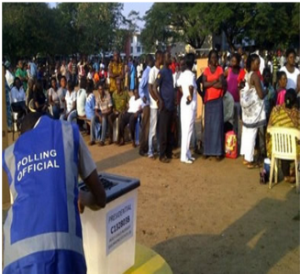
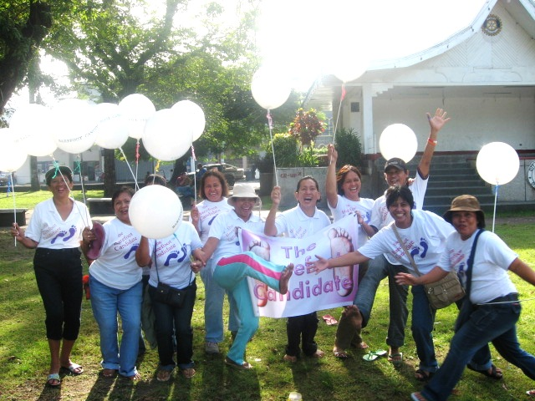
THANK YOU
Picture Source: NDI

