Slide 1
Gender and Election Observation
Gender, Women and Democracy
NDI, 2016
Notes:
This tool was developed by Caroline Hubbard and Claire DeSoi for NDI's Votes Without Violence program and toolkit.

Slide 2
GENDER AND ELECTION OBSERVATION: OBJECTIVES
Understand why gender is important for election observation
Identify potential barriers to women’s participation in the electoral process
Increase knowledge of how to incorporate gender aspects into election observation, including trainings, material and reporting
Notes:
TRAINER NOTE: You may also wish to ask participants what expectations they have for the session. What do they hope to learn or gain from it? You can then relate their expectations to the objectives and suggest how unrelated expectations might be met in other ways.

Slide 3
GENDER AND ELECTION OBSERVATION: TOPICS
Pre-election monitoring
Election day monitoring
Recruitment and observer team composition
Observation forms and checklists
Training for observers
Observer reporting

Slide 4
KEY TERMS
Gender
Sex
Gender equality
Gender equity
Notes:
TRAINER NOTE: See if people want to define these terms, or go around the room and ask participants to define them as a participatory activity.
Gender: Refers to the socially determined differences between women and men that are learned, changeable over time and have wide variations both within and between cultures.
Sex: Refers to the biological characteristic that categorize someone as either male or female. These characteristics are generally universal and determined at birth.
Gender Equality: Equality means that women’s and men’s rights, responsibilities and opportunities will not depend on whether they are born male or female.
Gender Equity: Provisions should be made to redress inequality before women can take advantage of the opportunities provided, creating equality of process and outcome.

Slide 5
WHY DO GENDER AND ELECTION OBSERVATION
Domestic observers should assess the quality of women’s participation in each stage of the electoral process as part of their assessment of the quality of the election.
Elections are a key opportunity to evaluate and strengthen women’s participation in politics, which will improve the credibility and democratic character of elections.

Slide 6
WHY DO GENDER AND ELECTION
OBSERVATION
Democratic elections should be inclusive, transparent and participatory.
Inclusive elections are ones that enable both men and women to participate equally.
The principle of inclusion is not only about enabling but also taking positive action to address particular barriers women might face.

Slide 7
WHY DO GENDER AND ELECTION
OBSERVATION
Democratic elections must include women’s equal participation in every phase of an election – before, during and after – as:
Voters
Candidates
Election administrators
Observers
An observation can look at women’s participation in each role during every phase of an electoral cycle.
Notes:
For an election process to be democratic, it must include the equal participation of both men and women - as voters, candidates, election administrators, and observers.
We are going to look at women’s participation in each phase of the electoral cycle, as voters, candidates, election administrators, and observers.

Slide 8
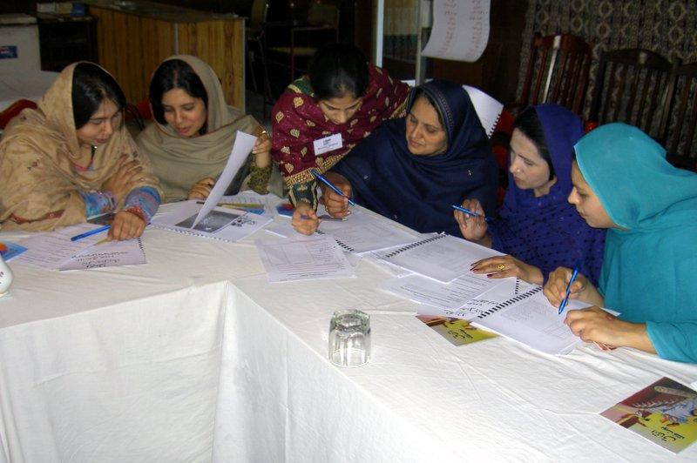
KEY PROCESSES TO OBSERVE
Key processes to observe during an election cycle include:
Documentation
Registration
Voter education
Voting
Nomination process
Campaigns
Polling operations
Picture Source: NDI

Slide 9
WOMEN AS VOTERS
Observing the inclusiveness of voting requires assessing whether norms and policies exist to guarantee that both men and women have:
Equal access to registration and voting locations
Equal access to the voter registration and verification process
Equal access to the complaint process
Equal ability to cast their own ballot
Notes:
ADDITIONAL NOTE: Any observation must determine if norms and policies exist and if identity documents can be obtained for voter registration.

Slide 10
WOMEN VOTERS:
WHAT TO OBSERVE OR ASSESS
Whether women are disproportionately affected by problems with the voting process, such as:
Do identification requirements have a negative impact on women?
Is the voting or registration location accessible to women? Is it safe and secure?
Is disaggregated data available to allow for a practical analysis of women’s participation?
Do women face threats of violence at registration?

Slide 11
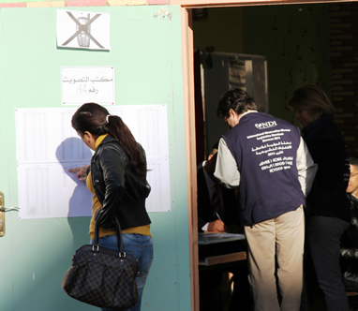
WOMEN VOTERS
Women voters face significant barriers to participation during registration and voting.
These barriers can be:
Physical
Legal
Logistical
Historical/traditional
Social
Cultural
Picture Source: NDI

Slide 12
INSTITUTIONAL BARRIERS
Voter registration documentation can be difficult for women to provide due to loss or lack of papers, conflict or internal displacement.
Location and hours of registration centers and polling stations can create obstacles for women. These include difficulties with transportation or freedom of movement, domestic and childcare responsibilities, and work schedules.
Concerns about security at polling or registration stations may dissuade women from coming.
Conditions at polling stations, such as long lines, bad weather or hostile surroundings may impede participation.

Slide 13
INSTITUTIONAL BARRIERS
EXAMPLE: BURKINA FASO
In Burkina Faso’s 2012 presidential election, women faced obstacles because of a requirement that citizens obtain a birth certificate before they could register.
Significant numbers of women did not have one because parents did not get birth certificates for female children.
This requirement put an undue burden on women that could have led to disenfranchisement.
Notes:
ADDITIONAL NOTE: The Ministry of the Interior ended up implementing a mobile registration initiative in the five regions with the lowest registration rates. This helped 16,000 women seeking to register to obtain their necessary birth certificates.

Slide 14
SOCIO-CULTURAL BARRIERS
Gender-based electoral violence against voters and candidates
Prevalence of family and proxy voting, or pressure to vote along family/tribal/ethnic lines
Traditions, social constraints and stereotypes that may create a sense of disempowerment for women, or restrict their choices or freedom of movement
Notes:
Make sure to define family and proxy voting when presenting

Slide 15
SOCIO-CULTURAL BARRIERS
Time constraints imposed by domestic duties
Concerns about ballot secrecy, including:
Fear that the secrecy of their vote may be compromised
Perception that they may face retaliation for independent choices
Intimidation/threats designed to make women vote a certain way or reveal how they voted
Coercion and/or violence from husbands seeking to influence how their wives vote

Slide 16
POTENTIAL BARRIERS:
WOMEN AS VOTERS
Are there registration obstacles for women? What are the document requirements? What is the registration location?
Are there particular socio-cultural barriers to women voting?
Have women historically voted in lower numbers than men?
Is disaggregated data collected on women voters?

Slide 17
VOTER EDUCATION:
WHAT TO OBSERVE OR ASSESS
Observers can analyze voter education programs to determine the particular needs and interests of women and whether they are being addressed:
Who is responsible for voter education?
What are the key messages?
How are these messages communicated? Is it in a format that is equally accessible to women?
Do the messages sufficiently address the needs and interests of both women and men voters?

Slide 18
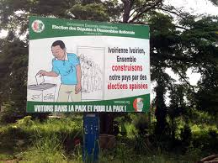
EXERCISE:
ASSESS VOTER EDUCATION ADS
Notes:
TRAINER NOTE: If you are conducting this as a training, ask the group: How do these images target women or not target women? Who is in the image? Are both women and men represented?

Slide 19
TRANSLATION: “Voting is an opportunity to realize our ambitions and the ambitions of our children. Our date is September 27.”

Slide 20
WOMEN CANDIDATES
Observing whether elections are inclusive for women candidates involves paying attention to norms and practices that affect whether men and women have an equal ability to run for public office. These can include:
Electoral systems
Nominating procedures
Political party practices
Political-electoral financing systems
Media and social media coverage
Notes:
For an election process to be democratic, it must include the equal participation of both men and women - as voters, candidates, election administrators and observers.
An observation should look at women’s participation in all phases of the electoral cycle as voters, candidates, election administrators and observers.

Slide 21
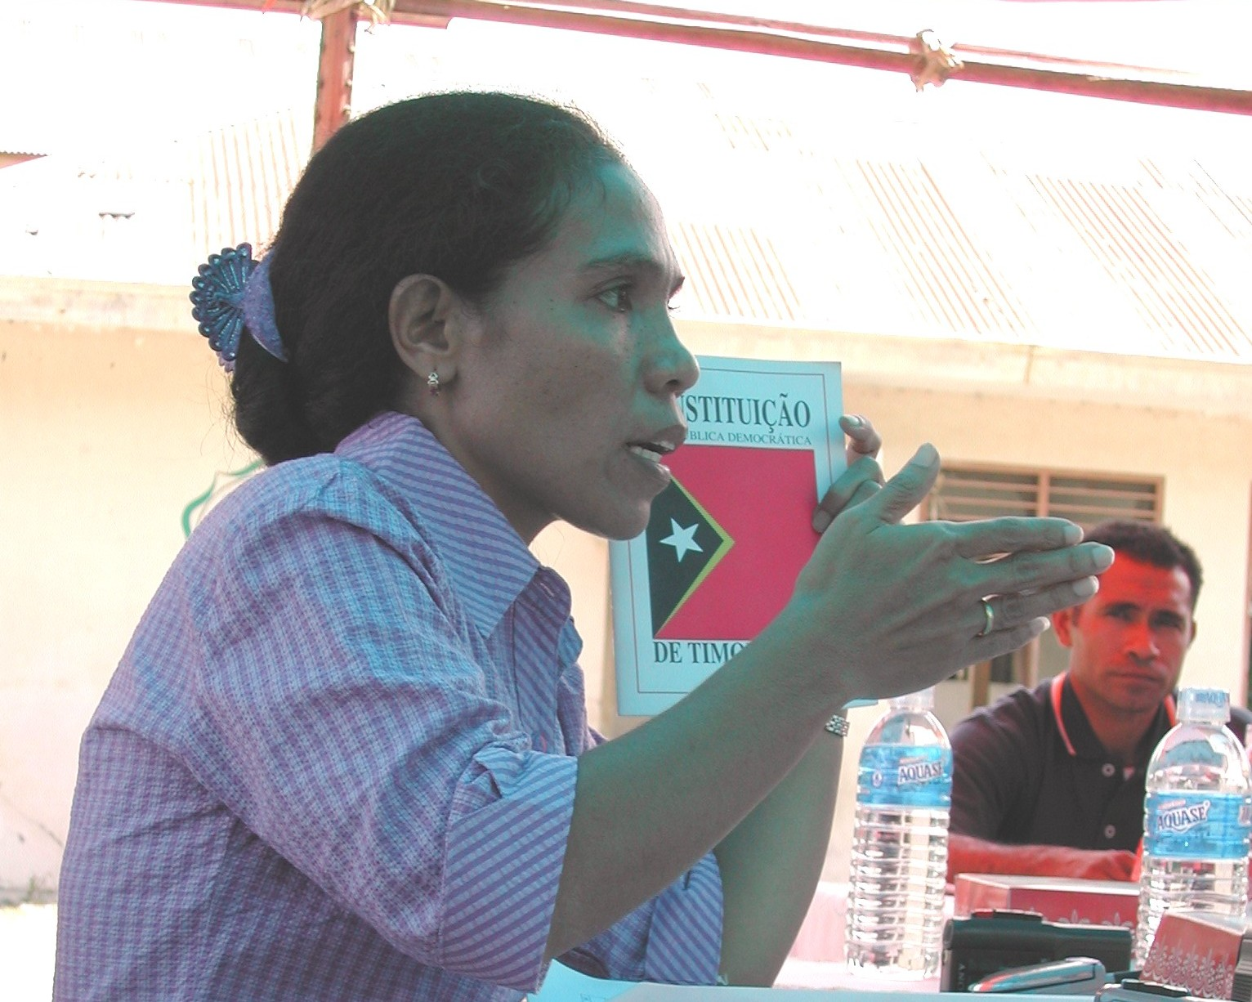
WOMEN CANDIDATES
A key aspect monitors should focus on is election coverage of female candidates by media, including social media.
Is it fair?
Is it equal?
Is it about the candidate’s issues or
appearance?
Picture Source: NDI

Slide 22
WOMEN CANDIDATES
What is an example of unfair coverage of a
female candidate?
Notes:
TRAINER NOTE: When conducting this training, ask the audience: what are some ways/examples of how women are portrayed in the media that you think could be considered discriminatory or unfair? For example: talking about what they are wearing, focusing on their expression or emotions (such as tears).

Slide 23
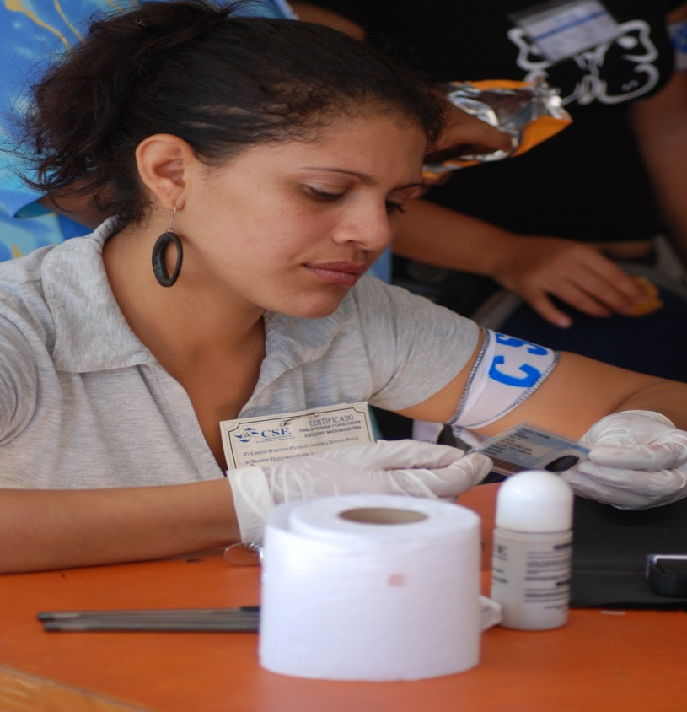
ELECTION ADMINISTRATION
Assess the number of women involved in election administration.
How many women are in leadership and decision-making roles?
Women should have the ability to participate as election observers,
commission members, poll workers, etc.
Picture Source: NDI
Notes:
Election observers should take note of the number of women represented in the election administration at the central, regional and polling station levels, as well as the number who are in leadership and decision-making roles.
TRAINER NOTE: At this point, you may wish to discuss the composition of the election administration (from the commission itself to regional offices and poll workers) and whether the structure/leadership have an individual focused on gender.

Slide 24
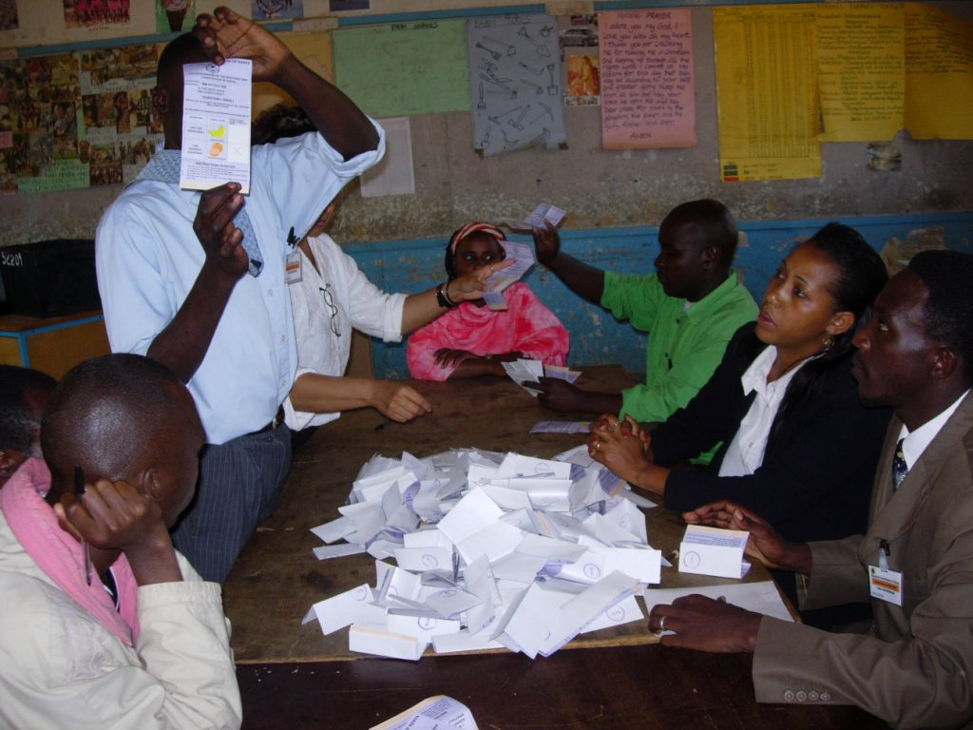
ELECTION ADMINISTRATION
Extensive pre-election assessment can provide a view of the election administration body’s awareness of the barriers that exist for women.
It can also help gauge the responsiveness of that body to related issues that may arise.
Picture Source: ACE Project

Slide 25
BACK TO: BURKINA FASO
The Minister of the Interior responded to the need for birth certificates by implementing a mobile registration initiative in the five regions with the lowest registration rates.
This helped 16,000 women seeking to register to obtain the necessary birth certificates.

Slide 26
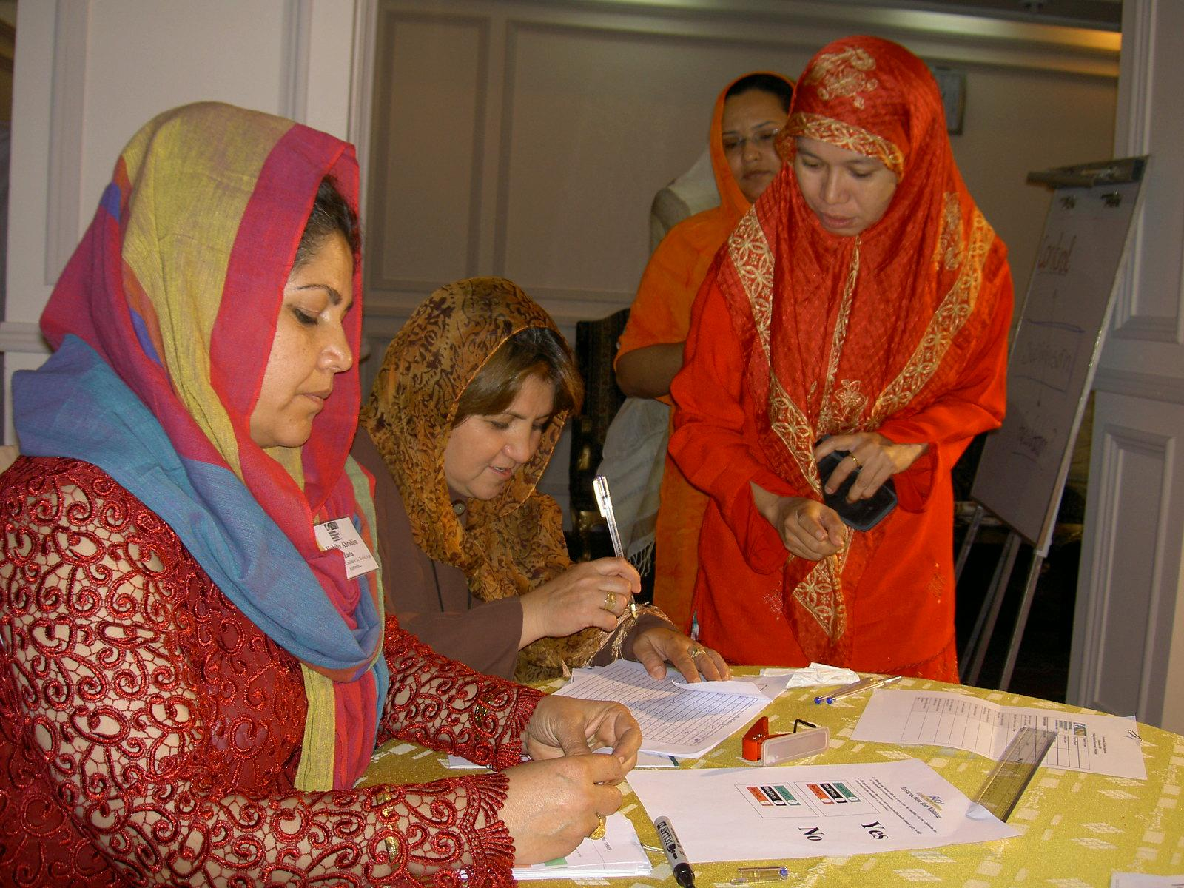
ASSESSMENT/REPORTS
Analysis and reporting on the election environment should include any findings on women’s participation, including potential barriers.
Picture Source: NDI

Slide 27
INTERVIEW KEY STAKEHOLDERS
It is important to seek information from women’s organizations on gender-related issues in the pre-election phase and after the election.
Women’s organizations are especially useful in closed societies, or in contexts where official data on women’s participation or issues of violence is non-existent or inaccessible.
Notes:
ADDITIONAL NOTES: When able, observer groups would also investigate the system for filing election grievances and determine whether there are any particular obstacles affecting women’s access to complaint mechanisms.
Women’s organizations and other civil society groups with a gender-related focus are a resource for observers on issues related to women’s participation.

Slide 28
INTERVIEW KEY STAKEHOLDERS
Some example questions for these groups and other key stakeholders may include:
What is the level of women’s involvement in previous elections? How does that level compare to the current election?
What are the similarities and differences between previous elections and this one?
What percentages of women are registered to vote in comparison to men? Is there a difference? If so, why?
Notes:
ADDITIONAL NOTES: What is the track record of how women have participated in the voting process? Have they voted in the same proportion as men?
Did previous voter education programs specifically target women voters? Have political parties reached their quotas (if they have them)?

Slide 29
INTERVIEW KEY STAKEHOLDERS
What are the levels of voter participation for women? How do they compare to men?
Are there unique barriers to women’s electoral participation?
Have there been threats unique to women?
What previous voter education and outreach programs exist? Who ran them and what was their extent?
Notes:
ADDITIONAL NOTES: What is the track record of how women have participated in the voting process? Have they voted in the same proportion as men?
Did any previous voter education programs specifically target women voters? Have political parties reached their quotas (if they have them)?

Slide 30
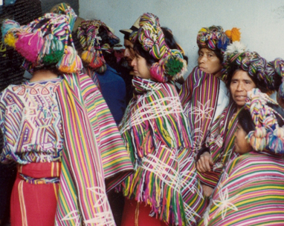
INTERVIEW KEY STAKEHOLDERS
Who are the key actors in election monitoring?
Are women’s organizations already or also monitoring elections?
Picture Source: NDI

Slide 31
THE VOTE:
WHAT TO OBSERVE OR ASSESS
Polling station atmosphere and security
Percentage of women on the polling station committee and gender of the chairperson
Representation of women among party poll-watchers
Women voters’ level of understanding of procedures
Sex-disaggregated voter data

Slide 32
THE VOTE
WHAT TO OBSERVE OR ASSESS
What percentage of voters turned away from polling stations were women
Protections for secrecy of the vote
Incidents of family or proxy voting
Incidents of electoral violence against women voters or election workers
Comparison of voter rates at the central and regional levels
Notes:
TRAINERS NOTE: Ask participants what other factors or issues they think should be considered when observing election day. It may also be useful to talk about how to observe certain kinds of incidents, and whether there are any particular issues in that country. (Refer back to definitions given earlier if necessary.)

Slide 33
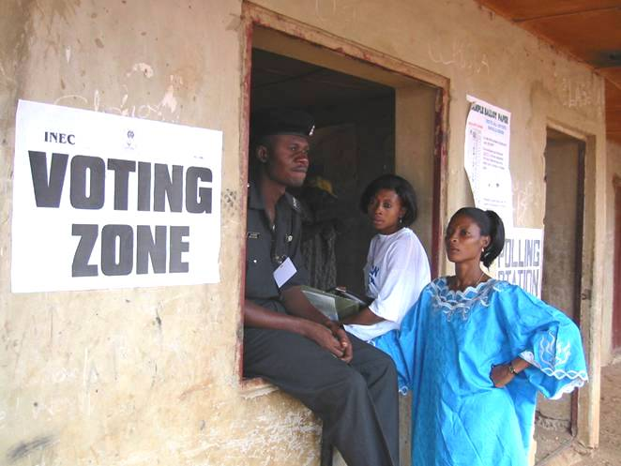
WHY DOMESTIC OBSERVERS?
The broad scope of domestic observers’ localized knowledge puts them in a strong position to identify obstacles to women’s electoral participation.
Picture Source: NDI

Slide 34
METHODOLOGY DOMESTIC OBSERVATION
Incident report forms and checklists should include relevant questions on gender issues.
Step 1: Identify the issues or challenges for a particular context.
Step 2: Identify key questions that should be included to assess women’s ability to participate.

Slide 35
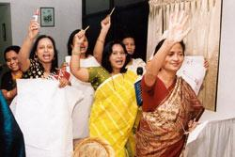
RECRUITMENT OF OBSERVATION TEAMS
There should be a gender balance of team members.
Any recruitment strategy should consider particular barriers for women.
Recruitment messages should include and target women.
Picture Source: NDI
Notes:
ADDITIONAL NOTE: The composition of observer teams can have an impact on the integration of gender in the observation process. To ensure gender representation and a focus on gender issues, consider that AT MINIMUM it is important to have an equal gender balance in team members.

Slide 36
TRAINING OBSERVATION TEAMS
Highlight importance of monitoring gender throughout the election.
Build understanding of potential barriers for women and how to identify and monitor them.
Where to look? What to look for?
Include background on women’s status and political participation in the country.
Notes:
TRAINERS NOTE: Training for any observers should emphasize the importance of monitoring both men’s and women’s participation. Trainings should include discussion of particular barriers that disadvantaged men and women face, as well as how to monitor these issues during the stages of the election process. Background information on the overall status of women in this country should also be provided to observers.

Slide 37
TRAINING OBSERVATION TEAMS
Written materials or observer manuals should provide guidance on questions to use during observation.
Include questions for monitoring women’s participation throughout the process and election day in:
Training materials
LTO report templates
Incident reports
Observer checklists
Notes:
TRAINER NOTE: It is useful to discuss why gathering this information is important both for assessing the quality of the electoral process itself, and also because it provides important information about barriers to and strategies for increasing women’s political participation in the post-election environment.

Slide 38
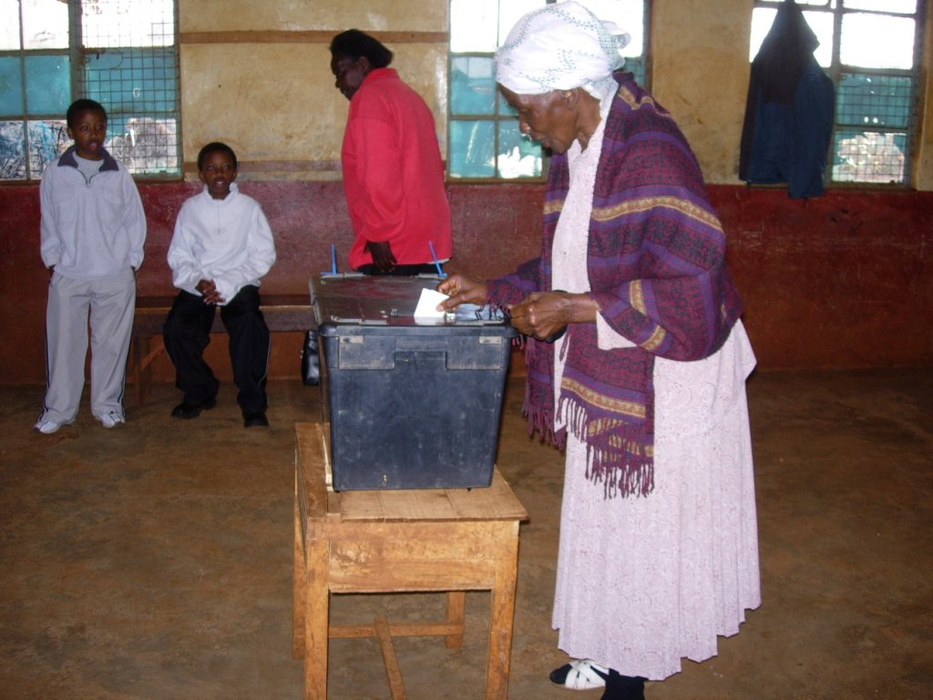
OBSERVATION STATEMENTS
Include information on participation of women as voters, candidates and workers.
State percentages of women elected (versus previous elections).
State percentages of women in election administration.
Include any gender-related security incidents or incidents of violence against women during the election.
Picture Source: NDI
Notes:
ADDITIONAL INFORMATION: All observer statements and reports should include information assessing the participation of women in the election process, as well as make recommendations for improvement. At a minimum, observer statements/reports should include the following (see slide).
TRAINER NOTE: It is useful to discuss why gathering this information is important both for assessing the quality of the electoral process itself, and also because it provides important information about barriers to and strategies for increasing women’s political participation in the post-election environment.

Slide 39
REVIEW
Why women’s participation is important
Barriers to women’s participation
Pre-election monitoring
Election day domestic observation
Observer training
Observer reporting

Slide 40
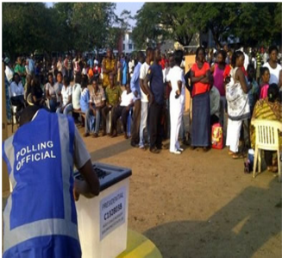
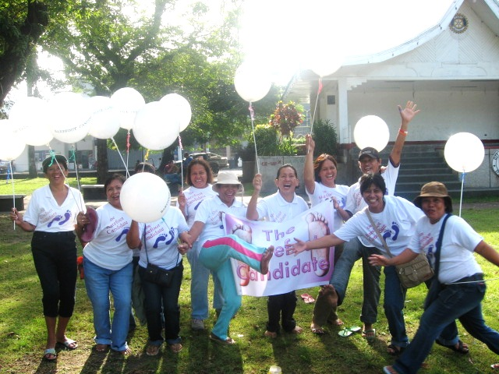
THANK YOU
Picture Source: NDI

