Slide 1
Gender and Election Observation: Pre-Election Observation
Gender, Women and Democracy
NDI, 2016
Notes:
This tool was developed by Caroline Hubbard and Claire DeSoi for NDI's Votes Without Violence program and toolkit.

Slide 2
GENDER AND ELECTION OBSERVATION: OBJECTIVES
Understand why gender is important for election observation
Identify potential barriers to women’s participation in the electoral process
Increase knowledge of how to incorporate gender aspects into election observation, including trainings, materials and reporting
Notes:
TRAINER NOTE: You may also wish to ask participants what expectations they have for the session. What do they hope to learn or gain from it? You can then relate their expectations to the objectives and suggest how unrelated expectations might be met in other ways.

Slide 3
GENDER AND ELECTION OBSERVATION: TOPICS
Pre-election monitoring
Short-term/election day monitoring
Recruitment/observer team composition
Observation forms/checklists
Training for observers/Training of trainers
Observer reporting

Slide 4
KEY TERMS
Gender
Sex
Gender equality
Gender equity
Notes:
TRAINER NOTE: See if people want to define these terms, or go around the room and ask participants to define them as a participatory activity.
Gender: Refers to the socially determined differences between women and men that are learned, changeable over time and have wide variations both within and between cultures.
Sex: Refers to the biological characteristic that categorize someone as either male or female. These characteristics are generally universal and determined at birth.
Gender Equality: Equality means that women’s and men’s rights, responsibilities and opportunities will not depend on whether they are born male or female.
Gender Equity: Provisions should be made to redress inequality before women can take advantage of the opportunities provided, creating equality of process and outcome.

Slide 5
WHY INCLUDE GENDER IN
ELECTION OBSERVATION
Domestic observers should assess the quality of women’s participation in each stage of the electoral process as part of their assessment of the quality of the election.
Elections are a key opportunity to evaluate and strengthen women’s participation in politics, which will improve the overall participatory quality of an election.

Slide 6
WHY INCLUDE GENDER IN
ELECTION OBSERVATION
Democratic elections should be inclusive, transparent and accountable.
Inclusive elections are ones that enable both men and women to participate fully and equally.
The principle of inclusion is not only about enabling but also taking positive action to address particular barriers women might face.

Slide 7
WHY INCLUDE GENDER IN ELECTION OBSERVATION
Democratic elections must include women’s equal participation in every phase of the election, including before election day itself, as:
Voters
Candidates
Election Administrators
Observers
Notes:
For an election process to be democratic, it must include the equal participation of both men and women - as voters, candidates, election administrators, and observers.
We are going to look at women’s participation in each phase of the electoral cycle, as voters, candidates, election administrators, and observers.

Slide 8
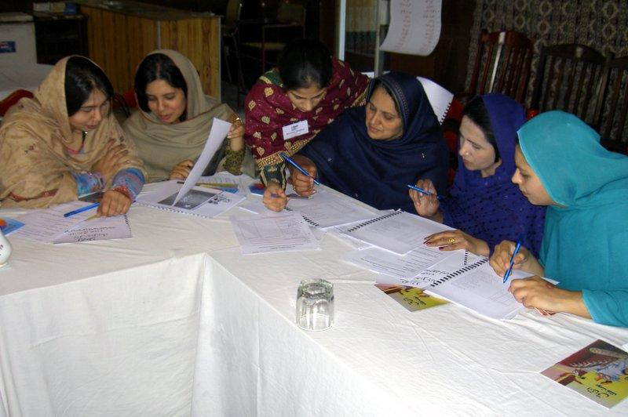
PRE-ELECTION:
KEY PROCESSES TO OBSERVE
Key processes to observe during an election cycle include:
Documentation
Registration
Voter education
Nomination process
Campaigns
Election workers
Picture Source: NDI
Notes:
What are the key processes to observe women’s participation in the pre-election phase?

Slide 9
PRE-ELECTION:
WOMEN AS VOTERS
Observing the inclusiveness of voting requires assessing whether norms and policies exist to guarantee that both men and women have:
Access to registration and voting locations
Access to the voter registration and verification process
Access to the complaint process
Notes:
Observation must determine if norms and policies exist and if identity documents can be obtained for voter registration.

Slide 10
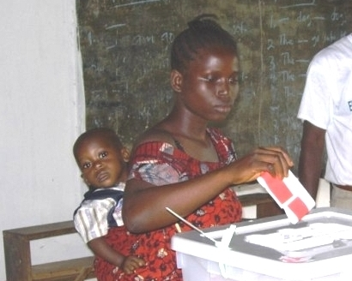
PRE-ELECTION:
WOMEN AS VOTERS
Voting is a fundamental right of all citizens.
Women face significant barriers to participation during voter registration. These barriers can be:
Physical
Legal
Logistical
Historical/traditional
Social
Cultural
Picture Source: NDI

Slide 11
PRE-ELECTION:
INSTITUTIONAL BARRIERS
Voter registration documentation requirements can be difficult for women to provide, sometimes due to loss or lack of papers resulting from conflict or internal displacement
Location and hours of registration centers can present obstacles for women because of problems involving transportation or freedom of movement, domestic and childcare responsibilities, and work schedules.
Concerns about security at registration stations may dissuade women from going to register.
Conditions at polling stations such as long lines, weather and surroundings may inhibit women from registering.

Slide 12
INSTITUTIONAL BARRIERS:
WHAT TO OBSERVE OR ASSESS
Assess if women are disproportionately affected by problems with the voting process, such as:
Do identification requirements have a negative impact on women?
Is the location accessible for women?
Is disaggregated data available to allow for a practical analysis of women’s participation?
Do women face threats of violence at registration?

Slide 13
EXAMPLE: BURKINA FASO
In Burkina Faso’s 2012 presidential election, women faced obstacles because of a requirement that citizens obtain a birth certificate before they could register.
Significant numbers of women did not have one because parents did not get birth certificates for female children.
This requirement put an undue burden on women that could have led to disenfranchisement.
Notes:
ADDITIONAL NOTE: The Ministry of the Interior ended up implementing a mobile registration initiative in the five regions with the lowest registration rates. This helped 16,000 women seeking to register to obtain their necessary birth certificates.

Slide 14
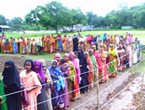
PRE-ELECTION
SOCIO-CULTURAL BARRIERS
Time constraints due to domestic duties and
Social norms may create a sense of disempowerment for women or restrict choices and/or women’s freedom of movement.
Picture Source: GNDEM

Slide 15
LEGAL AND SOCIAL-CULTURAL:
WHAT TO OBSERVE OR ASSESS
Do women face barriers registering to vote?
Do identification requirements pose a problem for women?
Are there access barriers or other process issues for women, such as location?
Are there social norms that will impact women’s knowledge, desire or ability to participate as voters or candidates?

Slide 16
PRE-ELECTION:
VOTER EDUCATION
Voter education programs can be used to discourage women from voting.
Observers can analyze voter education programs to determine particular needs of women and whether they are being addressed:
Who is responsible for voter education?
Can women access the same information as men?
What are the key messages being communicated?
Does voter education reproduce gender stereotypes or sexist language?
Do voter education messages sufficiently address the specific needs of both the male and female electorate?

Slide 17
PRE-ELECTION:
WOMEN AS CANDIDATES
Observing inclusiveness in elections involves paying attention to norms and practices that affect equity in men’s and women’s ability to run for public office and can include:
Electoral systems
Nominating procedures
Political party practices
Political-electoral financing systems
Media and social media coverage

Slide 18
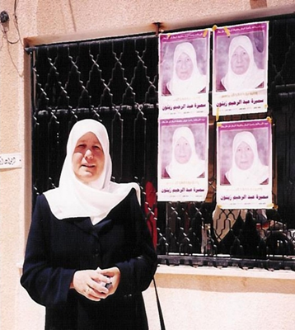
PRE-ELECTION:
WOMEN AS CANDIDATES
The high costs of campaigning and conservative traditions can dissuade women from entering formal politics.
Election coverage by media can be discriminatory or unfair, or promote negative stereotypes of women.
Picture Source: NDI

Slide 19
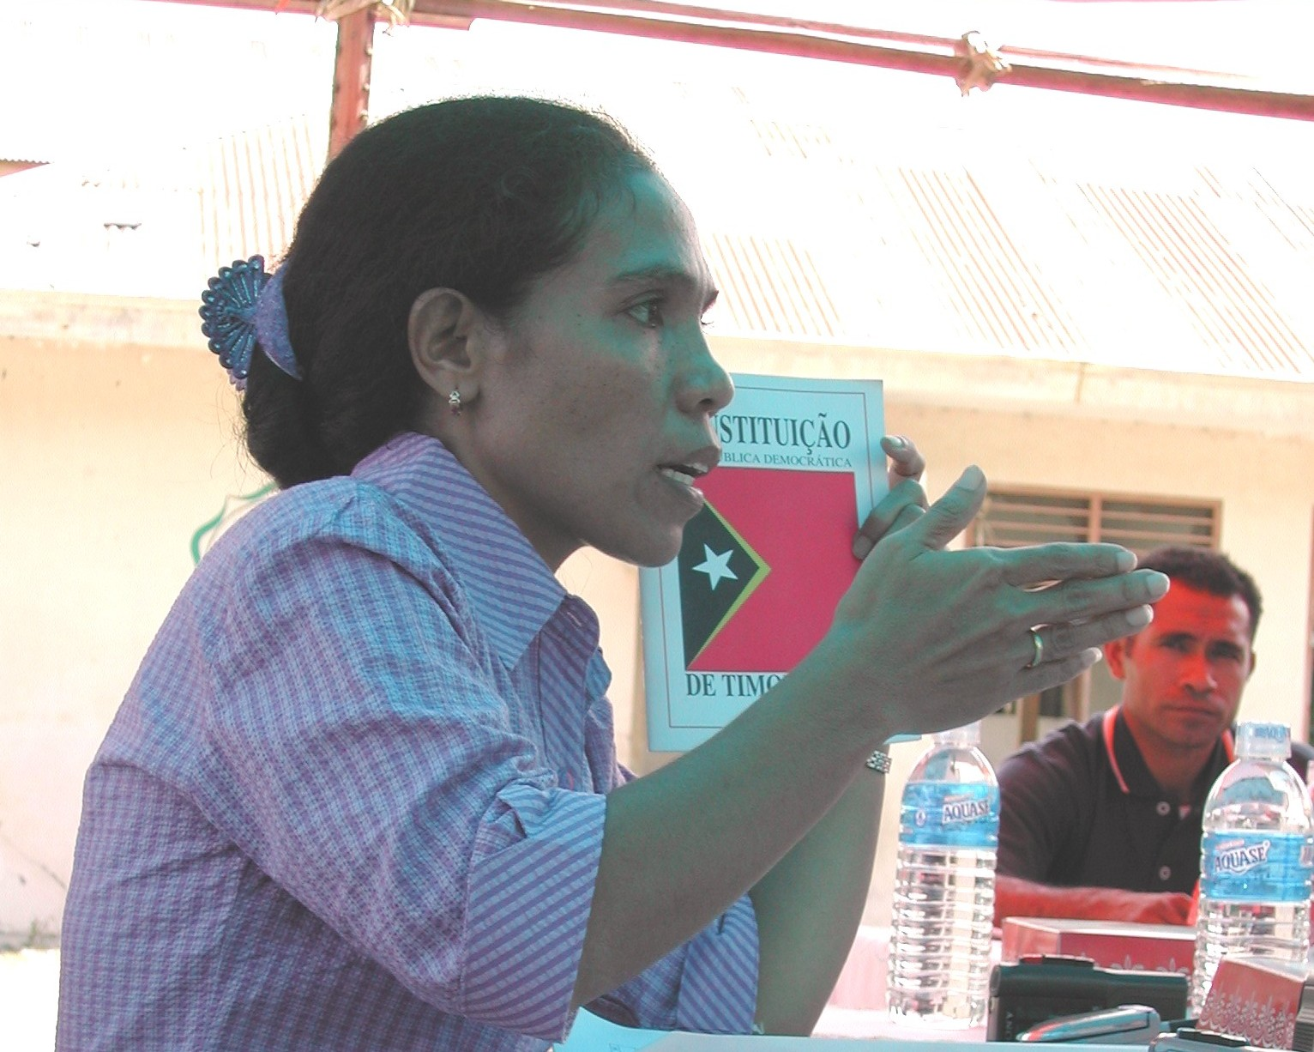
PRE-ELECTION:
WOMEN AS CANDIDATES
A key aspect monitors can assess is election coverage by media - including social media - of female candidates.
Is it fair coverage?
Is it equal coverage?
Is the coverage of the candidate’s issues or appearance?
Picture Source: NDI

Slide 20
PRE-ELECTION:
WOMEN AS CANDIDATES
What is an example of unfair coverage of a
female candidate?
Notes:
TRAINER NOTE: When conducting this training, ask the audience: what are some ways/examples of how women are portrayed in the media that you think could be considered discriminatory or unfair? For example: talking about what they are wearing, focusing on their expression or emotions (such as tears).

Slide 21
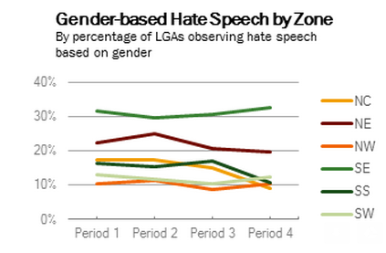
PRE-ELECTION:
WOMEN AS CANDIDATES
Hillary Clinton in 2008 was a victim of many negative on-line campaigns.
One of the most popular, with over 41,000 followers in March 2008 was “Hillary Clinton: Stop Running for President and Make Me a Sandwich.”
In Nigeria in 2015, the citizen observer group (TMG) found that gender-based hate speech was a problem throughout the pre-electoral period.

Slide 22
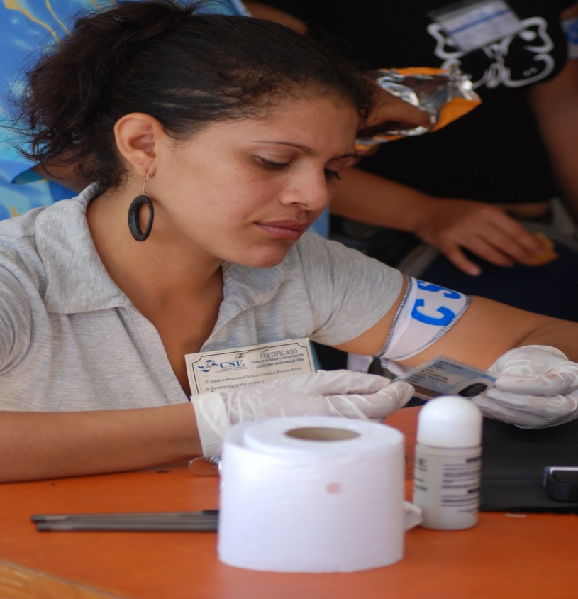
PRE-ELECTION:
ELECTION ADMINISTRATION
The number of women in election administration is also important to assess.
How many women are in leadership and decision-making roles?
Women should have the ability to participate as election observers,
commission members, poll workers, etc.
Picture Source: NDI
Notes:
Trainer Note: Election observers should take note of the number of women represented in the election administration at the central, regional and polling station levels, as well as the number who are in leadership and decision-making roles.
TRAINER NOTE: Discuss the composition of the election administration (from the commission itself to regional offices and poll workers) and whether the structure/leadership have an individual focused on gender.

Slide 23
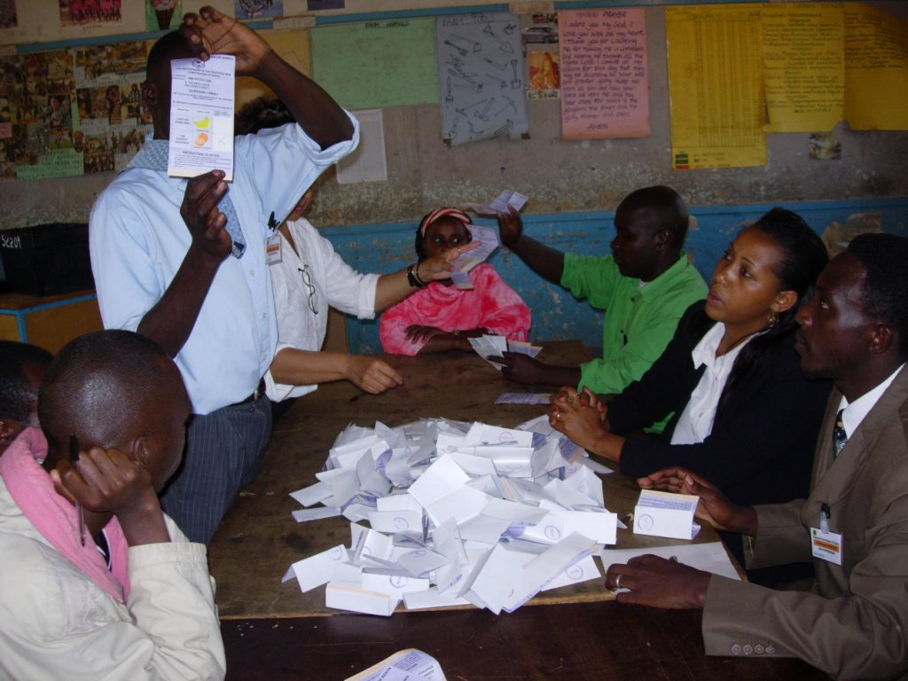
PRE-ELECTION:
ELECTION ADMINISTRATION
An extensive pre-election assessment will also examine the election administration body’s awareness of gender issues.
It should also gauge the responsiveness of those bodies to any related issues.
Picture Source: ACE Project
Notes:
Election observers doing a pre-election assessment will also assess the administration’s awareness of gender issues, such as those outlined in previous sections, and gauge the responsiveness of those bodies to any related issues that may arise.

Slide 24
PRE-ELECTION: INTERVIEW KEY STAKEHOLDERS
It is important to use women’s organizations as a source of information on gender-related issues in the pre-election phase.
Women’s organizations are especially useful in contexts where official data on women’s participation is non-existent or inaccessible.
Notes:
When able, observer groups can also investigate the system for filing election grievances and determine whether there are any particular obstacles affecting women’s access to complaint mechanisms.
Women’s organizations and other civil society groups with a gender-related focus are a resource for observers on issues related to women’s participation.

Slide 25
PRE-ELECTION: INTERVIEW KEY STAKEHOLDERS
What are women’s voter participation rates? How do they compare to men’s?
Are there unique barriers to women’s electoral participation? Have there been threats unique to women?
Are there previous voter education and outreach programs? Who ran them and what was their extent?
Notes:
What is the track record of how women have participated in the voting process? Have they voted in the same proportion as men?
Did any previous voter education programs specifically target women voters? Have political parties reached their quotas (if they have them)?

Slide 26
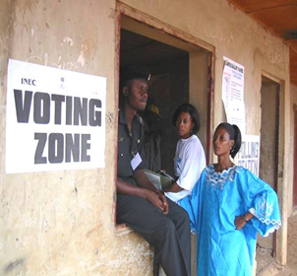
WHY DOMESTIC OBSERVERS?
The broad scope of domestic observers’ localized knowledge puts them in a strong position to identify obstacles to women’s electoral participation throughout the pre-election period.
Picture Source: NDI

Slide 27
WHY DOMESTIC OBSERVERS?
Domestic observation forms for all phases of the election should include relevant questions on gender issues.
Step 1 is to identify these issues/challenges for a particular context.
Step 2 is to identify key questions to include to assess women’s ability to participate.

Slide 28
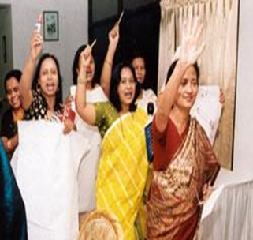
COMPOSITION OF OBSERVER TEAMS
There should be a gender balance of team members.
Any recruitment strategy should consider particular barriers for women.
Recruitment messages should include and target women.
Picture Source: NDI

Slide 29
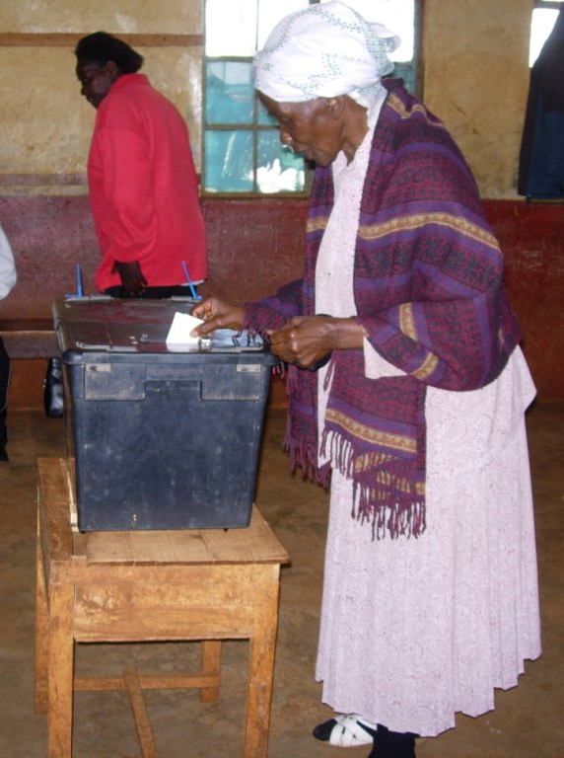
PRE-ELECTION:
OBSERVATION STATEMENTS
Pre-election analysis and reporting on the election environment should include findings on women’s participation:
As voters
As candidates
As election workers
Reports with this information become valuable resources for others working to improve women’s participation in elections.
Pre-election reports should also include any gender-related security incidents or VAW-E.
Picture Source: NDI
Notes:
All observer statements and reports should include information assessing the participation of women in the election process, as well as make recommendations for improvement. At a minimum, observer statements/reports should include the following (see slide).
TRAINER NOTE: It is useful to discuss why gathering this information is important both for assessing the quality of the electoral process itself, and also because it provides important information about barriers to and strategies for increasing women’s political participation in the post-election environment.

Slide 30
REVIEW
Why women’s participation is important
Barriers to women’s participation
Issues to monitor and questions to ask
Gender in recruitment, training, and reporting

Slide 31
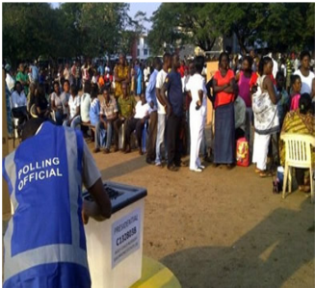
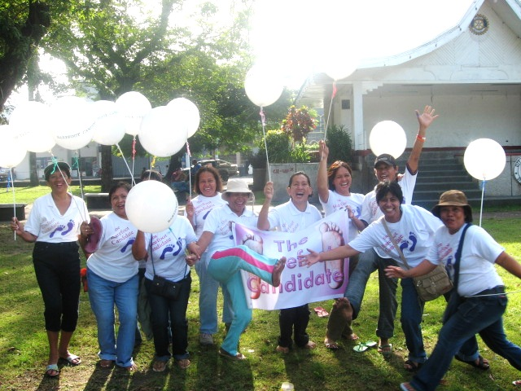
THANK YOU
Picture Source: NDI

