Slide 1
VIOLENCE AGAINST WOMEN IN ELECTIONS: MONITORING MEDIA
Gender, Women and Democracy
NDI, 2016
Notes:
This tool was developed by Caroline Hubbard and Claire DeSoi for NDI's Votes Without Violence program and toolkit.

Slide 2
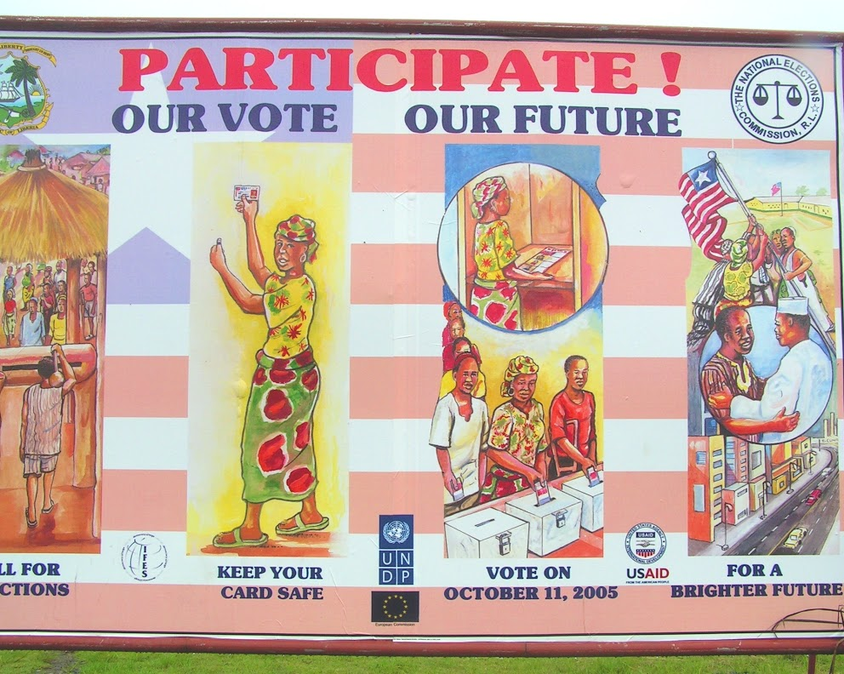
MONITORING MEDIA TOPICS
Key definitions
Why monitor the media
Why monitor the media for VAW-E
What’s important
Monitoring at different levels
Photo Source: NDI

Slide 3
KEY DEFINITIONS
What is media monitoring?
Monitoring the media during an election requires collecting data on election-related content published by print, broadcast and online media.
This could include an examination of the media laws and regulatory framework around media coverage during elections.
The data gathered is analyzed and the results are presented publicly.
Notes:
Definition adapted from ACE: The Electoral Knowledge Network, Media and Elections

Slide 4
KEY DEFINITIONS
What are “media”?
Traditional sources, such as television, radio print (newspapers, magazines, etc.)
Increasingly, online content and sources, including social media
Notes:
Definition adapted from ACE: The Electoral Knowledge Network, Media and Elections

Slide 5
WHY MONITOR MEDIA DURING ELECTIONS?
Media play a vital role during a country’s elections.
They provide important information about elections and candidates.
This helps citizens make free and informed choices about their governments and who they choose to represent them.

Slide 6
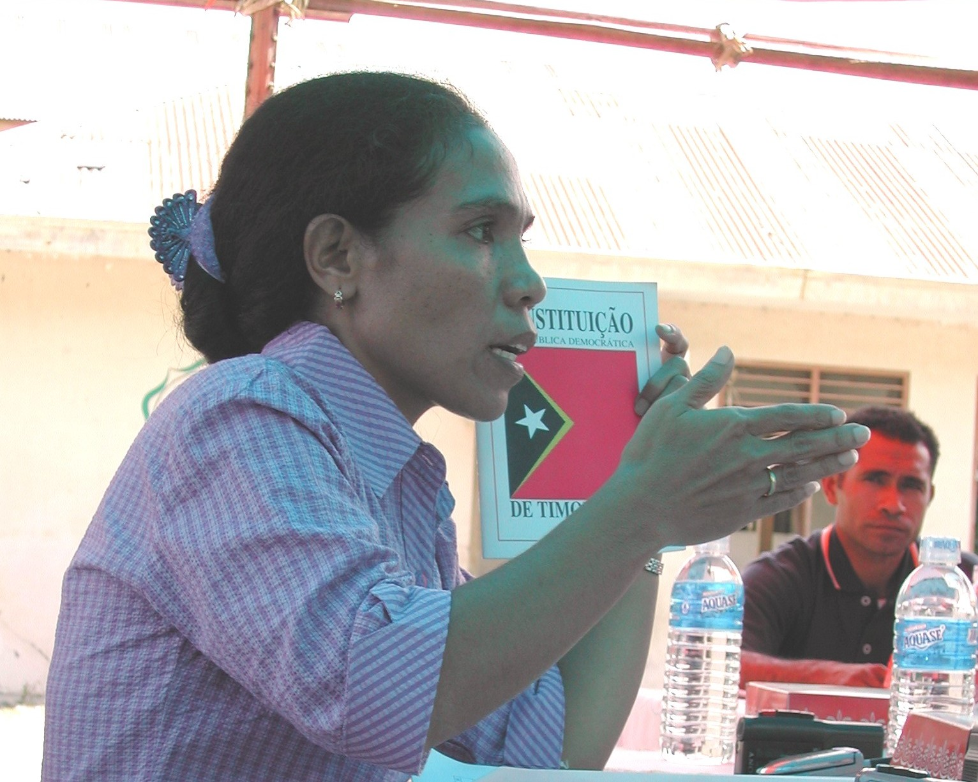
WHY MONITOR MEDIA DURING ELECTIONS?
Media provide information, but it is important to assess the quality of that information. Is it:
Fair?
Objective?
Balanced?
Accurate?
Comprehensive?
Photo Source: NDI

Slide 7
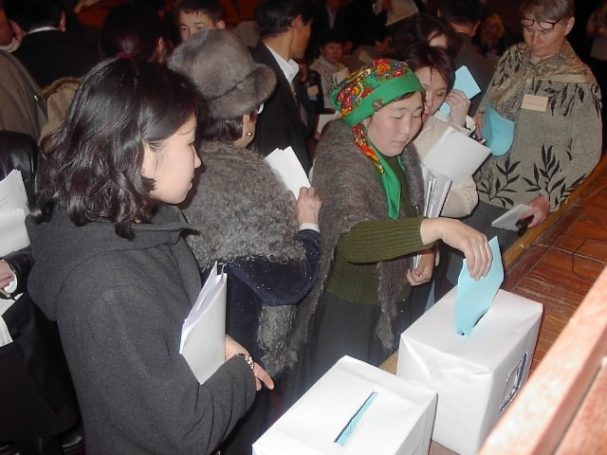
WHY MONITOR MEDIA DURING ELECTIONS?
Monitoring the media impartially, proficiently and with credible methodology can establish whether media are contributing to the democratic nature of elections or if they are causing harm..
Photo Source: NDI
Notes:
NDI: Media Monitoring to Promote Democratic Elections

Slide 8
WHY MONITOR MEDIA DURING ELECTIONS?
Monitoring media depends on context, but can mean measuring:
The amount of coverage given to individual candidates;
Levels of bias toward or against a candidate or party;
How much access candidates have to media; and
Voter education or direct political information.

Slide 9
WHY MONITOR MEDIA FOR VAW-E?
Media are often major instigators of violence against women in elections.
VAW-E includes psychological violence, which is easily incited through media.
Do media discuss a woman’s political platform? Or her appearance?
What about her marital status? Her personality?

Slide 10
WHY MONITOR MEDIA FOR VAW-E?
Media bias can have a significant effect on a woman’s chance of being elected.
Studies show that media coverage of a candidate’s appearance or personality has an impact on her chances of election.
It can encourage voters see her as weaker or less electable.
Coverage can also play into cultural stereotypes about gender.

Slide 11
AN EXAMPLE FROM COSTA RICA
In 2010, the PAC party released a television ad portraying presidential candidate Laura Chinchilla as a marionette operated by then-President Oscar Arias.
This conveyed the message that a woman candidate could rise to power only in the service of others.
Photo Source: nacion.com

Slide 12
WHY MONITOR MEDIA FOR VAW-E?
The absence of women from election coverage can also encourage VAW-E, compounding other barriers women face.
Biased coverage and degrading or sexist stereotypes can incite physical violence.
Social media can increase the danger for women because it is borderless, anonymous, amplified and permanent.

Slide 13
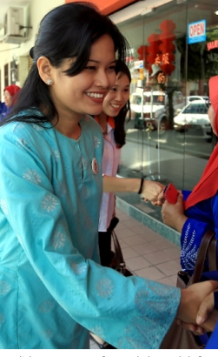
AN EXAMPLE FROM MALAYSIA
Just before Dyana Sofya Mohd Daud was named a candidate in the 2014 parliamentary elections, a picture of a woman in a bikini that was falsely claimed to be her went viral.
She subsequently faced questions about her moral character, wolf whistles at party events, and was called “cheap candy” by an extremist group.
Picture Source: Saw Siow Feng

Slide 14
MONITORING MEDIA FOR VAW-E
Media monitoring for VAW-E can be complementary to other media monitoring efforts.
It can also serve as an important complement to data collected in election observation efforts because:
It provides context;
Shows another dimension of violence; and
Brings perpetrators to light.

Slide 15
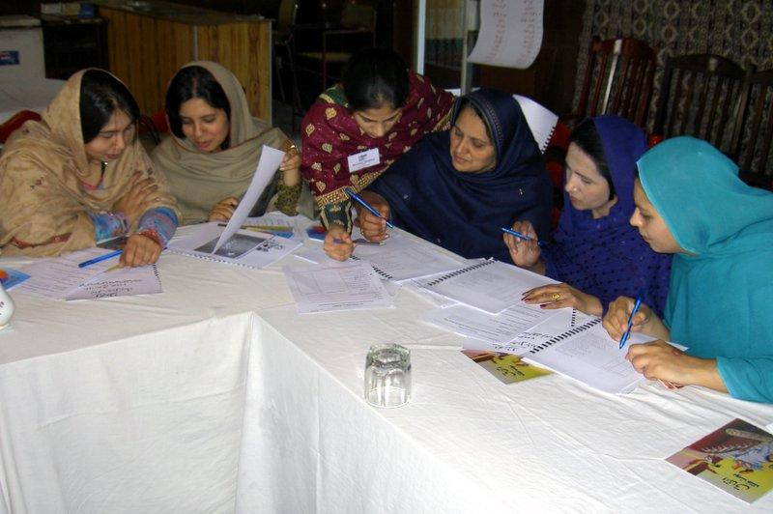
MONITORING MEDIA: WHAT TO MONITOR?
Traditional media
Traditional media include print and broadcast outlets, including newspapers, magazines, TV or radio.
These can be some of the most accessible and trusted news sources during an election.
Photo Source: NDI

Slide 16
MONITORING MEDIA: WHAT TO MONITOR?
Traditional media
Traditional media are often subject to higher standards of regulation and journalistic responsibility than newer media.
However, these outlets can still incite VAW-E, even unintentionally.
For example: they can reinforce traditional social norms that keep women out of politics.

Slide 17
MONITORING MEDIA: WHAT TO MONITOR?
Traditional media
Questions to ask before beginning:
Is the information provided about women candidates, voters or election officials biased or incomplete compared to men?
Do media focus disproportionately on women’s appearance, personality, family or moral character instead of their political opinions?
Do media publish threats or harassment against them?
Do journalists receive any training on how to portray women participating in the election?

Slide 18
MONITORING MEDIA: WHAT TO MONITOR?
Online and social media
New media and communications technologies have opened up new ways for journalists and politicians to reach different audiences.
Social media content can be created by many different outlets, sources and users; this can lead to an expansion of voices and viewpoints during elections.
However, social media in particular can also be a platform for hate speech, misinformation, abuse and harassment.

Slide 19
MONITORING MEDIA:
WHAT TO MONITOR?
Online and social media
Questions to ask before beginning:
Are there threats, harassment or hate speech against women candidates, voters, officials or observers on social media?
Do social media perpetuate traditional ideas about women’s “place” in society that are used to keep them out of politics?

Slide 20
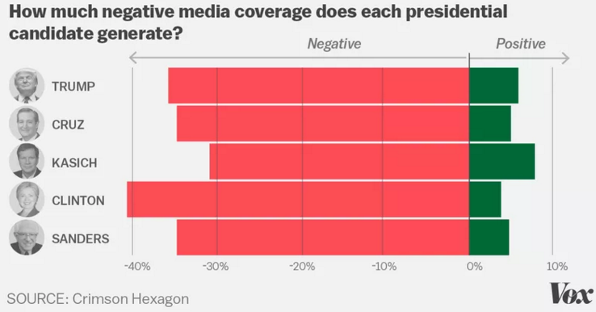
MONITORING MEDIA: EXAMPLE
Online and social media
Monitoring sentiment can be another way to gauge treatment of women candidates compared to men.
The software Crimson Hexagon evaluated coverage of candidates during the 2016 U.S. presidential election. Hillary Clinton, the only woman candidate, received more negative coverage than any of her male counterparts.
Notes:
For more information on this example, please see: http://www.vox.com/2016/4/15/11410160/hillary-clinton-media-bernie-sanders

Slide 21
MONITORING MEDIA: WHAT LEVEL OF COVERAGE?
Media monitoring can be conducted at the national level, local level or both at once.
National:
Shows a wider picture of any violence occurring and who the instigators may be on a broad scale; and
Can include coverage of regions or areas that are not part of an observation effort on the ground.
Local:
Captures more detailed information that would be lost to observers at a national level; and
Gathers data from local radio, posters, flyers and advertisements that are visible and important to local voters.
Notes:
(Ed. note - was originally one slide, had to be split into three)

Slide 22
MONITORING MEDIA: INITIAL GUIDING QUESTIONS
Will media monitoring be quantitative or qualitative?
Quantitative monitoring could be used to measure:
Gender balance in the time, access or coverage each candidate is given;
Number of women vs. men candidates, voters or election officials quoted; and
Number of times a word or phrase is used in connection with a woman candidate or election official.
Notes:
For more information see the OSCE handbook on media monitoring for electoral observation missions

Slide 23
MONITORING MEDIA: INITIAL GUIDING QUESTIONS
Will media monitoring be quantitative or qualitative?
Qualitative monitoring could be used to measure:
Balance or bias in information provided;
Tone used to discuss women candidates, voters or election officials: is it positive, negative or neutral?;
Omission of news or information; and
Incidents of hate speech, harassment or other acts of violence.
Notes:
For more information see the OSCE handbook on media monitoring for electoral observation missions

Slide 24
WHEN TO MONITOR? PRE-ELECTION
Considerations for observation groups:
A media monitoring observation can be extensive and intensive. Does the group have sufficient financial and human resources available?
How long will the monitoring last? It should be long enough to provide data and analysis for main incidents during a campaign.
When does the campaign or election period tend to be most intense/competitive?
Notes:
For more information see ACE: The Electoral Knowledge Network: Media and Elections

Slide 25
WHEN TO MONITOR? PRE-ELECTION
Monitors can examine:
Coverage of the preparations for elections, including voter registration and campaigns or treatment of women candidates/voters during the campaign period;
Data on voter education and/or political messaging from parties/candidates that target women; and
Whether the media are required to sign codes of conduct.
Are these codes of conduct voluntary? How many media outlets have signed them ahead of the election?
Notes:
For more information see ACE: The Electoral Knowledge Network: Media and Elections

Slide 26
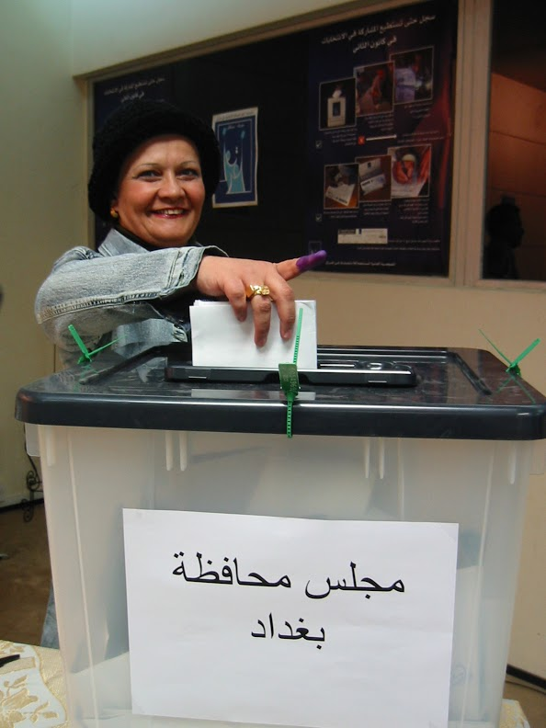
WHEN TO MONITOR? ELECTION DAY
Monitors can collect data on reports of voter turnout (especially women voters), vote counts and results announcements.
Social media may be especially critical to monitor warning signs or incidents of election day violence against women.
Photo Source: NDI

Slide 27
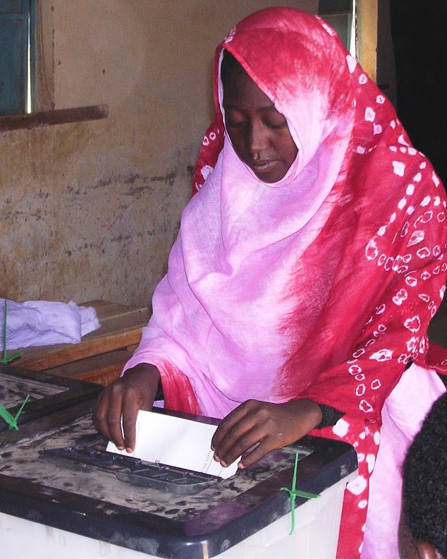
WHEN TO MONITOR? ELECTION DAY
Considerations for monitors:
The role of media may shift on election day, or there may be a blackout placed on political reporting or advertisements.
How quickly will data from the media monitoring be collected and analyzed? Will there be any mitigation efforts based on findings?
Photo Source: NDI

Slide 28
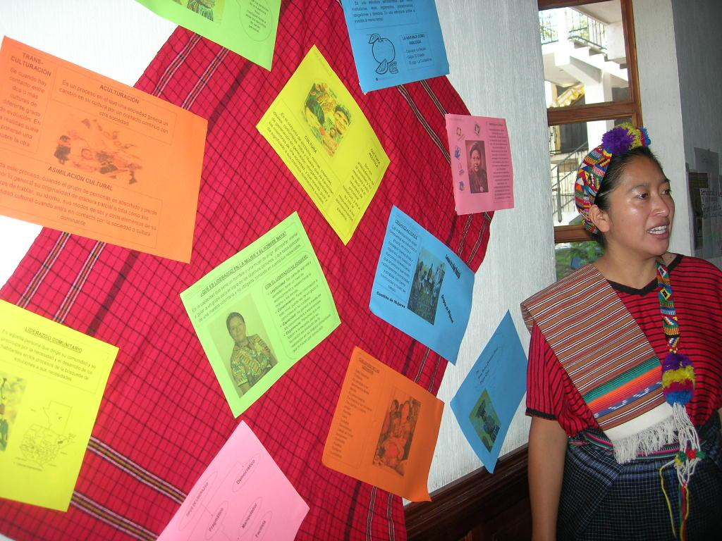
WHEN TO MONITOR? POST-ELECTION
Monitors can continue to analyze coverage of women candidates, officials or voters for unequal coverage, bias or harassment that may endanger them or interfere with their continued political participation.
Photo Source: NDI

Slide 29
WHEN TO MONITOR? POST-ELECTION
Considerations for monitors:
Does the media coverage throw election results into question for women candidates?
Does media coverage make it more difficult for women to assume the positions to which they were elected?
Are women voters or election officials unfairly targeted or ignored?

Slide 30
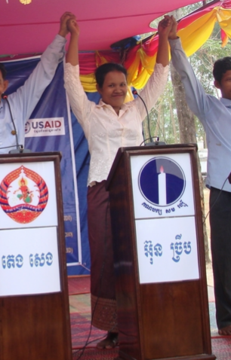
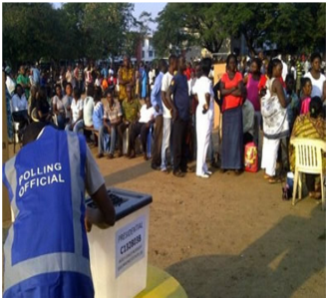
THANK YOU
Photo Source: NDI

