Slide 1
VAW-E VICTIM REFERRAL SYSTEMS: WHAT THEY ARE & HOW THEY SHOULD WORK
Gender, Women and Democracy, NDI
2016
Notes:
This tool was adapted by Caroline Hubbard and Claire DeSoi with permission from:
Chitra Nagarajan
Nigeria Stability and Reconciliation Programme
December 2015

Slide 2
Introduction to This Tool
This presentation was adapted from guidance developed by the Nigerian Stability and Reconciliation Programme
The guidance was originally crafted for developing victim referral systems for survivors of gender-based violence (GBV) and has been slightly adapted to guide election observers when monitoring and dealing with victims of VAW-E

Slide 3
Introduction to This Tool
Before observers start recording or asking individuals to disclose information about their experiences of violence, they must develop a system to refer cases to services that will support survivors
Referral systems are critical for coordinating service delivery and facilitating survivors’ access to services
Observer groups have a responsibility to identify services that are available and to connect women with those services

Slide 4
What Are Referral Systems?
A comprehensive system for referring cases of violence against women in elections (VAW-E) that observers witness or hear about to services that provide help to survivors. A referral system should:
✓ Coordinate service delivery
✓ Facilitate access to high quality and timely services for survivors
✓ Enable survivors to define their own needs and make their own decisions
It is important to increase quality and timeliness of care -- not just increase the number of cases referred

Slide 5
Guiding Principles for Referral Systems
Permission of survivor is required to take action
The safety and security of survivor must be prioritized
Ensure anonymity and confidentiality
Keep number of people who know of a case to a minimum
Do not use survivors’ names and faces
Ensure security of data
Provide a space that is safe and confidential
Follow local child protection guidelines and principles and ensure a trusted caregiver accompanies survivor if they are under 18
Do not force survivor to report incident to authorities
Offer survivors as many options as possible, and support them throughout process
Be survivor-centric (i.e. what works best for survivors)

Slide 6
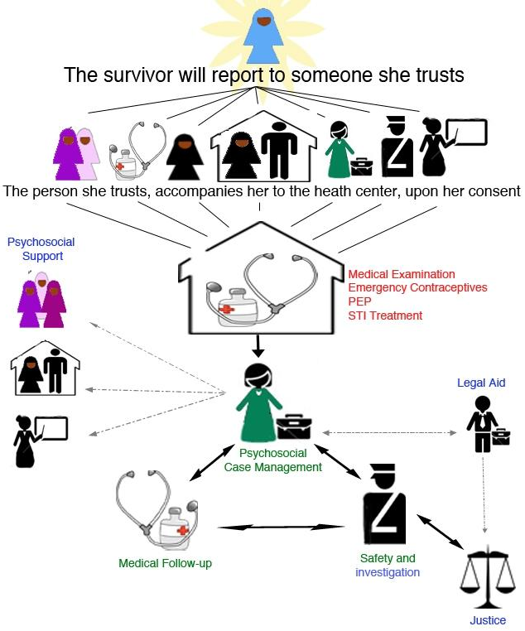
Developing Referral Systems
Key principles:
Anonymity
Confidentiality (including protection and security of data collected)
Child protection
Safety and security
Survivors decide what course of action they want to take

Slide 7
Developing Referral Systems
It is important that referral systems engage women and girls, community members and service providers to regularly assess, update and change referral pathways to reflect changing contexts or needs
Changes may be needed if there are shifting conflict dynamics (e.g. an increase in internally displaced persons)
Services that are of low quality, do not abide by local protection guidelines, or are otherwise problematic should be removed
Educate and engage others in your constituencies and organizations about the referral system -– especially how to report and how to support survivors
Connect and coordinate with others -– individuals, coordination bodies, working groups
Raise awareness about existence of the observation and how to report incidents among general public

Slide 8
Linking With Others
Who else provides services that a citizen observation group can link with to develop referral systems and pathways?
- Are there other organizations?
- Individuals?
- Institutions?
What other coordination bodies or working groups can a citizen observation group link with to ensure an effective referral system?

Slide 9
THANK YOU

