Slide 1
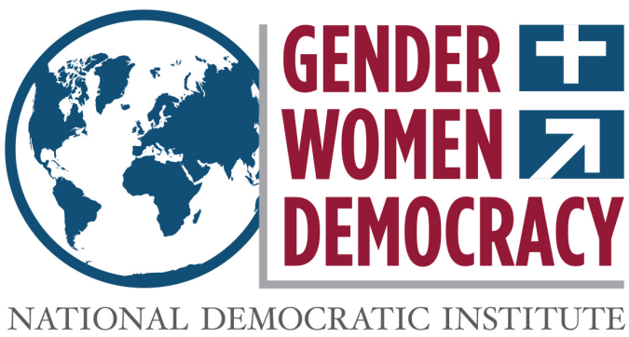
VIOLENCE AGAINST WOMEN IN ELECTIONS (VAW-E) Strategies for Change
Gender, Women and Democracy
NDI, 2016
Notes:
This tool was developed by Caroline Hubbard and Claire DeSoi for NDI's Votes Without Violence program and toolkit.

Slide 2
Strategies to Address VAW-E
VAW-E within VAW-P
When developing an advocacy strategy for VAW-E, it is important to understand that the issue of violence toward women in the electoral cycle sits within the broader problem of violence against women in politics (VAW-P).
Short and long term advocacy strategies need to be developed to address the problem, which is a key barrier to women’s political participation.

Slide 3
Strategies to Address VAW-E
Observation:
Data collection, awareness raising and education
Electoral Frameworks:
Implementing institutional change to processes, rules and actors
Political Parties:
Shifting norms and protocols within political parties
Legal Instruments:
Creating new legal frameworks or building upon existing instruments
Sociocultural Norms:
Advocating for change in gender norms that reinforce women’s subordinate status

Slide 4
Strategies to Address VAW-E
Data, Awareness, Education
Law enforcement, election officials, political parties and the public need to know VAW-E is an issue
They should know that it impacts not only women’s electoral participation but also the democratic quality of elections
There is a need to build understanding among stakeholders of an expanded definition of electoral violence that includes gender-based electoral violence.

Slide 5
Strategies to Address VAW-E
Increase Data Collection
Election observation: Citizen election observers can collect and distribute important data about VAW-E
Observer groups can also create partnerships and networks to monitor, document and address issues of violence against women in politics at the local, national and regional levels
Technology: The use of internet and communications tools can encourage anonymous reporting of incidents
Anonymity is critical for data collection on violence against women
Hotlines/Focus Groups: Can provide information on violence within insular communities or protected spaces (for example, political parties)
Crowdsourcing can provide a greater spread of data but also brings challenges: for example, in verifying incidents

Slide 6
Strategies to Address VAW-E
Increase Data Collection
In Ecuador, the Association of Women at the Municipal Level established a call center with legal and political advisors to provide free advice. Through this initiative they were able to collect testimony from local councilors who had experienced discrimination and used this information to develop draft legislation against harassment and gender-based political violence.
In Nigeria, a hotline started by the International Federation of Women Lawyers (FIDA) collected reports of VAW-E from callers during the 2015 state-level elections, which were evaluated by a response team for immediate action.

Slide 7
Strategies to Address VAW-E
Public Education and Awareness Raising
During an election cycle, public education campaigns can be conducted at the grassroots level to prevent acts of violence against women
Awareness raising among political leaders, election management, community and religious leaders, etc. is important to prevent violence
Awareness raising can be complemented by election-cycle advocacy for policy or process changes.

Slide 8
Strategies to Address VAW-E
Awareness Raising
CSOs can initiate awareness raising tools such as political party “score cards”
In Nigeria, The Women Advocates Research and Documentation Center monitors and ranks parties’ adherence to gender mandates in law and party governance
Score cards can be used to monitor parties’ respect for the rights of women to participate in elections without fear of violence

Slide 9
Strategies to Address VAW-E
Electoral Framework
Electoral framework: Policies and legislation can be changed or created to prevent and punish VAW-E
Electoral actors: Action can by taken by election management bodies (EMBs), political parties or candidates and influential political leaders to increase accountability for VAW-E, prevent it or raise awareness about it

Slide 10
Strategies to Address VAW-E
Electoral Framework
Electoral framework refers to the full set of legislation that relates to and influences elections
It is not only election law and EMB policies, but also the constitution, political party law and other legislation that impacts how candidates and media function or are regulated (for example, campaign finance regulations)
These are all part of the overall electoral framework and have a gendered impact

Slide 11
Strategies to Address VAW-E
Electoral Processes and Actors
EMBs (such as electoral commissions) should implement electoral policies and procedures to counter VAW-E and to empower women in electoral administration and process
Civil society has an important role to hold EMBs accountable and to advocate for changes in the electoral framework to ensure women’s safe participation

Slide 12
Strategies to Address VAW-E
Electoral Processes and Actors
Civil society can advocate for EMBs to have policies in place to protect women observers, election administrators and voters from violence during the registration process
Organizations can evaluate what is needed by investigating key questions, such as:
Are there mechanisms to enforce policies to protect women’s participation?
Are there reporting procedures in place?
Do these procedures provide for timely resolution of issues or complaints?
Are there requirements to release public reports and statistics about such procedures and their operation?

Slide 13
Strategies to Address VAW-E
Electoral Processes and Actors
Political parties can be platforms for VAW-E to occur, but can also take action against it
Internal party policy should be revised to counter VAW-E and promote women’s participation
Political parties should implement internal rules to counter VAW-E and to promote women’s participation.
Recognize and penalize behavior
Create safe reporting mechanisms for victims
Punish perpetrators

Slide 14
Strategies to Address VAW-E
Voluntary and Individual Actions
Candidates can take public pledges to denounce violence and ensure women’s safety during elections as voters, workers and candidates
Political parties can also make public pledges or agree to abide by voluntary codes of conduct: these can be across party lines or made individually by political leaders

Slide 15
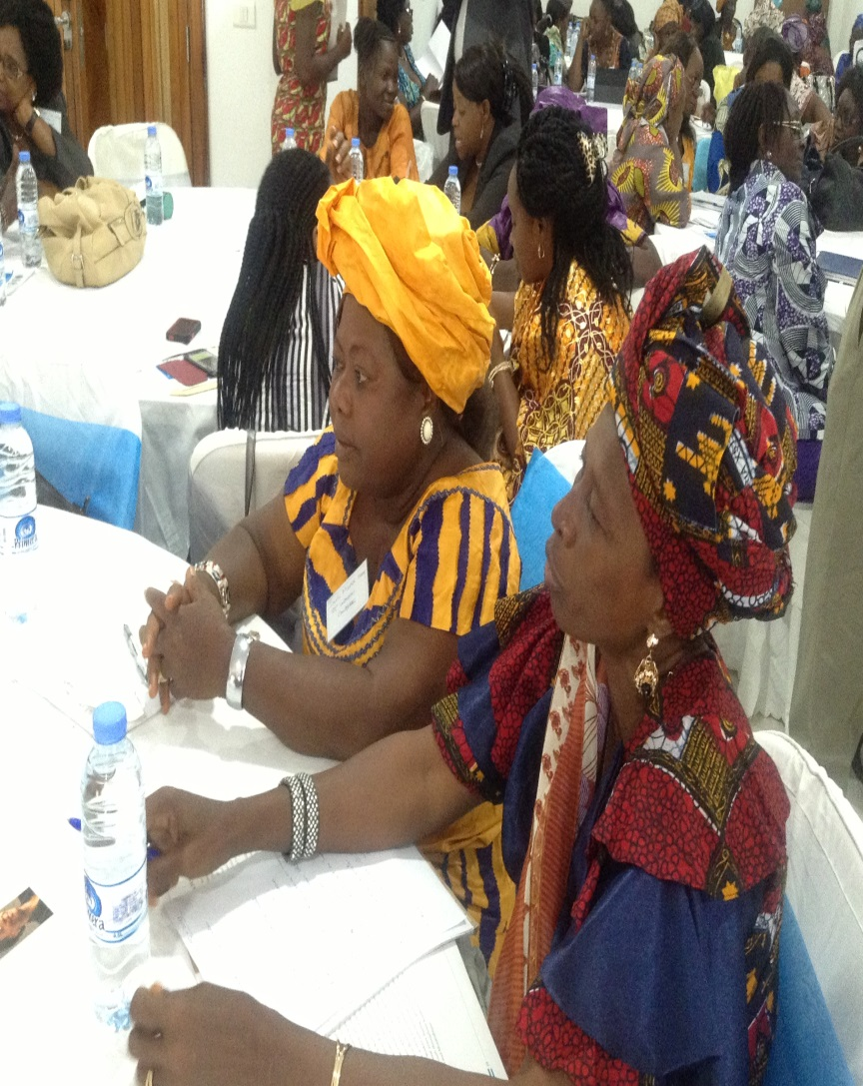
Strategies to Address VAW-E
Voluntary and Individual Actions
In Sierra Leone, eight parties signed an “open and safe election pledge” that strictly opposed all forms of violence and intimidation so that all women would be free to participate in the elections
Photo Credit: NDI
Notes:
For more information, see: http://fidakenya.org/?page_id=27

Slide 16
Electoral Processes and Actors: Voluntary and Individual Actions
Codes of conduct:
Can be created inside parties or across parties
Can be created by EMBs
Aim to prohibit VAW-E
These codes can oblige parties or EMBs to have internal reporting and resolution mechanisms, or direct complaints to external actors to consider and adjudicate
Notes:
For more information, see: http://fidakenya.org/?page_id=27

Slide 17
Strategies to Address VAW-E
VAW-E/P Legislation
Specific legal protections can be developed to respond to VAW-E/P, including the modification and implementation of related laws
There is a need for legal protections that recognize and prohibit gendered political violence
To implement these laws properly, police officers, judges and other electoral stakeholders, such as poll workers may require training on identifying VAW-P and how to respond to incidents
In the absence of a specific law on VAW-P, existing laws that do not mention political violence but prohibit domestic or gender-based violence offer a precedent for gender-sensitive electoral security

Slide 18
Strategies to Address VAW-E
VAW-P Legislation: Example
Bolivia has the first and only laws prohibiting violence against politically active women
It was passed in response to a 12-year campaign led by the Association of Female Councilors and Mayors of Bolivia (ACOBOL)
During the campaign, ACOBOL collected more than 4,000 claims of harassment filed by elected women over eight years
The law defines crimes and offenses considered to be acts of political harassment and violence, and obliges the state to prevent these behaviors
It explains how victims, their relatives or any other person can denounce these acts, verbally or in writing, and stipulates punishments for offenses

Slide 19
Strategies to Address VAW-E
VAW-P Legislation: Example
Proposed legislation in several countries has sought to highlight problems of violence in the culture of elected bodies themselves
Costa Rica
A female staff member accused a male deputy of sexual harassment and tried to sue him, but parliamentary immunity was invoked
Female deputies from two parties introduced a bill to remove immunity in cases of harassment, proposing to extend existing laws against sexual harassment in the workplace to elected officials
Under the proposal, those convicted of VAW-P would not be able to serve in public office in the future

Slide 20
Proposed Bills
To date, three other countries in Latin America have considered bills on violence against women in politics:
Ecuador (2011)
Mexico (2014)
Peru (2015)
Mexico has not passed a law, but has established a protocol to guide reporting procedures and generate coordination between institutions in responding
Notes:
For more information, see: http://www.parlamericas.org/en/group-of-women/political-violence.aspx

Slide 21
Common Elements of Bills and Laws on VAW-P
Aims: What the bill/law is trying to achieve
Justification: What national and international provisions it is based on
Definitions: How it defines political violence and harassment against women
Examples: How it explains what constitutes violence against women in politics
Penalties: How perpetrators of violence against women are punished

Slide 22
Common Elements: Aims and Justification
The aims of these VAW-P laws are in line with many previous national or regional agreements created to prevent the problem
The justifications for these bills/laws can also be traced to state constitutions and international laws that guarantee equal rights for all citizens, regardless of gender
Laws against VAW-P can be in response to advocacy efforts such as in Bolivia, and advance the goals of civil society organizations to defend against VAW-P and maintain women’s political, civic and civil rights
Notes:
Source: Under “Objectives”: http://www.unwomen.org/mdgf/C/Bolivia_C.html

Slide 23
Common Elements: Definitions and Examples
Violence against women in politics differs from violence against women or political violence
VAW-P is a distinct form of violence because it targets women because they are women to deter their political participation
As a result, defining what VAW-P is and looks like has become a prominent feature of these laws
Providing examples is also a good way to describe forms of violence that are less commonly thought of, such as economic violence

Slide 24
Common Elements: Punishments
Violence is often seen as a normal part of life. In politics, it is seen as a “price to pay” to become involved in political systems.
Because these laws and bills aim to reduce and eventually eliminate all forms of VAW-P, a critical element includes punishment for these acts.
Many of these laws prescribe jail sentences for an offender, varying from a few months to a several years.

Slide 25
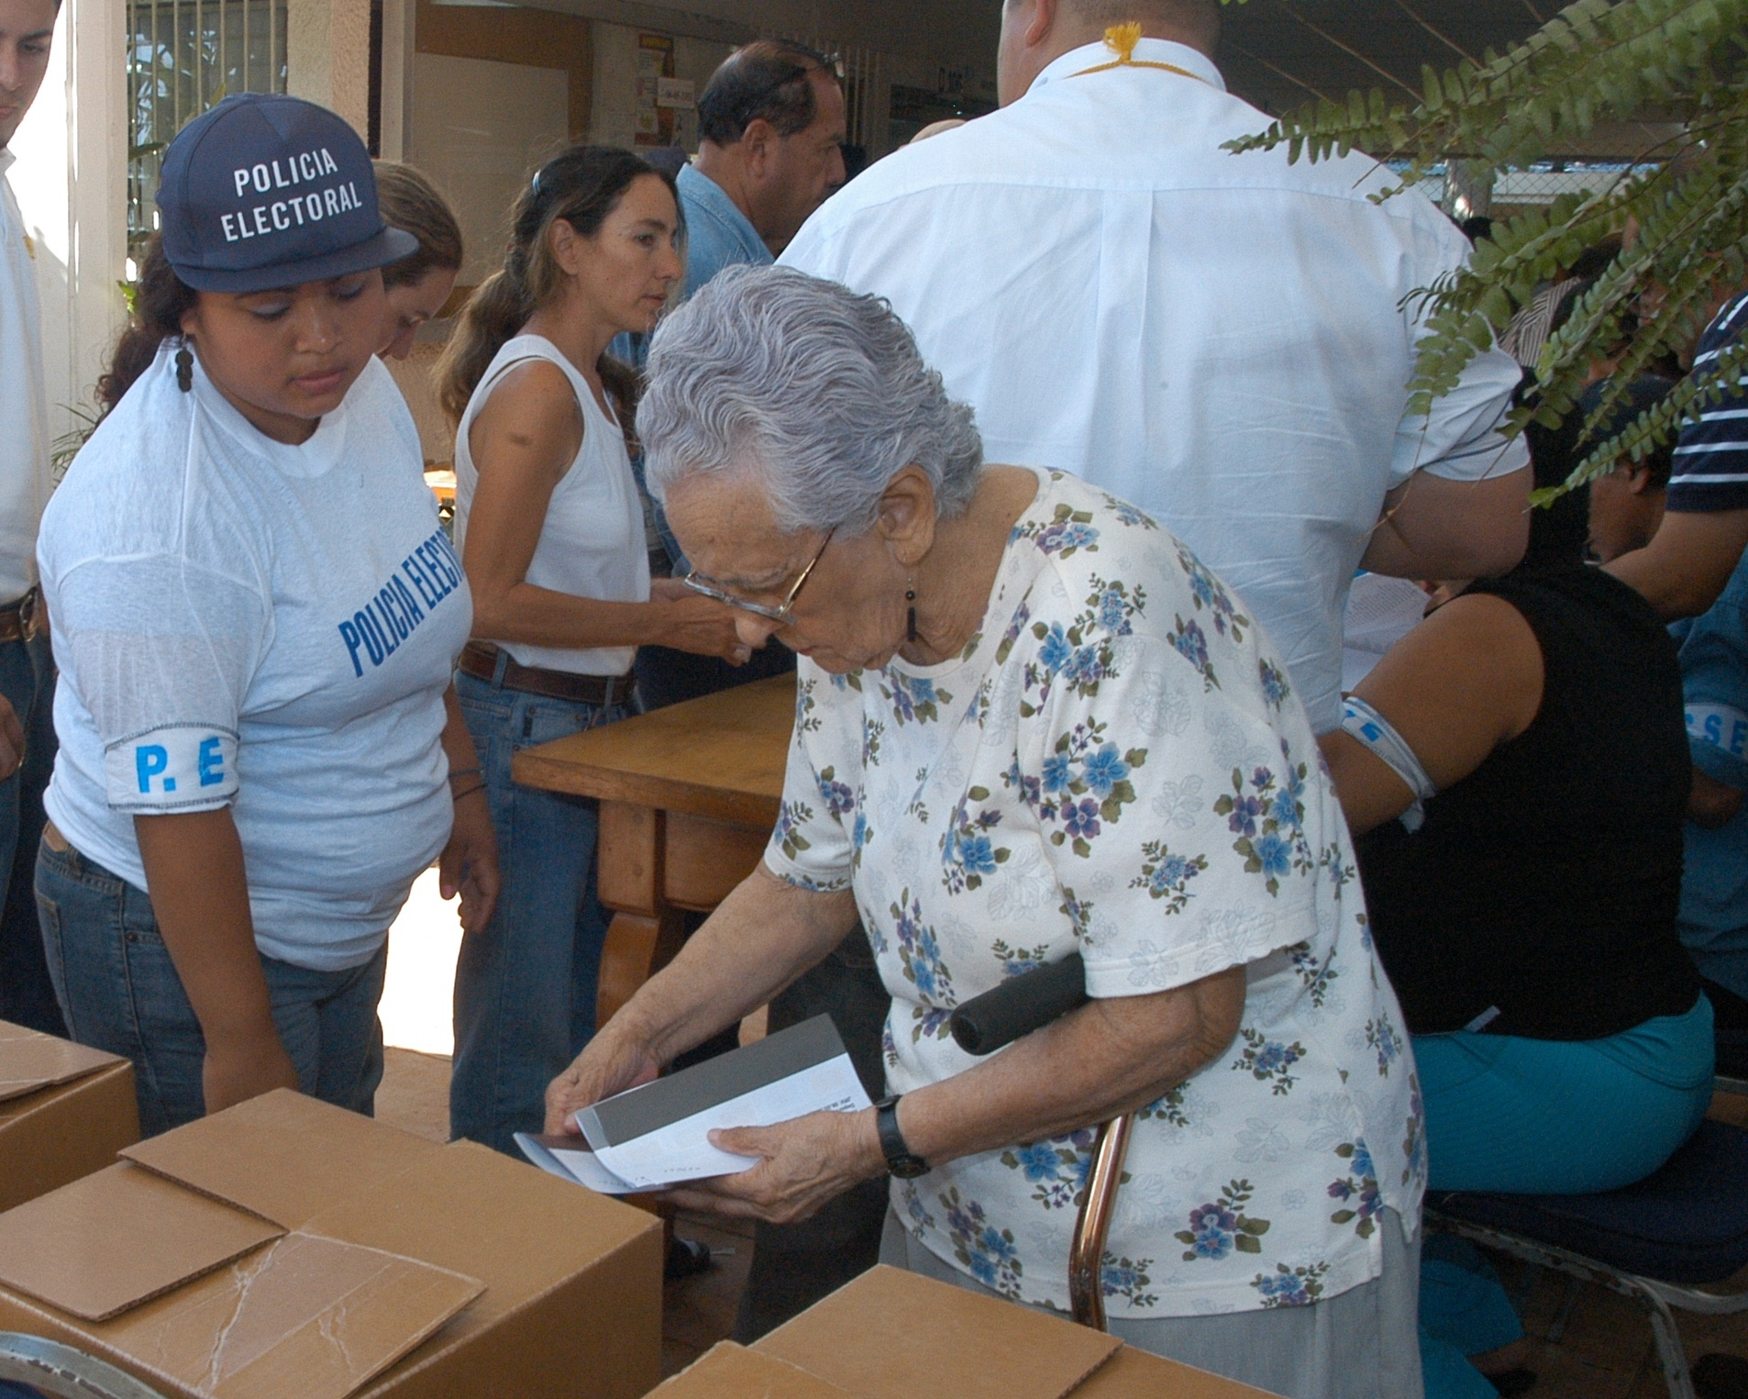
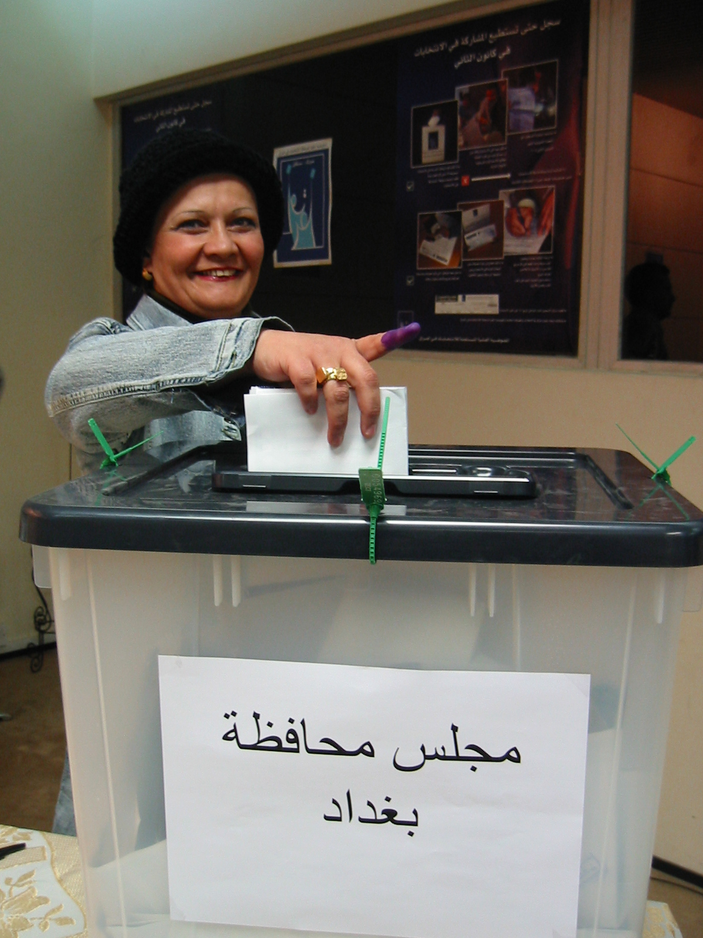
Thank you

