Slide 1
VIOLENCE AGAINST WOMEN IN ELECTIONS On Election Day
Gender, Women and Democracy, NDI
2016
Notes:
This tool was developed by Caroline Hubbard and Claire DeSoi for NDI's Votes Without Violence program and toolkit.

Slide 2
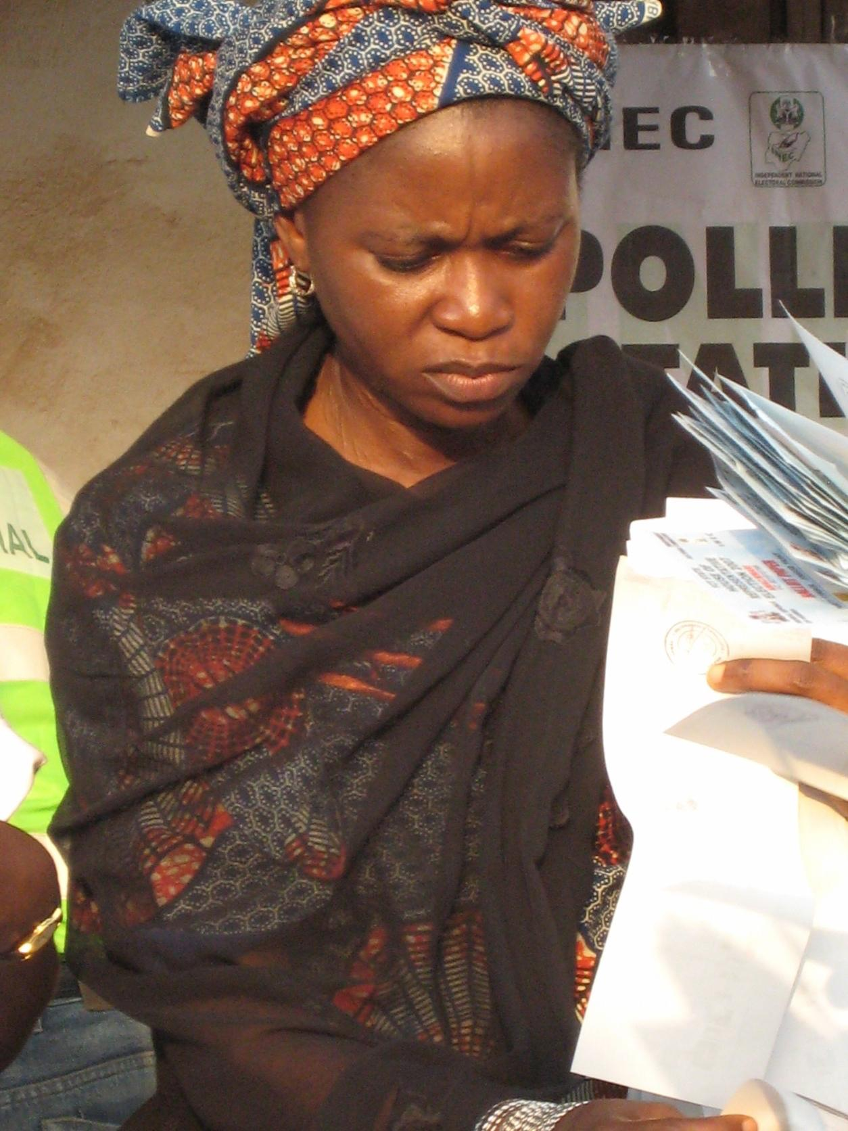
Violence Against Women in Elections: Topics
Key definitions
Gender-based VAW-E versus other electoral violence
Root causes, triggers, categories and indicators of VAW-E
Observing VAW-E on Election Day
Photo Credit: NDI

Slide 3
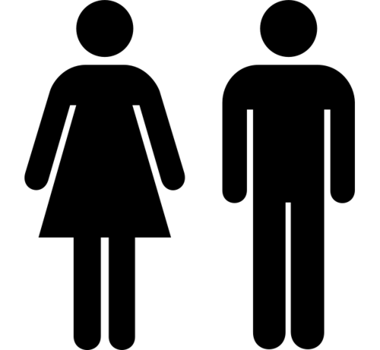
Key Terms
Sex
Gender
Gender Equality
Gender Equity
Notes:
TRAINER NOTE: See if people want to define these terms, or go around the room and ask participants to define them as a participatory activity.
Gender: Refers to the socially determined differences between women and men that are learned, changeable over time and have wide variations both within and between cultures.
Sex: Refers to the biological characteristic that categorize someone as either male or female. These characteristics are generally universal and determined at birth.
Gender Equality: Equality means that women’s and men’s rights, responsibilities and opportunities will not depend on whether they are born male or female.
Gender Equity: Provisions should be made to redress inequality before women can take advantage of the opportunities provided, creating equality of process and outcome.

Slide 4
Why Observe VAW-E?
To meet standards of integrity, democratic elections should be inclusive, transparent and accountable
Inclusive elections are those that enable men and women to participate in their own conscience, in representative numbers, and without fear of reprisal
The principle of inclusion requires positive action to address particular barriers women might face

Slide 5
Why Observe VAW-E?
Throughout the electoral period, observers have a responsibility to assess the participation of women as an integral part of the participatory quality of the election.
Observation should determine whether there are laws, regulations, policies and procedures to ensure that men and women can, under equal conditions, participate as:
Voters
Candidates
Election administrators
Observers
Party agents
Candidates, party representatives or supporters

Slide 6
Violence Against Women in Elections (VAW-E)
VAW-E is used as a targeted and destructive tool in various ways throughout the electoral cycle to dissuade or influence the participation of women as candidates, voters, election officials, observers, poll watchers and activists.
This has critical implications for the integrity of the electoral process.
When women are prevented from participating fully and equally in elections—voting, campaigning or exercising their political rights—democratic processes are nullified.

Slide 7
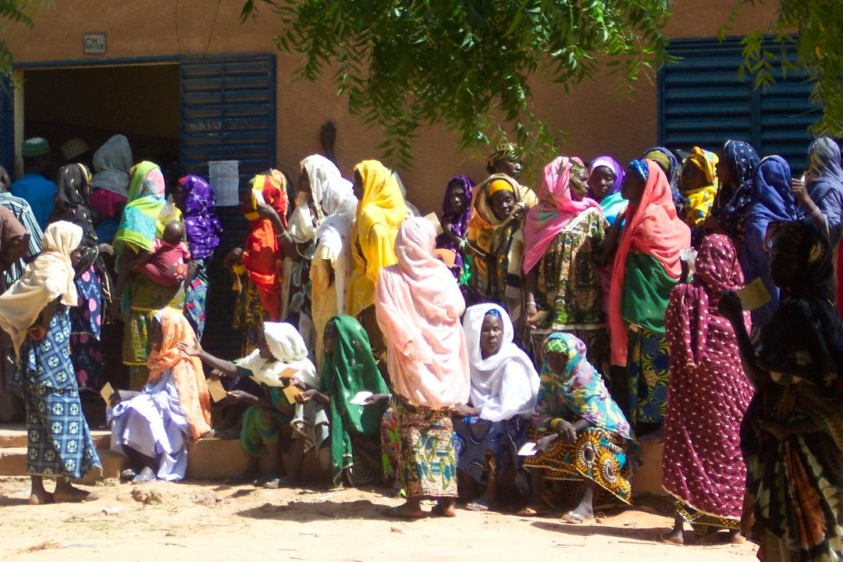
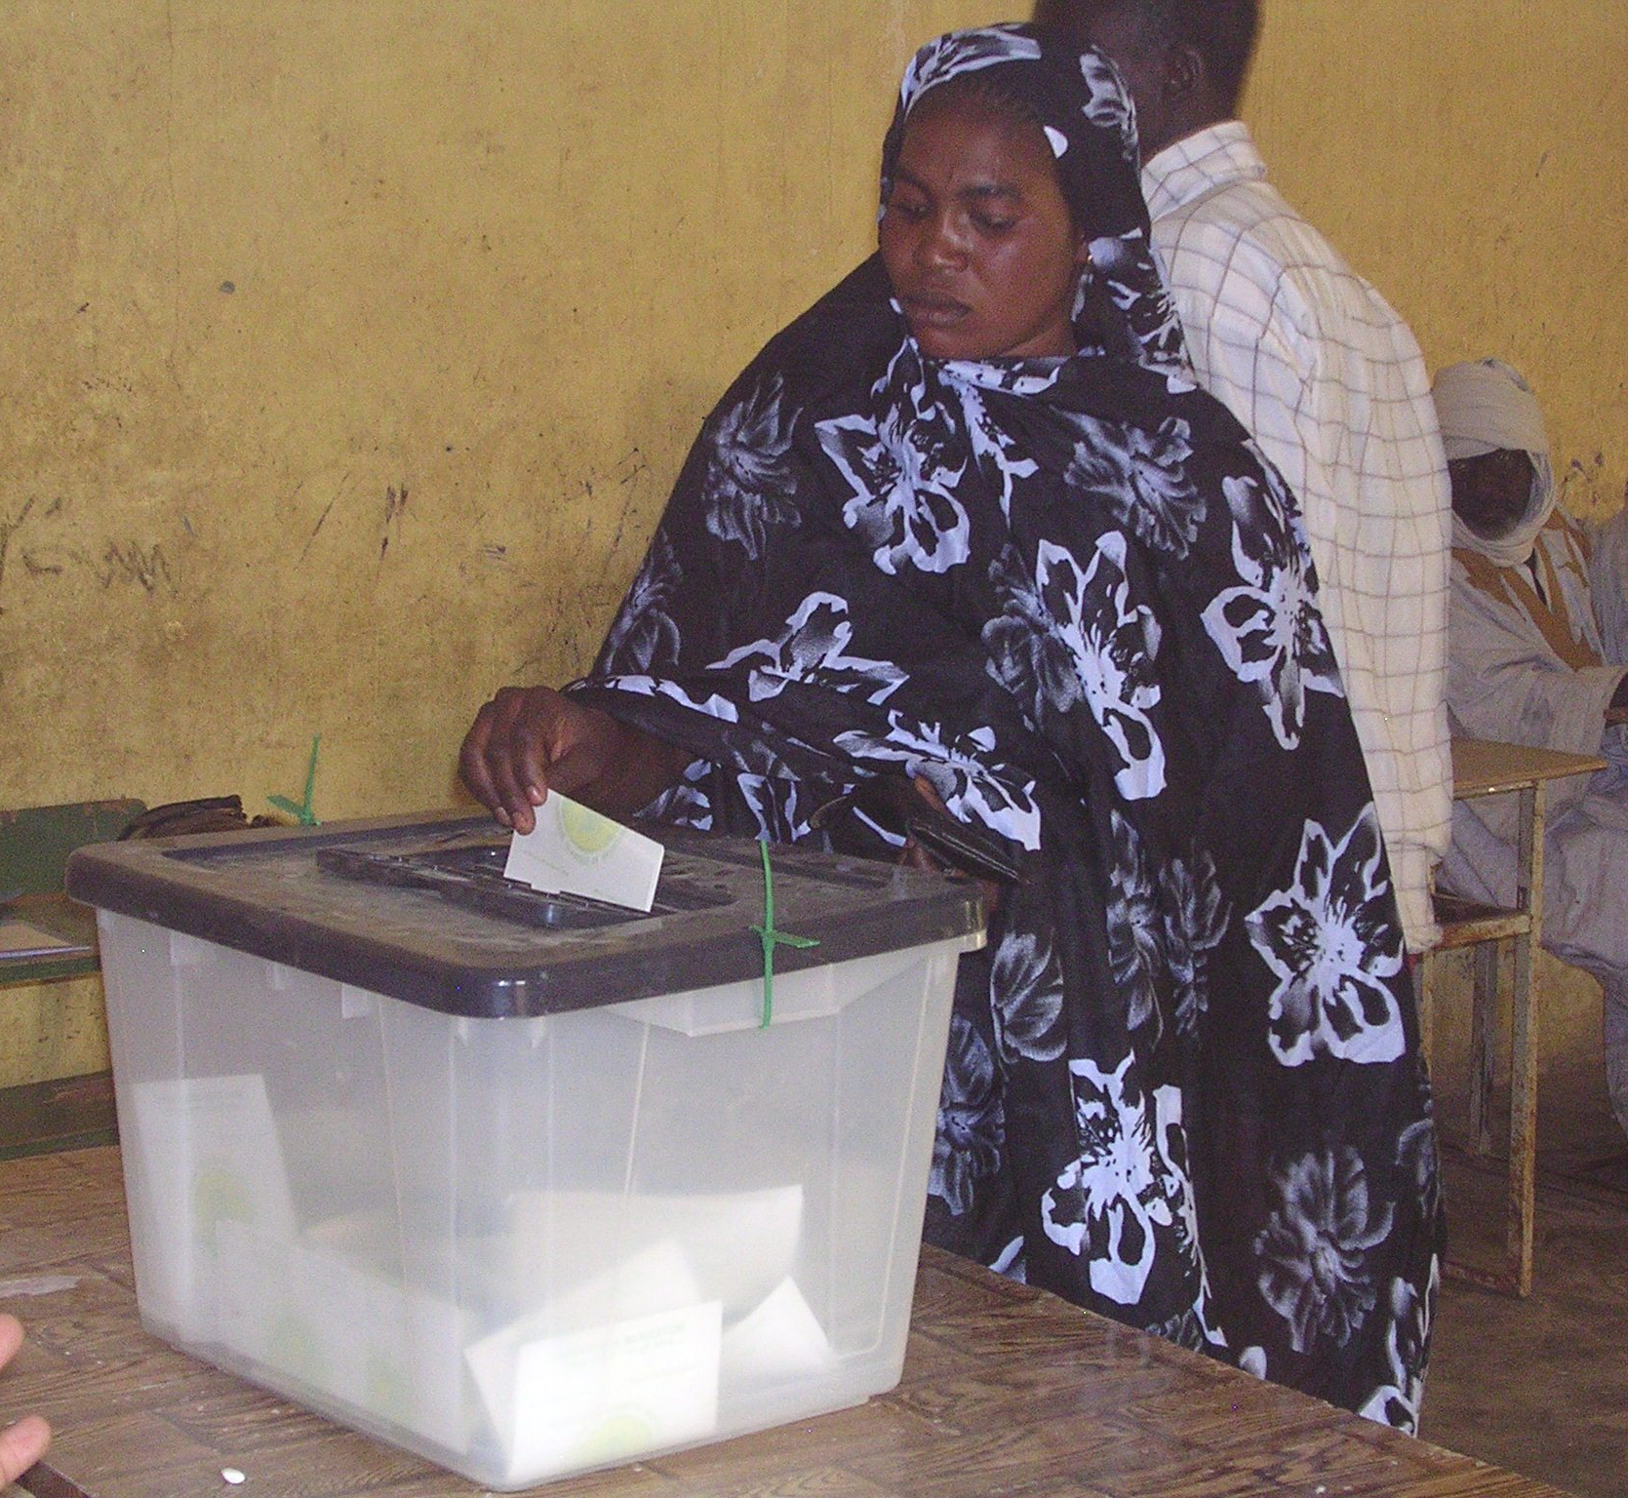
Key Definitions
Violence Against Women + Electoral Violence = Violence Against Women in Elections (VAW-E)
Photo Credit: NDI
Photo Credit: NDI

Slide 8
Key Definitions
The UN defines violence against women as ANY ACT of gender-based violence that results in, or is likely to result in, physical, sexual or mental harm or suffering to women, including threats of such acts, coercion or arbitrary deprivation of liberty, in public or in private life.

Slide 9
Violence Against Women in Elections (VAW-E)
Violence against women in elections is any act of gender-based election violence that is directed primarily at women because of their aspirations to seek political office, their link to political activities (such as working as election officials or attending campaign rallies) or simply their commitment to vote; as well as any use or threat of force to harm persons or property with the intention of influencing the electoral process that has a disproportionate or different impact on women because of their marginalized and vulnerable status in society.

Slide 10
Violence Against Women in Elections (VAW-E): The Role Of Observers
Election observing organizations can make VAW-E visible so that it can be addressed in the short-term, and solutions can be identified in the long-term
Monitoring violence throughout the electoral period can also be a way to mitigate violence by raising awareness, facilitating response to violence and potentially increasing the security and/or perceived security of an election

Slide 11
Violence Against Women in Elections vs. Other Electoral Violence
Although men and women may be victims of electoral violence, such as murder, harassment and coercion, traditional definitions do not capture additional acts and threats perpetrated against women because they are women.
Gender norms shape how and why women are subject to electoral violence, as well as what types of acts are pursued to curtail or influence their participation.

Slide 12
Violence Against Women in Elections vs. Other Electoral Violence
Gender refers to the socially determined differences between women and men that are learned, changeable over time and have wide variations both within and between cultures.

Slide 13
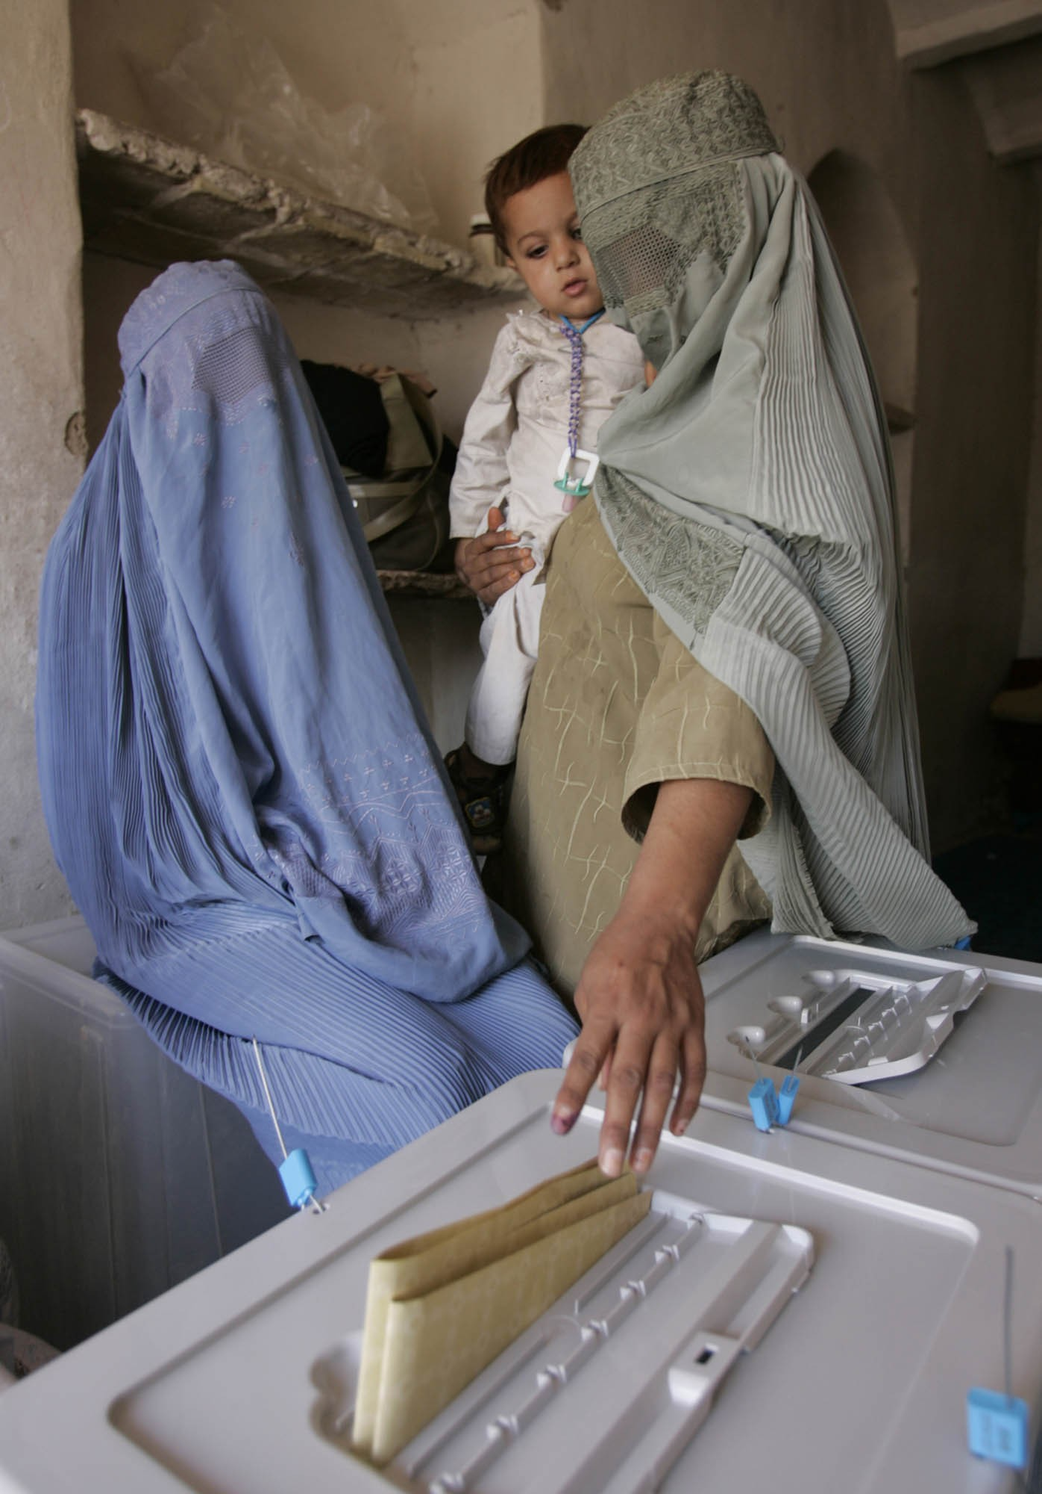
Violence Against Women in Elections vs. Other Electoral Violence
Non-gender motivated electoral violence can still have a disproportionately high impact on women because of their subordinate status in society and their increased vulnerability
Photo Credit: NDI

Slide 14
Violence Against Women in Elections Versus Other Electoral Violence
Though men and women were both victims during Cote d’Ivoire’s 2010/11 post-election violence, research by the Organisation des Femmes Actives de Cote d’Ivoire (OFACI) revealed women were often the first victims of party reprisals because they could not escape as easily as men
Women were home caring for children and thus more likely to be present to be victimized; they also had more difficulty escaping quickly with children

Slide 15
Violence Against Women in Elections Versus Other Electoral Violence
“….I was coming home from demonstration with other women, they stopped us…Some ran away but since I had a child, they caught me…We were a group but because of my daughter I could not run…They threw my child, tore my clothes…”
Testimony of a 23 year old Woman in Cote d’Ivoire - OFACI

Slide 16
Violence Against Women in Elections Versus Other Electoral Violence
Unlike men, women are more likely to experience familial or social intimidation in the private sphere and violence and intimidation from members and leaders of their own political party.
They are more often victims of sexual violence.
They are more vulnerable to non-physical harassment and intimidation than men.
The goal of such violence is directly aimed at upholding gender norms and traditional female roles, dissuading women from participation in political processes.
Women are more often victims than perpetrators of such violence.
The violence done to women is less “visible”/less often viewed as violence or as political.

Slide 17
Root Causes Of Violence Against Women in Elections
Culture of violence: political or other
Opposition to women’s leadership
Discriminatory and patriarchal structures and attitudes
Absence of supportive administrative and judicial structures—inadequate rule of law and governance institutions
Non-criminalization of violence against women/culture of impunity
Subordinate status and increased vulnerability of women
Intersection of inequalities and marginalization

Slide 18
Violence Against Women in Elections: Categories
VAW-E can occur in a variety of ways, perpetrated by different types of actors throughout the electoral cycle.
Instances range from harassment to murder.
It targets activists, voters, candidates, election administrators and elected women.
It falls into 5 categories: physical, sexual, psychological, threats and coercion, and economic.
Examples vary by country.

Slide 19
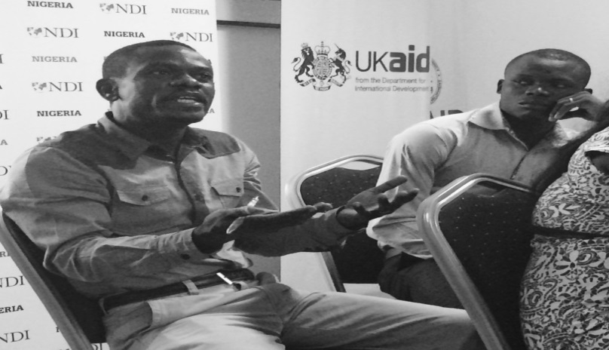
Violence Against Women in Elections: Categories
It is important to identify the specific types of violence that might occur in a particular context or country
In Nigeria, participants identified husbands dragging wives from polling stations and therefore added specific questions about this in their Election Day observation materials
In developing checklists, it is key to identify what is considered a form of violence
What are the types of violence to consider?

Slide 20
Violence Against Women in Elections: Physical
What: Murder and assault: pushing and dragging
Where: In private and public
Victims: Women activists, voters, candidates, election/polling administrators, party agents, observers and candidate representatives
Perpetrators: Family: father, brother, mother; own/opposition party, party militants; security forces; religious groups; organized crime...
Aim: Win inter-party conflict, maintain status quo for women’s role in society, force vote preference, stop womenfrom voting, stop women officials from working
Most visible form of violence

Slide 21
Violence Against Women in Elections: Physical
Libya, 2012: In the post-election period, a woman was killed by Islamists opposing women’s political participation
The woman was mistakenly killed because she bore resemblance to her cousin, a newly elected woman member of parliament
The example from Nigeria of men dragging their wives away from polling stations is less drastic, but perhaps more common on Election Day

Slide 22
Violence Against Women in Elections: Sexual
What: Rape, sexual exploitation, sexual harassment
Where: In private and public
Perpetrators: Family, security forces, warring factions, male politicians, party, religious groups, organized crime, party members, polling workers
Aim: Deter women’s mobilization and participation, force them to vote in certain ways, express anger with process, prevent women from voting

Slide 23
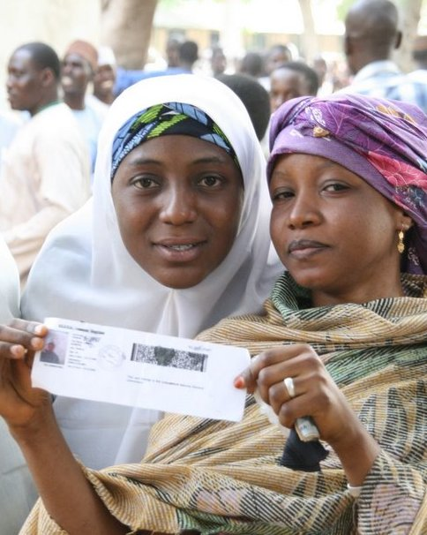
Violence Against Women in Elections: Sexual
Cote d'Ivoire: A survey by an NGO (OFACI) conducted after election violence in 2010/2011, identified 71 rapes, which included young girls , married women, and older women by armed men and other political party affiliates.
In Nigeria, when men and women are forced to line up in the same line to vote, women are sexually molested by men behind and in front of them
Photo Credit: NDI

Slide 24
Violence Against Women in Elections: Psychological
What: Slander, character attacks, harassment by media, insults equating women participating in politics with immoral practices, hate speech
Victims: Women voters, party/polling agents, candidates and candidate reps, observers
Where: In private and public
Perpetrators: Opposition party/own party, male politicians, media, social media, family-husband, brother, father, religious leaders, election workers
Most pervasive form of VAW-E, but least visible

Slide 25
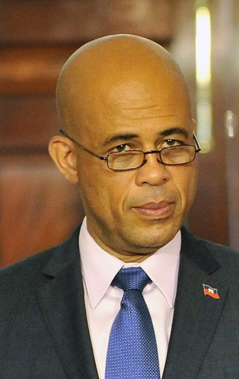
Violence Against Women in Elections: Psychological
Haiti, 2015 : President Martelly was speaking on behalf of his party at a public rally when a woman accused his government of incompetence and complained that he had not managed to bring electricity to their community
He dismissed her by saying "pick a man and go into the bushes" -- implying she needed to go have sex
Many have seen this not only as verbal abuse, but "sexual assault”
Photo: Wikipedia Commons

Slide 26
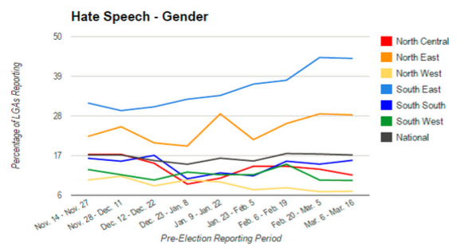
Violence Against Women in Elections: Psychological
This graph shows data collected by observers in Nigeria, divided by state. It records the percentage who witnessed or heard reports of hate speech against female candidates because of their gender
It illustrates that gender-based hate speech was higher in SE and NE Nigeria

Slide 27
Violence Against Women in Elections: Psychological
Aim: Prevent women from taking an active leadership role in public life, and maintain and increase the male dominated power structure
Impact on process: Prevents women from feeling as if their participation is important and will be reflected in policy
Making comments against one woman or taking violent action against one woman can have repercussions for all women.

Slide 28
Violence Against Women in Elections: Threats & Coercion
What: Threats, false accusations, intimidation, false gauge of environment (such as leading women to believe that it is dangerous for them to vote), blackmail and pressure
Victims: Voters, party agents, poll workers, observers, candidate reps, rally participants/activists
Where: In private and public
Perpetrators: Husband, father, brother, security forces, party leaders/members, religious groups, poll workers

Slide 29
Violence Against Women in Elections: Threats & Coercion: Examples
A threat to divorce, deprivation of resources, or physical violence by a husband to force his wife’s preference for voting
Someone entering the polling station with their wife/daughter/family member can be a threat because the vote is no longer secret
Male party members standing at the door or in the polling station can be a threat
Verbal attacks on voters or officials at a polling station
Unauthorized people in polling stations

Slide 30
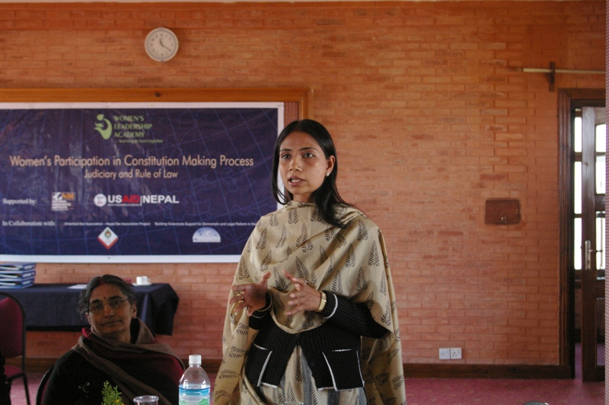
Violence Against Women in Elections: Threats & Coercion
Pakistan, 2015: Local community leaders made an agreement with each other to prevent women from voting in the District Council elections.
Mosques issued alerts for women with a threat that they would be harmed if they attempted to vote
Women who went to vote at the polling station were blocked by men wielding batons
Photo Credit: NDI

Slide 31
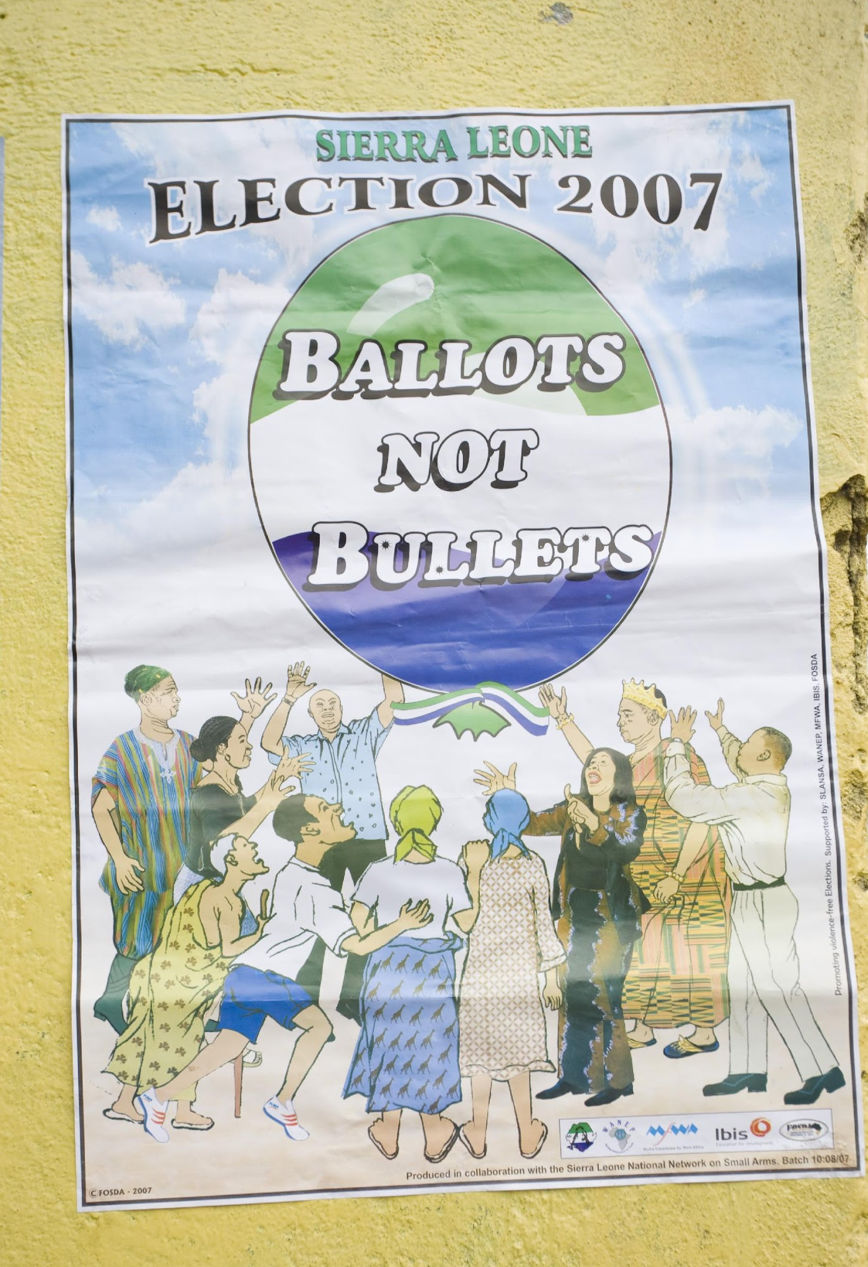
Violence Against Women in Elections: Threats & Coercion
Aim:
Deter women from voting
Diminish or deter women’s participation in electoral processes, including election administration
Deter women from expressing their own political viewpoints or priorities
Photo Credit: NDI

Slide 32
Violence Against Women in Elections: Economic
What: Economic control, denial of or delay in providing financial resources, property damage
Where: In private and public
Victims: Women candidates, voters, activists, election administrators, elected women
Perpetrators: Family, own/opposition party members and leaders, officials
Aim: Block/restrict women’s access to resources available to men to prevent their expression of political viewpoints/priorities, prevent competition

Slide 33
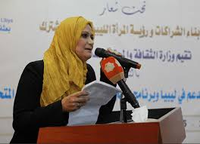
Violence Against Women in Elections: Economic
Pakistan: Reported that in past elections posters containing female candidates’ photos were destroyed, while posters with male candidates’ photos were left undisturbed.
Targeted property damage further reduces the economic resources available to women candidates, which impacts their electability directly
Photo Credit: NDI

Slide 34
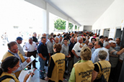
Violence Against Women in Elections: What Can We Measure?
Election Day Observation
Photo Credit: NDI

Slide 35
Violence Against Women in Elections: What Can We Measure?
Participation: All eligible voters have a real opportunity to work, to observe and to vote freely
Accountability: Election procedures are followed to ensure the secrecy of voting, to prevent illegal voting (such as family voting/coerced voting etc.) and to ensure that the will of the voters (not their party or family) is recorded
Transparency: Citizens (both women and men) have the right to be present from the time the poll is preparing to open until it completes operations and closes

Slide 36
Violence Against Women in Elections: What Can We Measure?
Number of election or polling administrators who are women
Representation of women in polling administration leadership
Representation of women among candidate representatives and/or female party pollwatchers
Number of women present for counting and delivering election results after polling stations close
Treatment of women voters, observers, election workers, party agents etc. inside or outside polling stations

Slide 37
Violence Against Women in Elections: What Can We Measure?
Atmosphere inside or near the polling stations and overall security situation
Incidents of threats and intimidation to influence or stop women’s vote
Number of voters turned away, and the percentage of these voters who were women
Whether family voting or forced voting took place
Cases of physical or sexual violence against women voters, polling agents, etc.

Slide 38
Violence Against Women in Elections: What Can We Measure?
An election day observation, including a Parallel Vote Tabulation (PVT) can provide valuable information about any violent incidents occurring inside or near polling stations or in a community on election day:
Type of violence (such as harassment, intimidation or physical violence)
Who perpetrated the violence
Who was targeted by violence
Motivation for the violence
Impact of the violence

Slide 39
Election Day:
What Can We Measure?
What kinds of violence are observed on election day, whether at polling stations or in communities?
- Physical
- Sexual
- Threats / Coercion
- Psychological
- Economic
Who is involved?
- Who is/are the victim(s)?
- Who is/are the perpetrator(s)?
What is the purpose of the violent act?
What impact does it have on the election?

Slide 40
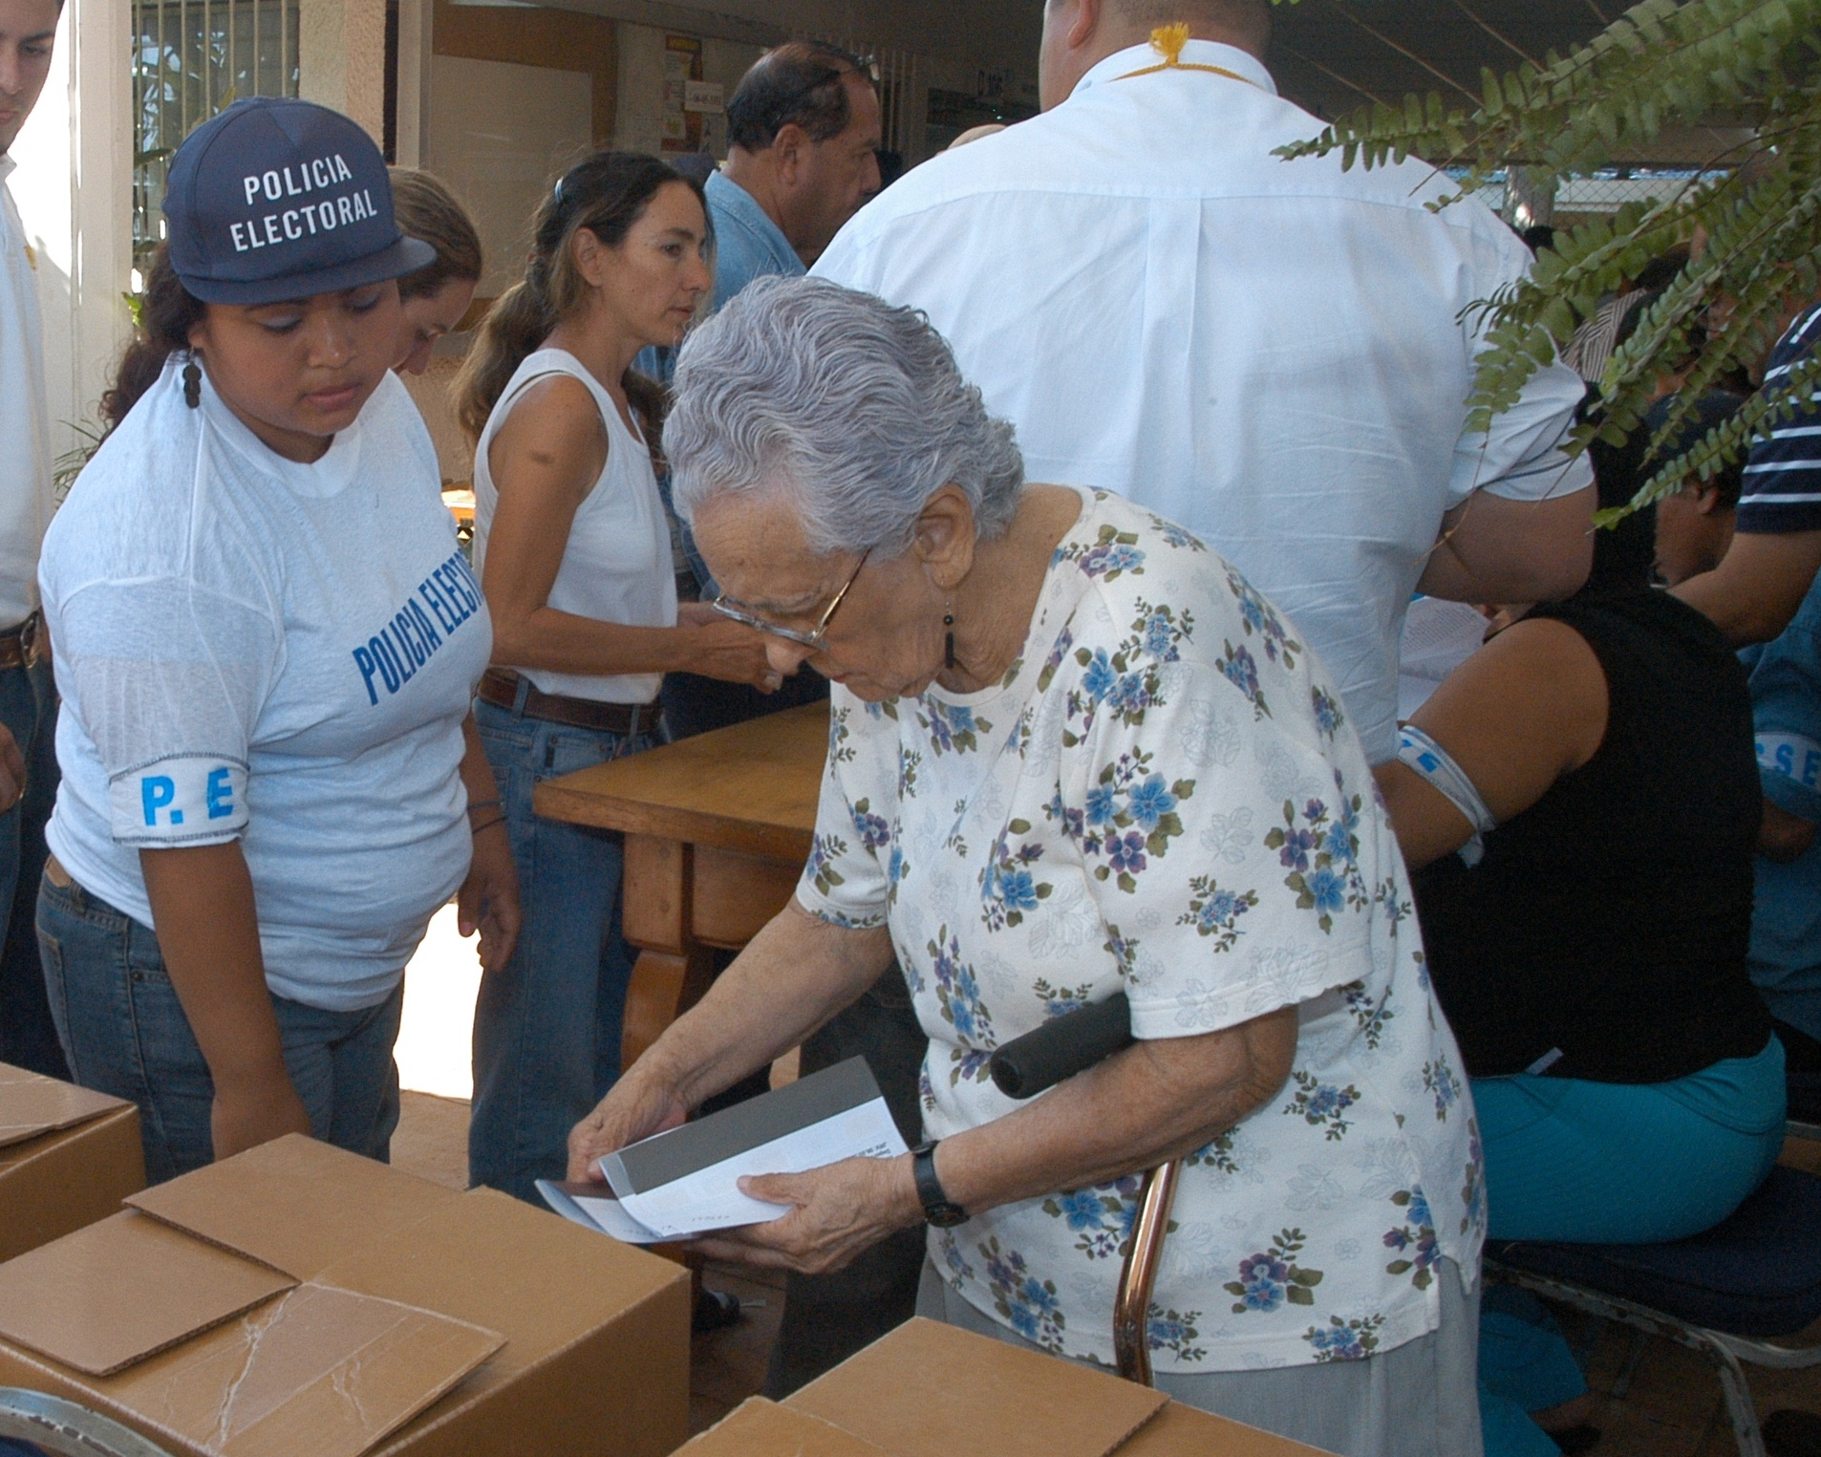
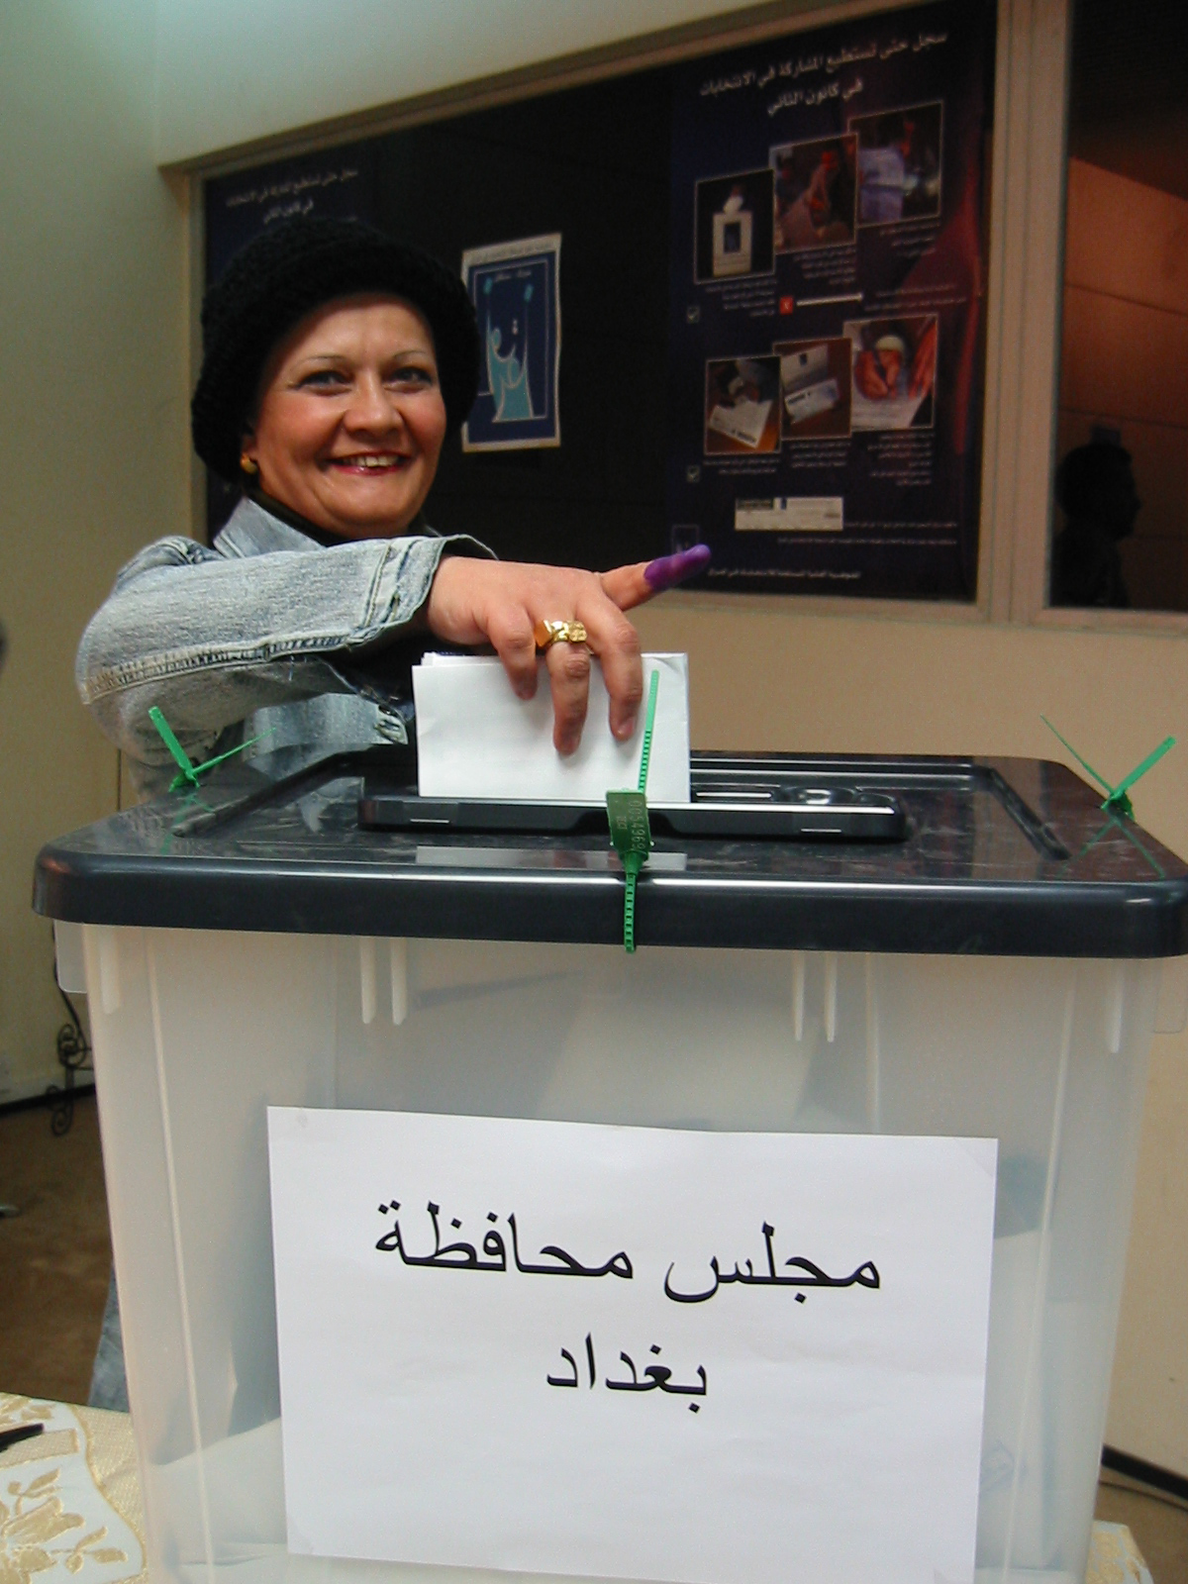
Questions?

