Slide 1
VIOLENCE AGAINST WOMEN IN ELECTIONS Before an Election
Gender, Women and Democracy, NDI
2016
Notes:
This tool was developed by Caroline Hubbard and Claire DeSoi for NDI's Votes Without Violence program and toolkit.

Slide 2
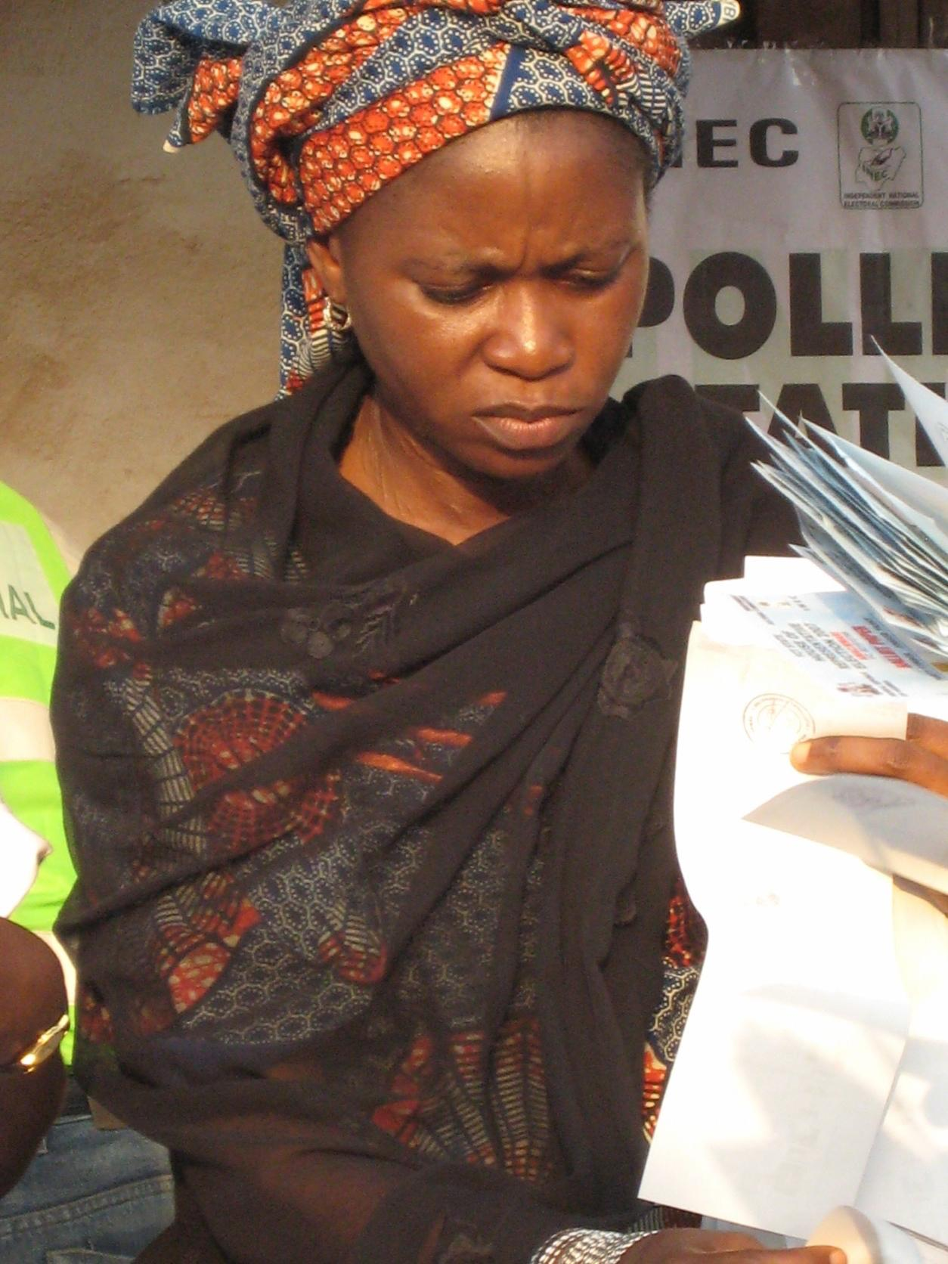
Violence Against Women in Elections (VAW-E): Topics
Key definitions
Gender-based VAW-E versus other electoral violence
Root causes, triggers, categories and indicators of VAW-E
Observing VAW-E during pre-election period
Photo Credit: NDI

Slide 3
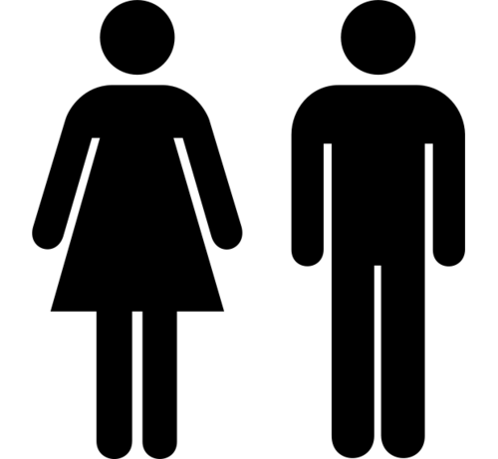
Key Terms
Sex
Gender
Gender equality
Gender equity
Notes:
TRAINER NOTE: See if people want to define these terms, or go around the room and ask participants to define them as a participatory activity.
Gender: Refers to the socially determined differences between women and men that are learned, changeable over time and have wide variations both within and between cultures.
Sex: Refers to the biological characteristic that categorize someone as either male or female. These characteristics are generally universal and determined at birth.
Gender Equality: Equality means that women’s and men’s rights, responsibilities and opportunities will not depend on whether they are born male or female.
Gender Equity: Provisions should be made to redress inequality before women can take advantage of the opportunities provided, creating equality of process and outcome.

Slide 4
Why Observe VAW-E?
To meet standards of integrity, democratic elections should be inclusive, transparent and accountable
Inclusive elections are those that enable men and women to participate in their own conscience, in representative numbers, and without fear of reprisal
The principle of inclusion requires positive action to address particular barriers women might face

Slide 5
Why Observe VAW-E?
Throughout the electoral period, observers have a responsibility to assess the participation of women as an integral part of the participatory quality of the election.
Observation should determine whether there are laws, regulations, policies and procedures to ensure that men and women can, under equal conditions, participate as:
Voters
Candidates
Election administrators
Observers
Party agents
Candidates, party representatives or supporters

Slide 6
Violence Against Women in Elections
VAW-E is used as a targeted and destructive tool in various ways throughout the electoral cycle to dissuade or influence the participation of women as candidates, voters, election officials, observers, poll watchers and activists.
This has critical implications for the integrity of the electoral process.
When women are prevented from participating fully and equally in elections—voting, campaigning or exercising their political rights—democratic processes are nullified.

Slide 7
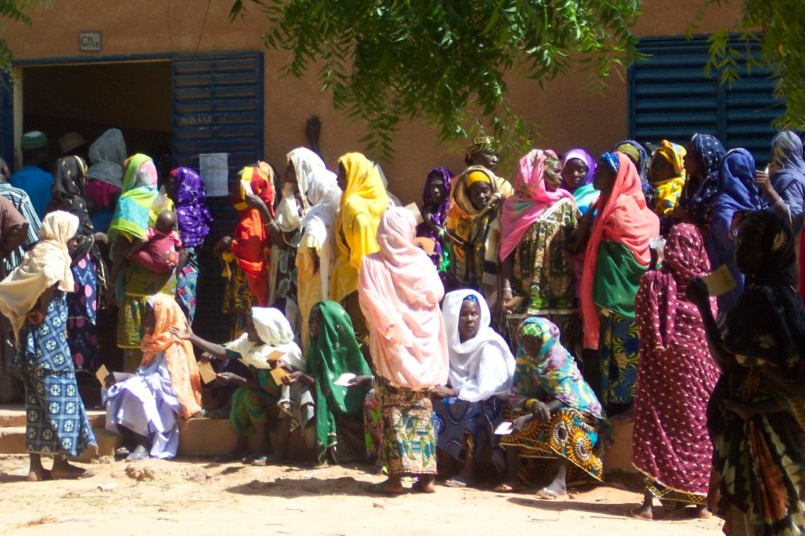
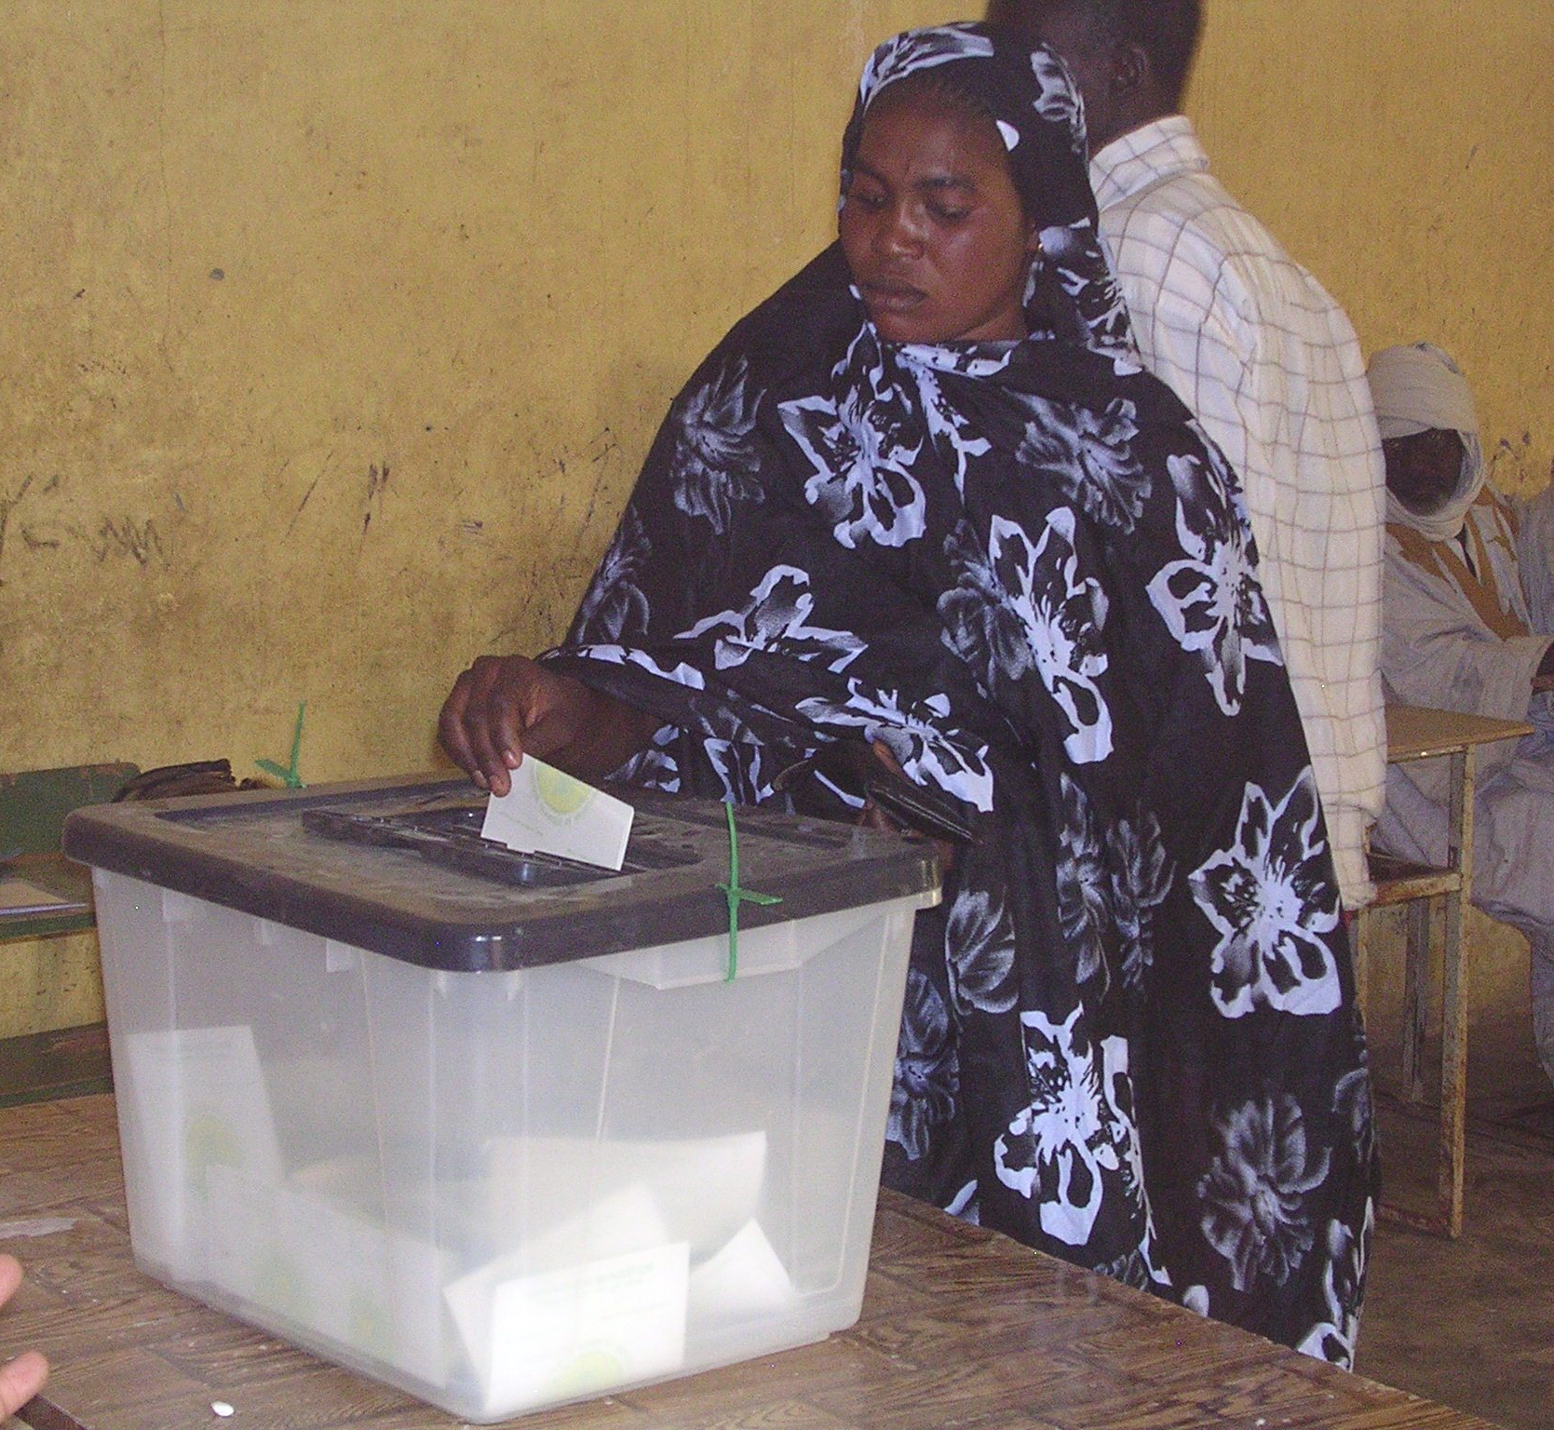
Key Definitions
Violence against women + electoral violence = Violence against women in elections (VAW-E)
Photo Credit: NDI
Photo Credit: NDI

Slide 8
Key Definitions
The UN defines violence against women as ANY ACT of gender-based violence that results in, or is likely to result in, physical, sexual or mental harm or suffering to women, including threats of such acts, coercion or arbitrary deprivation of liberty, in public or in private life.

Slide 9
Violence Against Women in Elections
Violence against women in elections is any act of gender-based election violence that is directed primarily at women because of their aspirations to seek political office, their link to political activities (such as working as election officials or attending campaign rallies) or simply their commitment to vote; as well as any use or threat of force to harm persons or property with the intention of influencing the electoral process that has a disproportionate or different impact on women because of their marginalized and vulnerable status in society.

Slide 10
Violence Against Women in Elections: The Role Of Observers
Election observing organizations can make VAW-E visible so that it can be addressed in the short term, and solutions can be identified in the long term.
Monitoring violence throughout the electoral period can also be a way to mitigate violence by raising awareness, facilitating responses to violence, and potentially increasing the security and/or perceived security of an election.

Slide 11
Violence Against Women in Elections vs. Other Electoral Violence
Although men and women may be victims of electoral violence, such as murder, harassment and coercion, traditional definitions do not capture additional acts and threats perpetrated against women because they are women.
Gender norms shape how and why women are subject to electoral violence, as well as what types of acts are pursued to curtail or influence their participation.

Slide 12
Violence Against Women in Elections vs. Other Electoral Violence
Gender refers to the socially determined differences between women and men that are learned, changeable over time and have wide variations both within and between cultures.

Slide 13
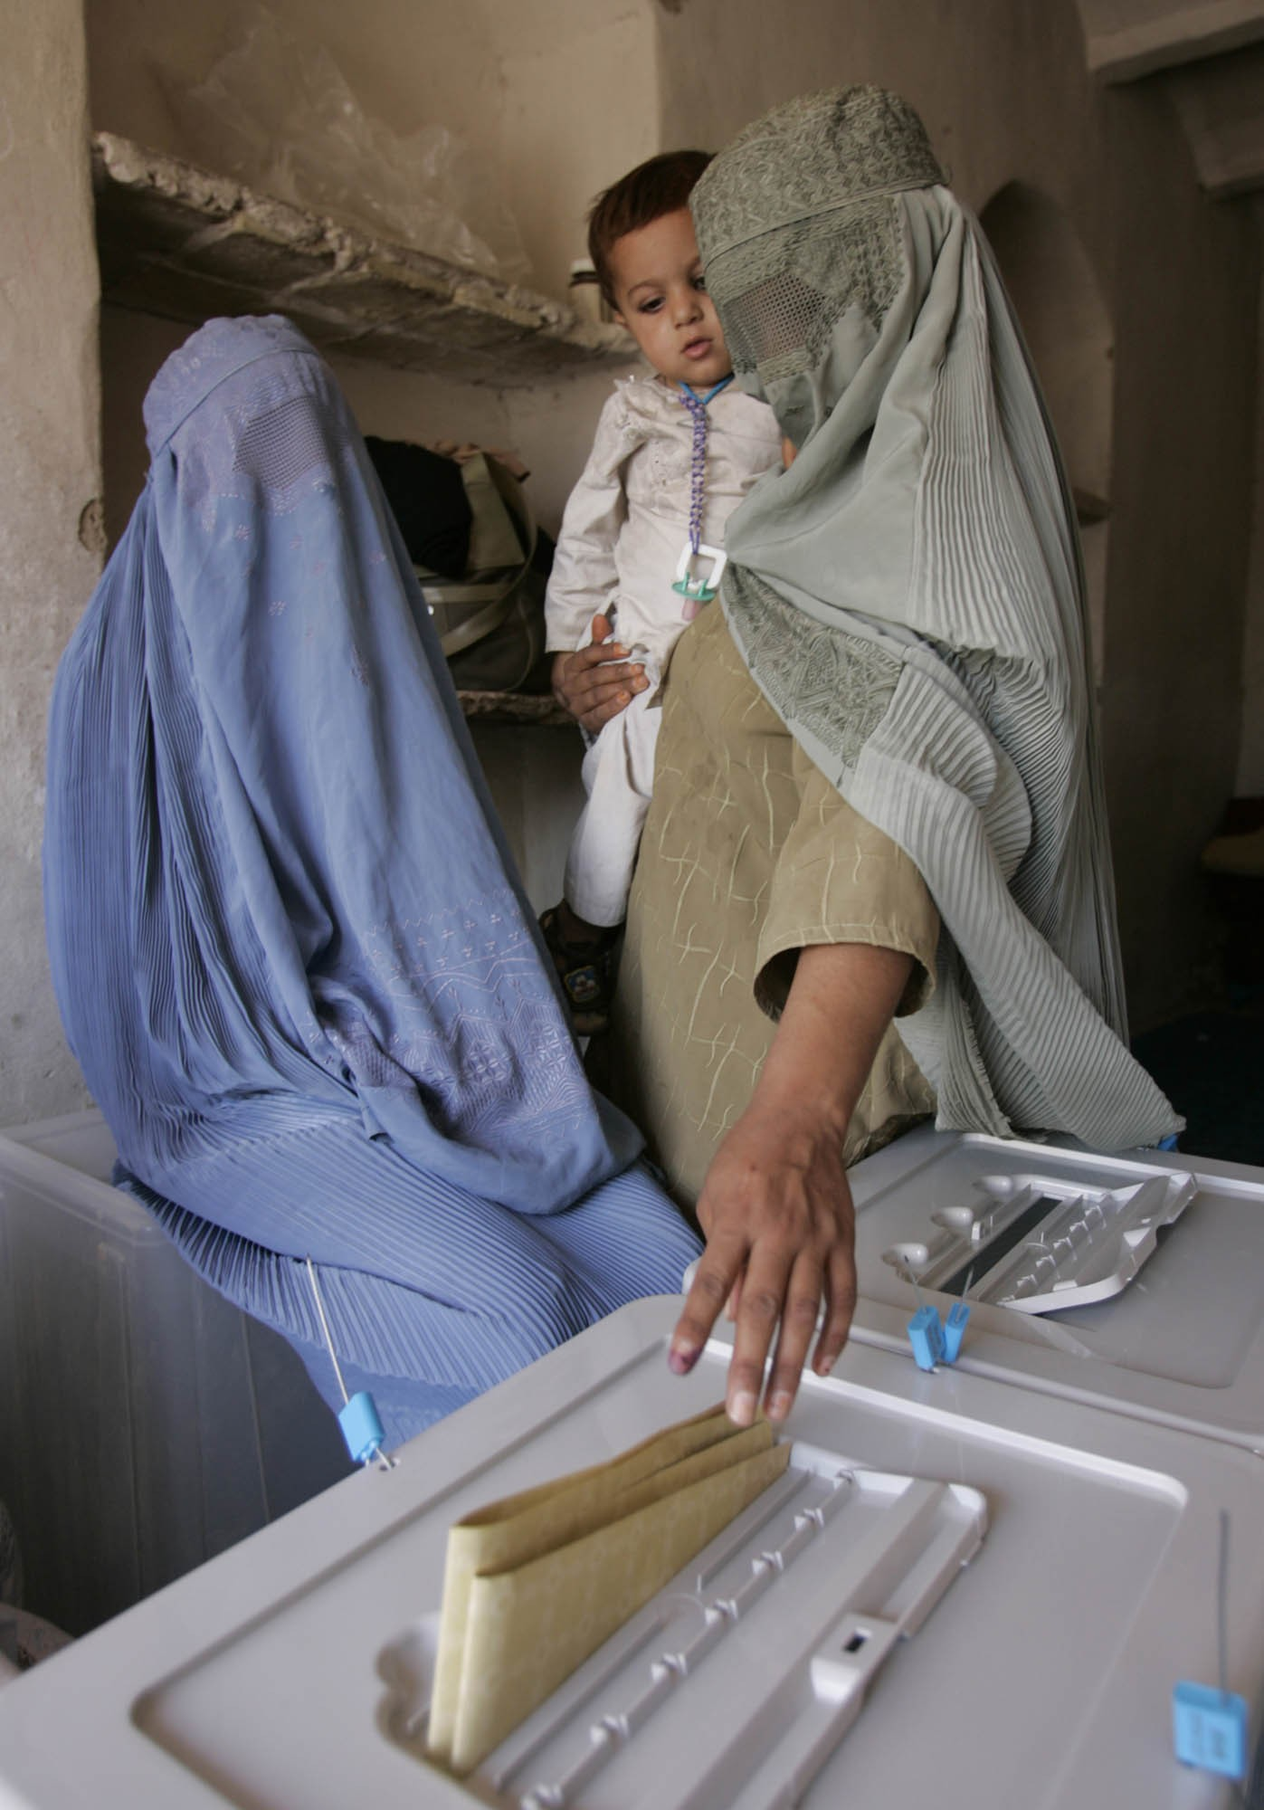
Violence Against Women in Elections vs. Other Electoral Violence
Non-gender motivated electoral violence can still have a disproportionately high impact on women because of their subordinate status in society and their increased vulnerability.
Photo Credit: NDI

Slide 14
Violence Against Women in Elections vs. Other Electoral Violence
Though men and women were both victims during Cote d’Ivoire’s 2010/11 post-election violence, research by the Organisation des Femmes Actives de Cote d’Ivoire (OFACI) revealed that women were often the first victims of party reprisals because they could not escape as easily as men.
Women were home caring for children and thus were more likely to be present to be victimized; they also had more difficulty escaping quickly with children.

Slide 15
Violence Against Women in Elections vs. Other Electoral Violence
“….I was coming home from a demonstration with other women. They stopped us…Some ran away but since I had a child, they caught me…We were a group but because of my daughter I could not run…They threw my child, tore my clothes…”
Testimony of a 23-year-old woman in Cote d’Ivoire - OFACI (Organization of Active Women in Ivory Coast)

Slide 16
Violence Against Women in Elections vs. Other Electoral Violence
In Bangladesh in 2014, minority groups were targets of post-election violence resulting from political party fighting. People were murdered and property destroyed.
Threats that women would be raped were common, and many families in Hindu villages sent women away to stay with relatives. In one village, 300 women were sent away for fear of further attacks.
Women’s overall vulnerability and likelihood of experiencing sexual violence forced them to leave their homes, schools and jobs. Their lives were interrupted.

Slide 17
Violence Against Women in Elections vs. Other Electoral Violence
Unlike men, women are more likely to experience familial or social intimidation in the private sphere and violence and intimidation from members and leaders of their own political party.
They are more often victims of sexual violence.
They are more vulnerable to non-physical harassment and intimidation than men.
The goal of such violence is directly aimed at upholding gender norms and traditional female roles, dissuading women from participation in political processes.
Women are more often victims than perpetrators of such violence.
The violence done to women is less “visible”/less often viewed as violence or as political.

Slide 18
Root Causes of Violence Against Women in Elections
Culture of violence: political or other
Opposition to women’s leadership
Discriminatory and patriarchal structures and attitudes
Absence of supportive administrative and judicial structures—inadequate rule of law and governance institutions
Non-criminalization of violence against women/culture of impunity
Subordinate status and increased vulnerability of women
Intersection of inequalities and marginalization

Slide 19
Violence Against Women in Elections: Categories
VAW-E can occur in a variety of ways, perpetrated by different types of actors throughout the electoral cycle.
Instances range from harassment to murder.
It targets activists, voters, candidates, election administrators and elected women.
It falls into 5 categories: physical, sexual, psychological, threats and coercion, and economic.
Examples vary by country.

Slide 20
Violence Against Women in Elections: Categories
It is important to identify the specific types of violence that might occur in a particular context or country.
In Guatemala, observers identified government-provided social benefits as a mechanism for possible coercion of women voters. They added specific questions about it in their pre-election observation materials.
In developing checklists, it is key to identify what is considered a form of violence.
What are the types of violence to consider?

Slide 21
Violence Against Women in Elections: Physical
What: Murder and assault: pushing and dragging
Where: In private and public
Victims: Women activists, voters, candidates, election/polling administrators, party agents, observers and candidate representatives
Perpetrators: Family: father, brother, mother; own/opposition party, party militants; security forces; religious groups; organized crime...
Aim: Win inter-party conflict, maintain status quo for women’s role in society, force vote preference, stop womenfrom voting, stop women officials from working
Most visible form of violence

Slide 22
Violence Against Women in Elections: Physical
In Guatemala in 2011, candidate for mayor Mayra Veronica Lemus Perez was gunned down at a lunch celebrating the launch of her election campaign.
Although the gunmen were unidentified, it was believed she was killed because of her political aspirations.

Slide 23
Violence Against Women in Elections: Sexual
What: Rape, sexual exploitation, sexual harassment
Where: In private and public
Perpetrators: Family, security forces, warring factions, male politicians, party, religious groups, organized crime, party members, polling workers
Aim: Deter women’s mobilization and participation, force them to vote in certain ways, express anger with process, prevent women from voting

Slide 24
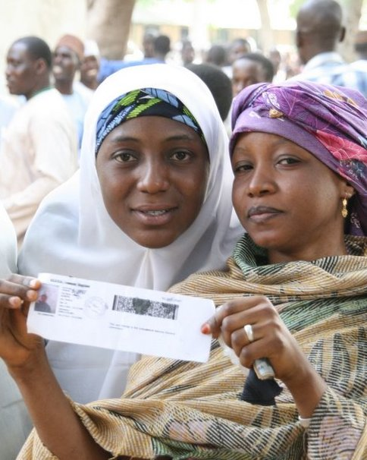
Violence Against Women in Elections: Sexual
Cote d'Ivoire: A survey by an NGO (OFACI) conducted after election violence in 2010/2011, identified 71 rapes, which included young girls, married women and older women by armed men and others affiliated with political parties.
In Nigeria, when men and women line up together to vote, women have been sexually molested by men behind and in front of them.
Photo Credit: NDI

Slide 25
Violence Against Women in Elections: Psychological
What: Slander, character attacks, harassment by media, insults equating women participating in politics with immoral practices, “hate speech”
Victims: Women voters, party/polling agents, candidates and candidate reps, observers
Where: In private and public
Perpetrators: Opposition party/own party, male politicians, media, social media, family-husband, brother, father, religious leaders, election workers
Most pervasive form of VAW-E, but least visible

Slide 26
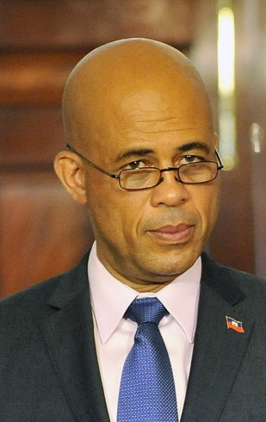
Violence Against Women in Elections: Psychological
Haiti 2015 : President Martelly was speaking on behalf of his party at a public rally when a woman accused his government of incompetence and complained that he had not managed to bring electricity to her community.
He dismissed her by saying "Pick a man and go into the bushes" -- implying she should go have sex.
Many have seen this not only as verbal abuse but "sexual assault.”
Photo: Wikipedia Commons

Slide 27
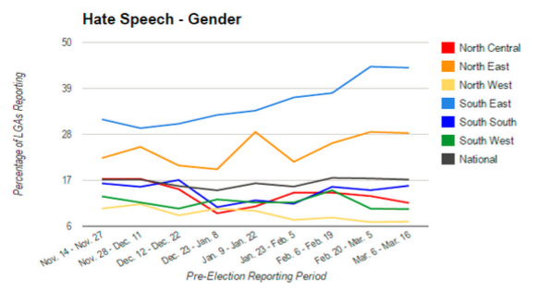
Violence Against Women in Elections: Psychological
This graph shows data collected by observers in Nigeria, divided by geopolitical zone. It records the percentage of observers over time who witnessed or heard reports of hate speech against female candidates before the national election because of their gender.
It illustrates that gender-based hate speech was higher in SE and NE Nigeria.

Slide 28
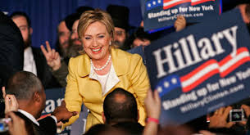
Example of Psychological VAW-E
in the Media
“Hillary Clinton: Stop Running for President and Make me a Sandwich”
Photo: POLITICO
United States 2008: One of the most popular online campaigns against Hillary Clinton, with 41,000 followers on Facebook

Slide 29
Example of Psychological VAW-E
in the Media
Costa Rica 2010: The PAC party released a television ad portraying presidential candidate Laura Chinchilla as a marionette operated by then-president Oscar Arias.
This conveyed the message that a woman candidate could not rise to power on her own.
Photo: Screenshot from Otton Solis

Slide 30
Violence Against Women in Elections: Psychological
Aim: Prevent women from taking an active leadership role in public life, and maintain and increase the male dominated power structure
Impact on process: Prevents women from feeling as if their participation is important and will be reflected in policy
Making comments against one woman or taking violent action against one woman can have repercussions for all women.

Slide 31
Violence Against Women in Elections: Threats and Coercion
What: Threats, false accusations, intimidation, false gauge of environment (such as leading women to believe that it is dangerous for them to vote), blackmail and pressure
Victims: Voters, party agents, poll workers, observers, candidate reps, rally participants/activists
Where: In private and public
Perpetrators: Husband, father, brother, security forces, party leaders/members, religious groups, poll workers

Slide 32
Violence Against Women in Elections: Threats and Coercion
Bolivia 2014: Maura Quispe’s party used blackmail and threats to force her to step down as candidate because she was an indigenous woman and they preferred a male candidate.
Tunisia 2014: A female candidate for parliament was threatened by her fiancé with the end of her engagement if she did not give up her candidacy.
Afghanistan 2010: Fauzia Gilani received threatening phone calls telling her to withdraw her candidacy. When she did not, 10 members of her staff were abducted. She was told they would be released only if she withdrew from the race.

Slide 33
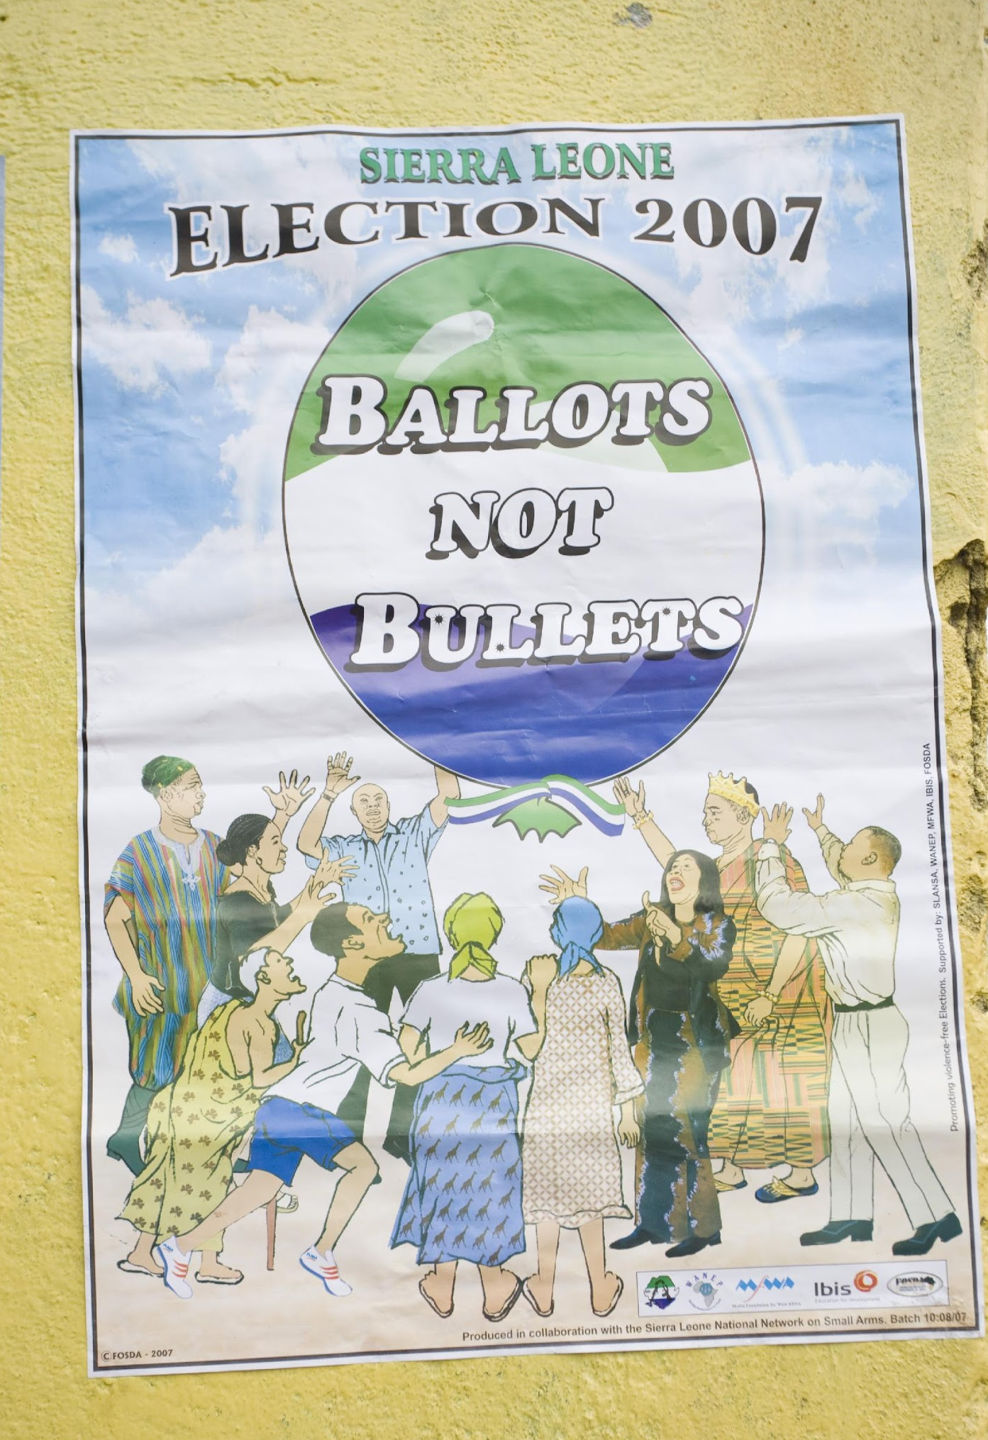
Violence Against Women in Elections: Threats and Coercion
Aim:
Deter women from voting
Diminish or deter women’s participation in electoral processes, including election administration
Deter women from expressing their own political viewpoints or priorities
Photo Credit: NDI

Slide 34
Violence Against Women in Elections: Economic
What: Economic control, denial of or delay in providing financial resources, property damage
Where: In private and public
Victims: Women candidates, voters, activists, election administrators, elected women
Perpetrators: Family, own/opposition party members and leaders, officials
Aim: Block/restrict women’s access to resources available to men to prevent their expression of political viewpoints/priorities, prevent competition

Slide 35
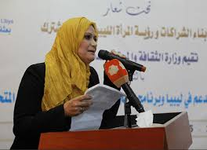
Violence Against Women in Elections: Economic
Pakistan and Libya: In past elections, posters containing female candidates’ photos were destroyed, while posters with male candidates’ photos were left undisturbed.
Targeted property damage further reduces the economic resources available to women candidates, which has a direct impact on their electability.
Photo Credit: NDI

Slide 36
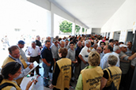
Violence Against Women in Elections: What Can We Measure?
Role of Pre-Election Observers
Photo Credit: NDI

Slide 37
VAW-E in the Pre-Election Period: What Can We Measure?
Participation: All eligible voters, candidates, election officials and observers have a real opportunity to campaign, work, observe and prepare to vote freely.
Accountability: Election procedures are followed to ensure women can register to vote and seek nomination or election, and election day preparations provide that the will of the voters -- not their party, family or other coercive groups -- will be recorded.
Transparency: Citizens (both women and men) have the right to be informed from the time the electoral period begins on election day until operations are completed and the polls close.

Slide 38
VAW-E in the Pre-Election Period: What Can We Measure?
Treatment of women as voters seeking to register, observers, election workers, party members, etc.
Treatment of women candidates by their own or other parties, and their treatment by the media
Atmosphere around political events or rallies and the security situation
Incidents of threats and intimidation to influence or stop women’s participation as voters or candidates
Cases of physical or sexual violence, cases of threats and coercion or psychological or economic violence

Slide 39
VAW-E in the Pre-Election Period: What Can We Measure?
What kinds of violence are observed?
- Physical
- Sexual
- Threats/coercion
- Psychological
- Economic
Who is involved?
- Who is/are the victim(s)?
- Who is/are the perpetrator(s)?
What is the purpose of the violent act?
What impact does it have on the election?

Slide 40
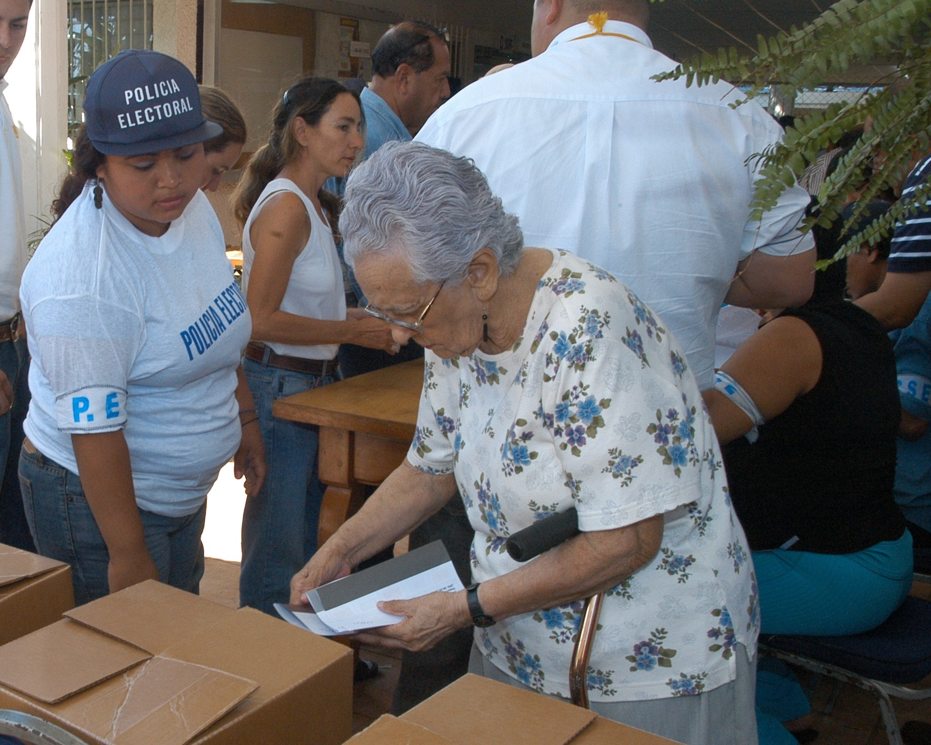
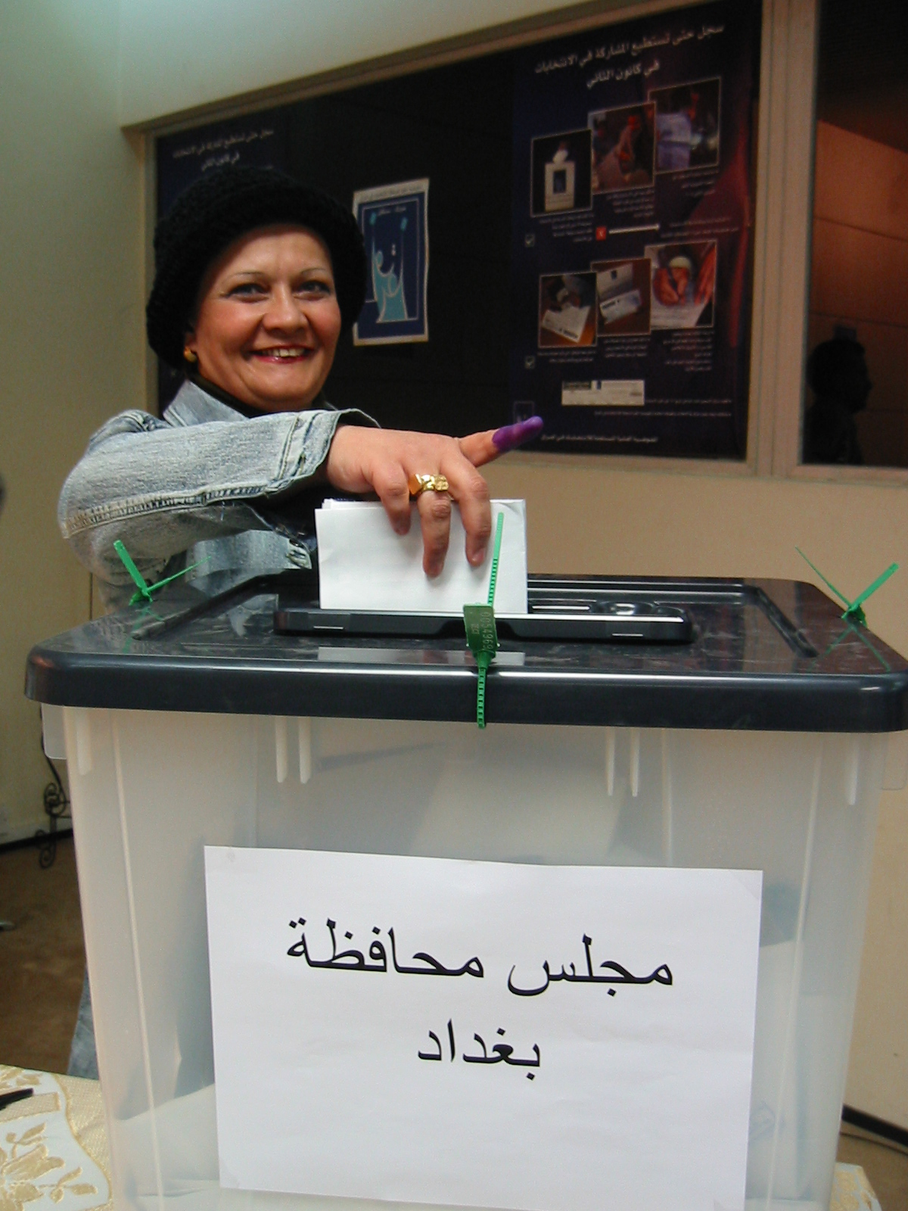
Questions?

